Slide 1
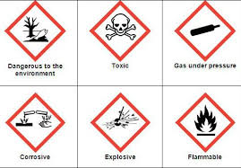
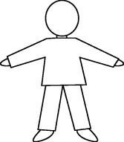









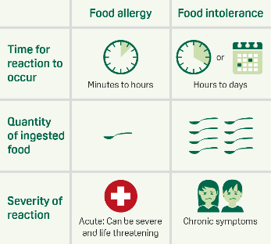

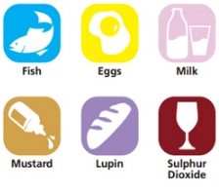
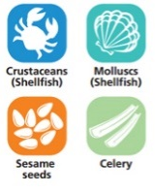


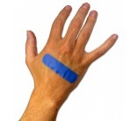
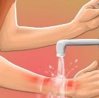
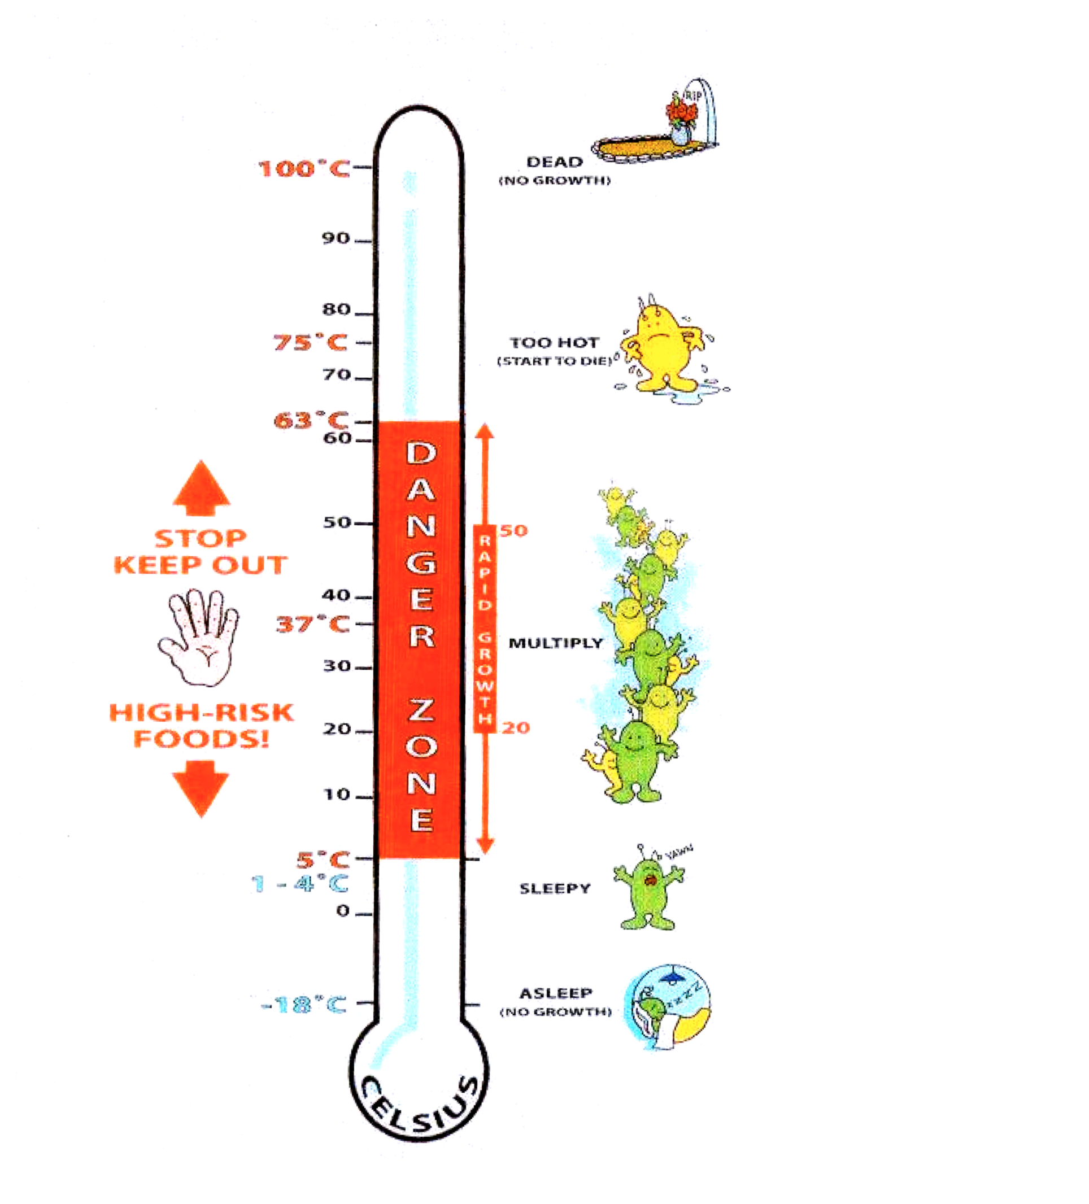
SKILLS = knowledge that can be learnt
QUALITIES = characteristics
Manager
In charge of day to day running of business. Person responsible for making profit
Second (sous) chef
In charge of production and supervision
Skills = able to cook, organisational skills, communication skills, good time management
Qualities – approachable, authoritative, teamplayer, reliable,
Head Chef
Person in charge of kitchen. Maybe called Executive chef.
Skills = able to cook, nutritional knowledge for menu planning, budgeting skill
Qualities – approachable, good leader, authoritative, reliable, honest
Job roles - Kitchen staff
Pastry chef
(patissier)
Pastries & desserts
Larder chef
(garde manger)
Cold foods; salads, dressings, patés, buffet items
Sauce Chef
(saucier)
Sauces, stews, sautés
Vegetable chef
(entremetier)
Vegetables, soups, starches, eggs
Assistant
Chef
(commis)
Helps in all areas of kitchen
Kitchen porter
Cleans up after chefs
-18 ⁰C freezer
0-5 ⁰C fridge
63 ⁰C Hot hold
75 ⁰C Core temperature of cooked food
Assistant manager
Responsible to manager, may have work delegated by manager. Will be in charge in managers absence
Control of substances hazardous to health
Job roles – food and drink service
SPECIAL DIETS
Allergens
Lactose intolerance. People must avoid milk, cheese butter , yogurt and processed foods that contain milk products.
Coeliac disease ( gluten intolerance). People must avoid wheat, wheat products, pasta noodles, semolina, bread, pastry, sauces, rye, barley and oats (including breakfast cereals. They can eat rice, potatoes, corn and corn products.
Nut allergy. People must avoid nuts, blended cooking oils and margarine that contains nut oils.
Restaurant manager
In charge of restaurant. Takes bookings, relays information to head chef, arranges staff training, rotas etc
Head waiter/ess
Second in charge of restaurant. Greet and seat customers. Deals with complaints
Caterers must by law provide information to customers on which of their products contain any of the 14 allergens
Diabetes. Diabetics find it difficult to control their blood sugar levels, so they need to eat starchy foods at regular intervals. They avoid foods high in sugar.
Vegans do not eat the flesh of any animal or any animal product e.g. cheese.
Lacto-vegetarians do not eat the flesh of any animal but they will eat eggs, milk, cheese, honey etc.
Wine waiter/ess
Responsible for helping customers select wine
Waiting staff
Serve customers, clear tables and check customers satisfied with service.
Skills = silver service, numeracy and literacy skills, good memory
Qualities – approachable, friendly,
Muslims do not eat pork, shellfish or drink alcohol. Meat has to be Halal.
Hindus do not eat beef.
Some Sikhs avoid meat and fish.
Jews do not eat pork or shellfish. They do not eat meat or milk at the same time. (lasagne) meat has to be Kosher.
First Aid treatments
Cuts = clean, dry and cover with a blue waterproof plaster
Menu planning
WHO is going to eat the food
WHEN is it going to be eaten
WHERE is it going to be served/eaten
WHAT type of food is going to be eaten
Remember a range of TEXTURES, FLAVOURS, SHAPES and COLOURS
Burn = put under cold running water for 10 minutes or until stinging stops. Do not cover. If larger than a 10p seek medical advice

Slide 2
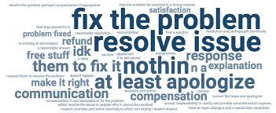
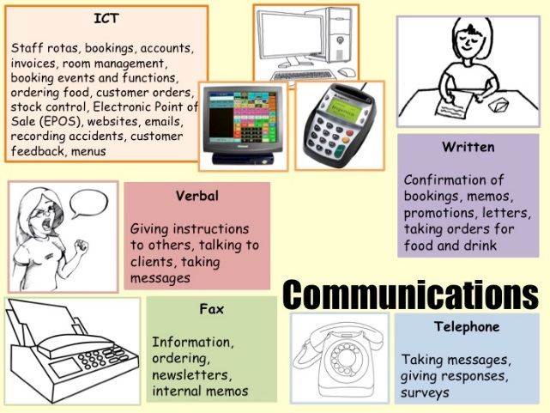

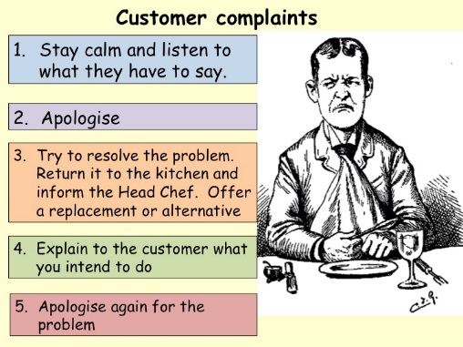
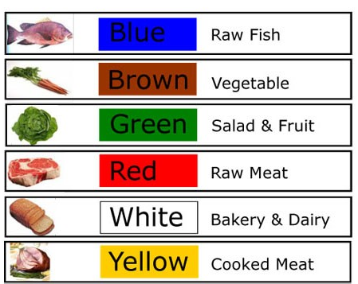


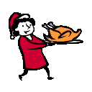




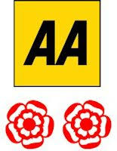
Portion Control - is the amount of each item on the menu and how much is produced and served.
Examples of portion control
scoops
ladles
Fruit juice glasses
Individual pie dishes
ramekins
Sundae dishes
Individual moulds
Individual pudding basins
Individual disposable foil covered plastic pots
Dispensing machines
Soup plates or bowls
Tablespoons/ serving spoons
What are the advantages and disadvantages of each type of communication?
IMPORTANT BECAUSE…
It keeps costs down
Keeps loses in food preparation and serving to a minimum
It offers customers a satisfying portion without waste
Gives customers feeling of value for money
It helps ensure the business makes a profit.
Point of sale
IN ORDER TO GROW AND MULTIPLY GERMS NEED:
Food standards and awards
Time
Moisture
Food
Warmth
EXAM QUESTION COMMAND WORDS
DEFINE - GIVE THE MEANING OF …..
LIST - Make a list.
STATE - Write clearly but briefly. Write in sentences
DESCRIBE - Give an account of, Allow the reader to ‘see’ the answer; ‘paint a picture in words’. You must use appropriate terminology and write coherently, using connectives.
DISCUSS - Add detail to a reason already stated, Give important aspects of, Give advantages and disadvantages of….
EXPLAIN - Make clear, giving reasons. Use ‘because’ in your answer
EVALUATE - Give important aspects of, Give your own opinion of…
Hazard Analysis Critical Control Points (HACCP)
Process | Hazards | How to prevent them (controls)
Purchase and delivery
Storage
Preparation
Cooking
Chilling
Reheating
Service
It is a food safety management system to identify the areas of their food business which are most dangerous and to make sure that they are controlled in some way. By law ALL food businesses must have one.
Safer Food Better Business (SFBB)
Scheme introduced by the Government to help businesses to complete HACCP. Special packs are available for businesses to use and record their HACCPs
Hazards
A HAZARD is something that could CAUSE HARM to the CONSUMER.
Actual cost of the ingredients
Overheads (electricity, gas, rates, rents etc.)
Staff costs (wages)
Profit (this will depend upon the amount of profit a business wants to make)
VAT
Food cost x 100 ÷ 40 = selling price
Costing
Hazards can be either
Physical e.g. glass in food
Biological e.g salmonella bacteria in raw chicken
Chemical e.g contamination from cleaning chemicals

Slide 3
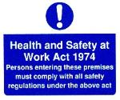
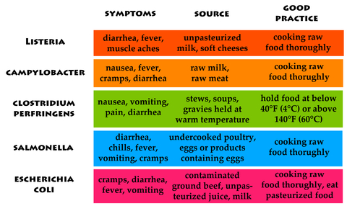
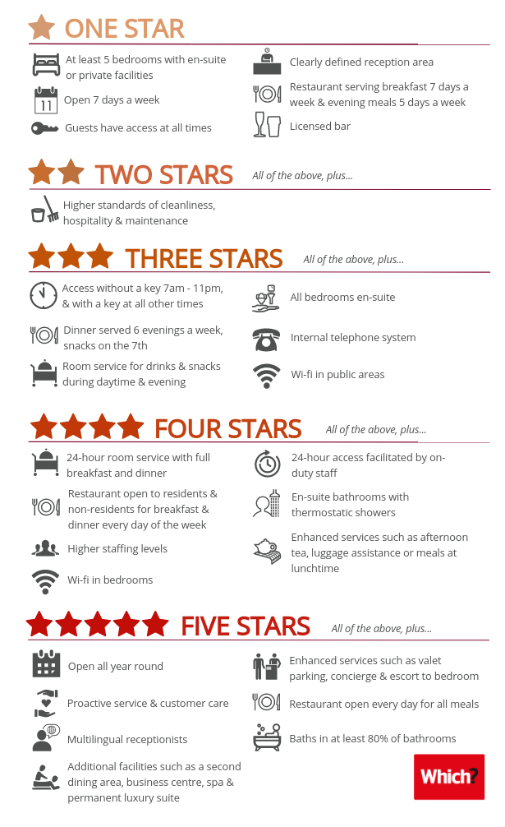
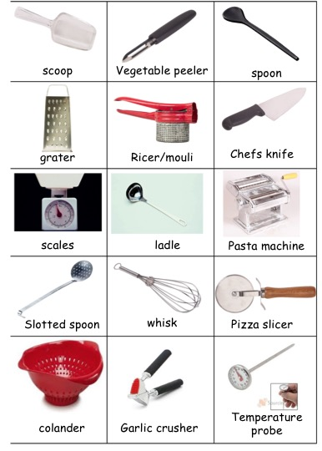
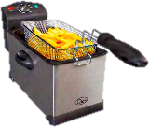
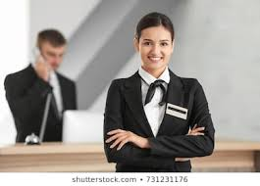


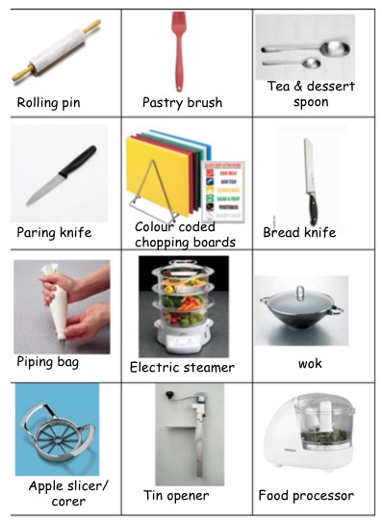
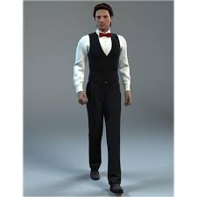


Packaging
HEALTH & SAFETY AT WORK ACT 1974
The law means that employers must ensure the health, safety and welfare of staff. It also states that staff (employees) must:
  Take care of their own health, safety and welfare and other persons that they work with.
  Co-operate with the employer to comply with all health & safety matters.
  Not interfere with or misuse anything provided in the interests of health, safety and welfare.
Employers must ensure they provide safe premises, equipment, provide supervision and training, have a written safety policy and consult with unions and have a safety
committee.
Small scale food preparation equipment
Safe Use of Equipment:
Hot equipment -care when using to avoid burns/scalds
-take care when moving/lifting heavy pans
-turn pan handles towards back of cooker
-do not use wet cloths for hot pans
-do not fill fryers above indicator level
Don't put wet foods into fryers
-lower food into fat carefully
-change fat regularly
Safety Signs
MANDATORY sign = “You must”
WARNING sign = “Take care”
Uniform
PROHIBITION sign = “Do not”
FIRE safety measures
FIRST AID measures

Slide 4
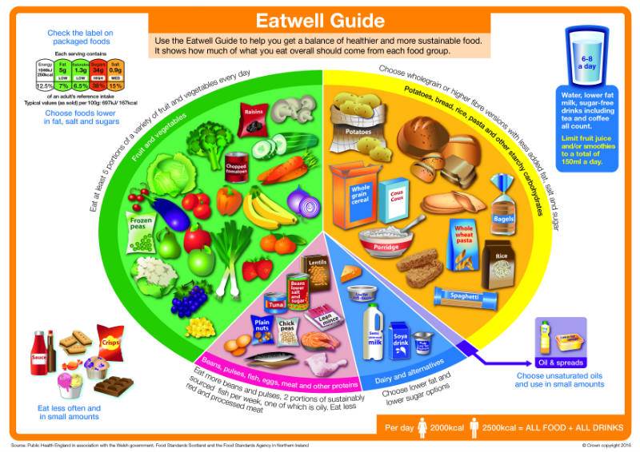
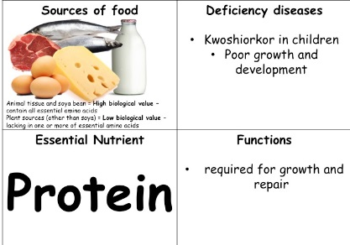
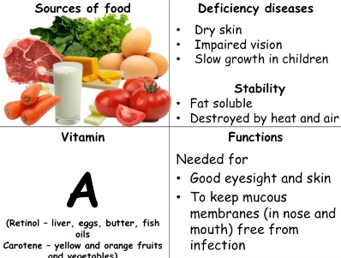
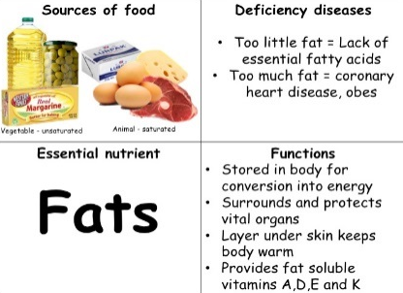
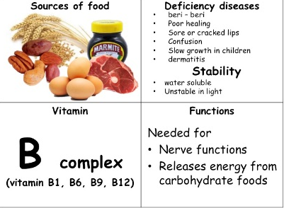
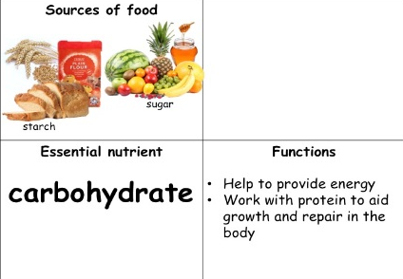
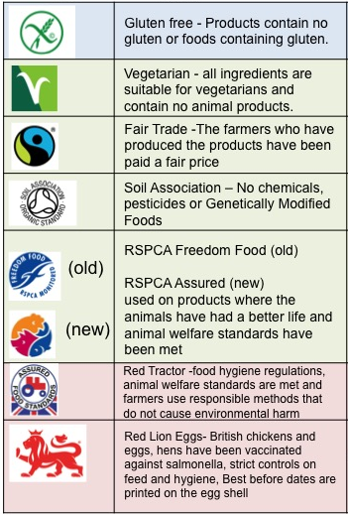
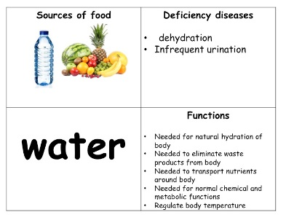
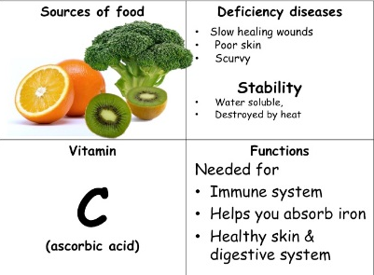
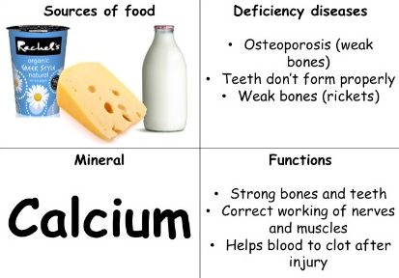
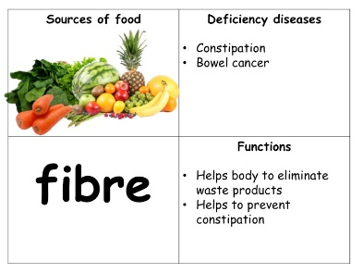
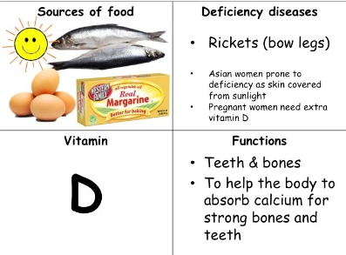
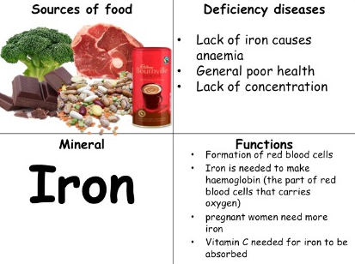

TYPES OF FOOD SERVICE – CAN YOU STATE THE ADVANTAGES AND DISADVANTAGES OF EACH?
Nutrition and Healthy Eating
The 5 essential nutrients
Type of service | Description
Counter Service | Counter service - includes cafeteria, multi-point, free flow, fast food, vended, seated and buffet
Fast food | Fast-food- customers may queue and pay for their food before they eat
Cafeteria | Cafeteria service- customers queue at some type of counter, collect their food on a tray and pay for their food before they eat
Buffet | Buffet service- may be assisted or self service customers help themselves to (or are served) food from a buffet table
Waiting Service | Table service - the waiter or waitress comes to the table and serves all of the food and drink
Automatic Vending Machine | Vended service-customers use vending machines that dispense food and drink
Travel service | Transported meals - in aeroplanes, when the meals are packed safely and then reheated when they are needed
Protein
Fat
Carbohydrate
Vitamins
Minerals
PLUS Water and Fibre (neither are nutrients but are required for a healthy diet).
List the Governments 8 tips for healthy eating
Base meals on starchy foods
Eat lots of fruit and vegetables
Eat more fish (particularly oily fish)
Cut down on saturated fat and sugar
Eat less salt
Get active and be a healthy weight
Drink 1.2 litres of water
Don’t skip breakfast
THE ENVIRONMENTAL HEALTH OFFICER
(EHO)
Responsibility of EHO in food premises
Inspecting food premises (building & equipment
Personal hygiene of employees
Storage of food
In the premises
All entrances and exits are clear from blockages
Equipment and utensils are clean and able to be kept clean
Fire doors are clear and undamaged
Adequate lighting
Good ventilation
Adequate hot/cold water –separate hand wash sinks
Fridge/freezer temperature records – twice a day
Equipment service records and stored safely
Rubbish bins covered and emptied regularly
Can take following action
Offer advice
Issue hygiene rating
Serve formal notices e.g. improvement notices requiring work to be completed within set time
Take to court and prosecute – which could result in fine or prison sentence
Close premises down

