Slide 1
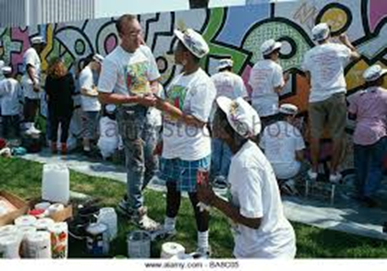
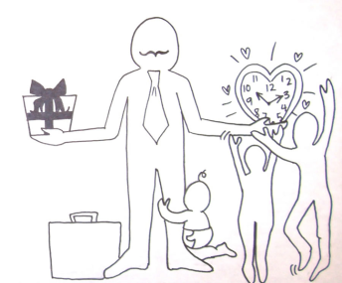
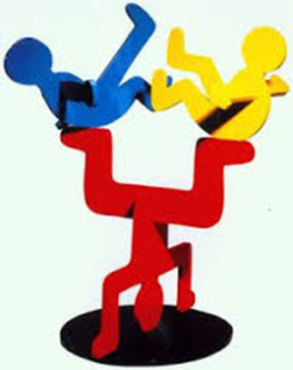
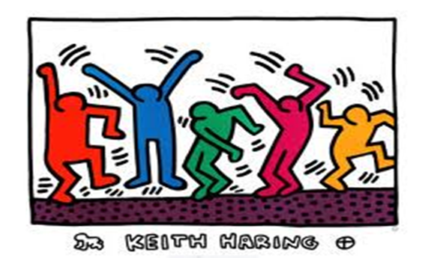
HARING
Year 9 Knowledge Organiser
Word Bank
Collection
Colour
Crosshatch
Dimension
Foreground
Illusion
Perspective
Frieze
Semiotics
When Haring arrived in New York, it was home to a thriving underground art scene. Haring befriended fellow emerging artists like Jean-Michel Basquiat and Kenny Scharf, who shared his interest in the colorf ul and transgressive graffiti art of the city's streets. Haring and these other artists organized exhibitions at downtown nightclubs and other alternative locations, where art, music and fashion all came together in a dynamic mix.
Artist Keith Haring was born on May 4, 1958, in Reading, Pennsylvania. He moved to New York City in 1978 and began using the city as his canvas, making chalk drawings in subway stations. His art was eventually seen everywhere from public murals and nightclubs to galleries and museums around the world. He was also known for his activism in promoting AIDS awareness.
Common Mistakes
Rushing your painting - paint slowly and carefully and try to keep paint within the lines
Not drawing in the style of Haring -
Skills - Researching Analysing Designing Painting with watercolours and powder paints

Slide 2
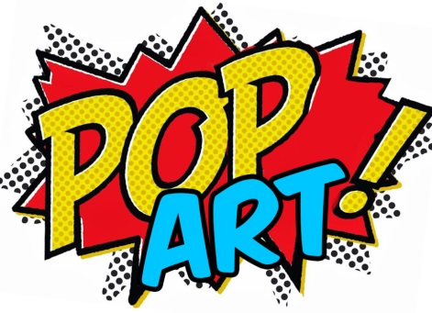
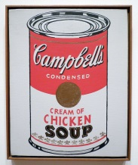
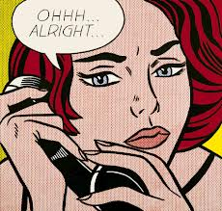
Year 9 Knowledge Organiser
Roy Lichtenstein 1923 – 1997
Lichtenstein is famed for his paintings based on comic strips, often depicting tense, dramatic situations.
He restricted himself to using primary colours, black and white.
The Pop Art movement occurred in the 1950’s & 1960’s and demonstrated bold imagery with brash heightened colour.
The Pop Art style derived from everyday objects, items of mass culture such as comic strip panels, soup cans, beer bottles and road signs.
Andy Warhol 1928 – 1987
Warhol was the most influential Pop Artist. He used the silk screen process to transfer photographic images on to canvas. He used images of celebrities and mass – produced, commercial products,
Key Words Composition Lichtenstein Primary colours Mass Production
Skills Observational drawing painting with acyrlic paint printing

Slide 3
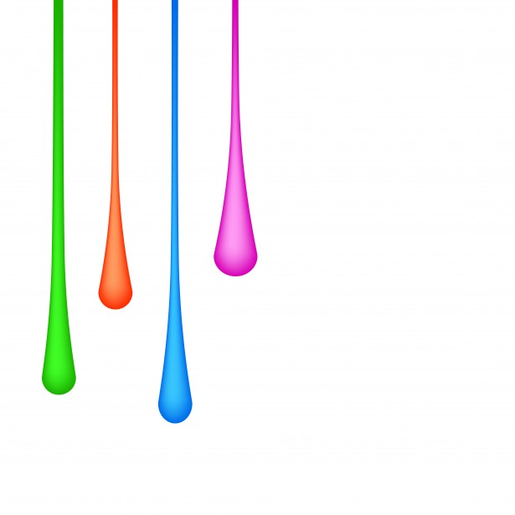
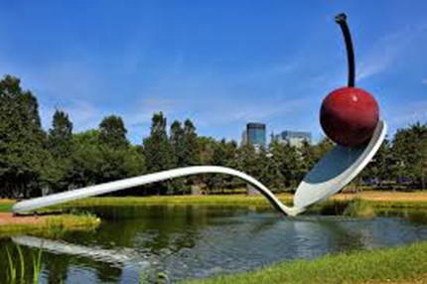
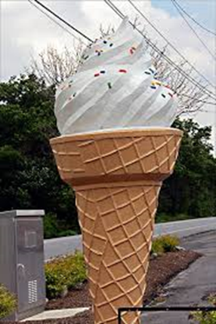
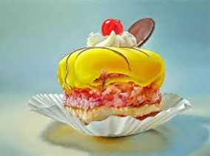
Year 9 Knowledge Organiser
Word Bank
Paint Poster Water colours Oils Acrylic Colour wash Dry brush marks Brush strokes sponging technique
Pencil Graphite soft hard tone tonal range dark medium light shadows
highlights blending in shading contrast
Composition busy calm bold geometric organic surface grid flowing canvas paper wood
Collage mixed media, papier mache, layers, paste, texture low relief, transparent
Is it Art?
Possible ways to start your sentences
In this piece I have………
I have used the following materials………
Through working in this way I have learnt how to…………
This piece contains the following characteristics……
Here I have shown………… In the style of………………
This piece could have been improved by including……………
I could have made greater use of………………
In this piece I have used too much/ not enough ………..
The artist………… has influenced my design.
I was inspired by …………… When creating this piece of work.
To improve this piece I could have…………
Skills - Analysing photo realism Annotating – Presentation Skills Creativity Innovation

