Slide 1
1.1 Being an Entrepreneur
What do I need to know?
What is an entrepreneur? What motivates an entrepreneur? What skills and characteristics are important for an entrepreneur to have? How can these skills and characteristics be applied to the business world?
Financial Motivator | Personal Motivator | Social Motivator
An entrepreneur who is motivated to do well by the money they can earn. e.g. Jahmilla is motivated to work hard so that she can earn £100,000 to buy a private jet. | An entrepreneur who is motivated through personal reasons of their own. e.g. Anson is motivated to work hard at his new business idea so he can finally take his mum on holiday to Thailand. | An entrepreneur who is motivated by helping other people. e.g. Emre is motivated to work hard at his entrepreneurial idea because he wants to help others.
Skills and Characteristics | Application to the Business World
Confident | Believing ideas will become successful
Motivated | Wanting the business to do well
Determined | Not allowing difficulties to affect the business
Results-focused | Taking action with the end result in mind
Initiative | Taking action without being told
Decision-making | Make decisions quickly and under pressure
Analytical ability | Using logical reasoning
Communication | Able to communicate with a variety of stakeholders
Key Words
1) Entrepreneur | Someone who is willing to put their career and financial security at risk to pursue a business idea.
2) Motivation | The reason or driving force behind an individual’s behaviour or actions e.g. Miss Paras gets up at 4:00 am every morning to go to the gym because she is motivated to lose weight for her holiday to Jamaica.
3) Skills | The ability to do something well e.g. time-management
4) Characteristics | A quality that someone may have e.g. honesty

Slide 2
1.2 Business Aims and Objectives - Financial
What do I need to know?
What are aims? What are objectives? What financial aims and objectives might a business have? What is the difference between break even and profitability? What is the difference between revenue and profit maximisation?
Aims | Objectives
Aims are the bigger goals that the business wants to achieve Eg. Increase revenue | Objectives are the smaller steps required to meet the aim Eg. promote the product using social media to create more awareness
Breakeven | Profitability
This is where the business’ total revenue is equal to its total costs TR = TC Formula: Fixed costs Selling price – variable costs | Profit is the owners reward for investing in the business Profit or loss = Sales revenue – Total costs
Increasing Revenue | Profit Maximisation
Over time a business needs to increase the money they are making from sales (sales revenue). To do this they could: Increase prices Up-sell their products Cross sell Offer bundle deals Increase marketing/advertising | A business will try to ensure they make the most possible profit from each product/service they sell

Slide 3
1.2 Business Aims and Objectives – Non-Financial
What do I need to know?
What is customer satisfaction? What is business expansion? What are the different ways business can expand? What is employee engagement and satisfaction? What is diversification in business? How can a business diversify? What is corporate social responsibility?
Market segmentation / Diversification:
Reasons why businesses need to segment their market: Benefits they require Amount of money they are able/willing to pay Quantity of goods they require Quality of goods they require Time and location at which they wish to purchase the goods
Non-financial aims/objectives | Application to the Business World
Customer satisfaction | Making customers happy so they are more likely to return and be loyal to the business
Expansion | Purchasing new premises or employing new staff
Employee engagement/ satisfaction | Happy employees provide excellent customer service and work harder. Often satisfied employees stay in the business longer
Diversification | Expanding the range of products sold within the market
Ethical/corporate responsibility | Consider social and environmental factors when completing their business operations
CSR = Corporate social responsibility
Stakeholder | Ethical / corporate responsibility
Investors/ shareholders | To provide a good return for the money they have invested in the business
Employees/ manager | Paid a fair wage and have safe working conditions
Customers | Good quality products at a fair price
Suppliers | To purchase goods on a regular basis and pay all invoices on time
Environmental groups | Have environmentally friendly operations

Slide 4
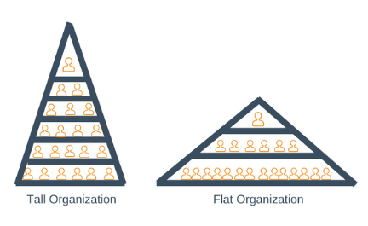
1.3 Legal structures
What do I need to know?
What is a sole trader? What is a partnership? What is a PLC and LTD? What is a franchise? What is a co-operative? What are the features of a flat organisational structure? What are the features of a tall organisational structure? Why a business might restructure?
Organisational structure | Definition and examples
Sole trader | A business owned and controlled by one person Eg. plumber or electrician
Partnership | A business owned and controlled by 2-20 individuals Eg. solicitor or estate agents
Public limited company | A business owned by shareholders that can be anyone Eg. Marks and Spencer
Private limited company | A business owned by shareholders who are friends and family of the entrepreneur Eg. JCB ltd
Franchise | The franchisor grants a licence to another business so they can sell its brand or business idea Eg. McDonalds
Co-operative | A business owned by their staff, who are members of the firm Eg. Co-operative Press
Public sector | Private sector
Businesses that are owned by the government – there are very few remaining Eg. Royal mail | Businesses that are owned by private individuals Eg. Sole traders, parnerships, PLCs, LTDs
Key Words
1) Hierarchy | Refers to the number of layers of authority within the organisation
2) Chain of command | The line of communication and authority within a business
3) Span of control | The number of people for which an individual or organisation is responsible
3) Delayering | When businesses remove layers of authority to allow faster and more effective communication
4) Redundancy | When the business reduces the number of workers as there is no longer any work for certain employees
Tall organisation Vs Flat organisation

Slide 5
1.4 Stakeholder engagement
What do I need to know?
What is an internal stakeholder? What is an external stakeholder? What are the interests of each stakeholder?
Stakeholder | Engagement
Owners | Interested in how the business is doing eg. profit and loss each year.
Shareholders | Interested in if the business is likely to continue in the future. They want to know that their share investment is safe and how much dividends they will earn.
Management | Managers require up-to-date information so they can plan for the long term future of the business.
Government | Checks compliance with legislation eg. health and safety and finance records
Employees / workers | Need to be assured of their job security. They are interested in the working conditions of the business and being paid on time.
Customers | Need to be certain the business will sell them a high quality product that gives ‘value for money’
Suppliers | Need to ensure the business will pay on time and assured that the business will purchase from them in the future.
Local community | Mostly provide the employees for the organisation. Also concerned about pollution and noise.
Internal stakeholder | External stakeholder?
These are stakeholders within an organisation Owners Managers Employees Workers | These are stakeholders outside of an organisation Customers Suppliers Shareholders Local community Government Financial providers
Businesses that engage with their stakeholders are likely to:
Have increased staff motivation and retention
A good reputation
New ideas
Increased share price

Slide 6
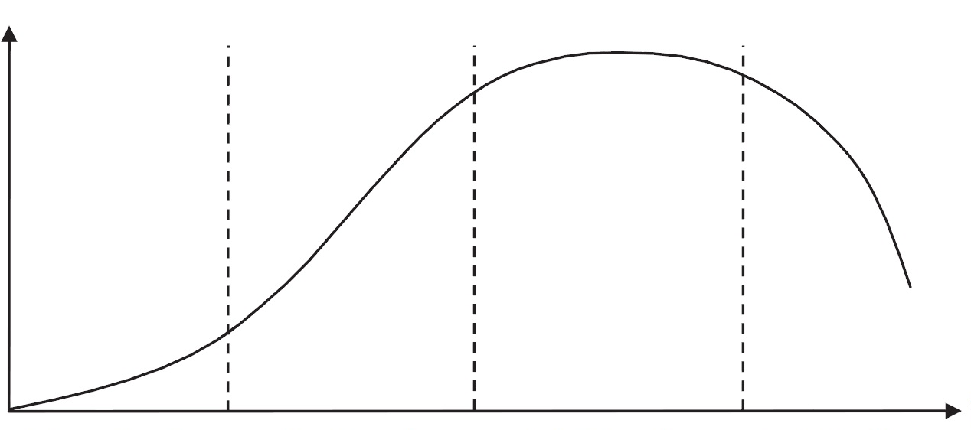
2.1 Marketing Mix - Product
What do I need to know?
What is a tangible product? What is an intangible product? What is the design mix? What are the features of each stage of the product life cycle? What are some extension strategies? What is the Boston Matrix?
Function
Design mix
Tangible | Intangible
Physical items that exist in the real world Eg. A car, a mobile phone, a teddy bear | Products that have no physical being Eg. Car insurance, mobile phone networks
Economic manufacture
Aesthetics
Extension:
New advertising campaigns
New pricing strategy
New product features
Increased sales
Increased customer knowledge
Profit begins to rise
Competitors may enter the market
Product life cycle
Boston Matrix
Low sales
Lack of customer knowledge
Advertising high
Low profit or loss being made
Low market share
Market share
Sales
Star
Question mark
Cash cow
Dogs
Sales at the maximum
Profit is maximised
Competition levels very high
Customer interest peaks
No further room for sales expansion
Sales decrease
Customer interest drops
Customers switch to substitute products
Product becomes unfashionable or undesirable
Market growth
Maturity
Decline
Time
Introduction
Growth

Slide 7
2.1 Marketing Mix - Place
What do I need to know?
What are the factors that affect where a product/service is sold? What are the channels of distribution? What are the advantages and disadvantages of using E-commerce?
Factors affecting place
Location of customers
Location of the raw materials used to make the products
Availability of staff
Availability of transport to distribute the products
E-commerce
(Selling goods through a website directly to customers)
Advantages:
Low cost
Quick and easy for customers
No need to pay for the ‘middle man’
Disadvantages
Risk the products may not be as they look online to customers
Consumers may be concerned about giving bank details online
Notes:
*shinnel

Slide 8
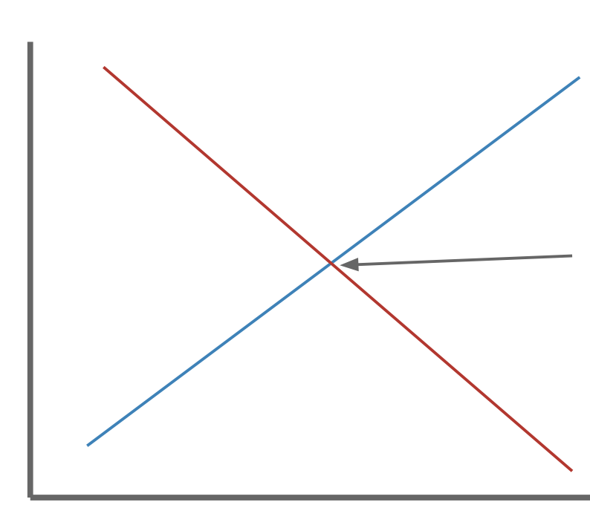
2.1 Marketing Mix - Price
What do I need to know?
What is equilibrium price? What is price skimming? What is price penetration? What is psychological pricing? What is loss leader pricing? What is competitive pricing? What is promotional pricing? What are the advantages and disadvantages for these pricing strategies?
Pricing strategy | Price tactic
Price skimming | The business introduces the product at a high price and then gradually lowers it over time. Eg. Dyson bag less cleaner
Price penetration | The business introduces the product at a lower price than usual to attract customers. It gradually increases the price over time. Eg. selling a new flavour of crisps for cheaper
Psychological | The business sets a price that appears to be attractive to a customer. Eg. selling a holiday for £999 instead of £1000
Loss leader | The business is willing to make a loss on a product in order to get customers to purchase the product. It then increases the price once the customer likes the product.
Competitive | The business sets a price that is similar to that of a local competitor. Eg. supermarkets price matching goods.
Promotional | The business temporarily reduces the price of a product to increase interest in it.
Supply curve
Price
Equilibrium
Demand curve
Quantity

Slide 9
2.1 Marketing Mix - Promotion
What do I need to know?
What is advertising? What is sales promotion? What is personal selling? What is direct marketing? What are promotional objectives?
Ways of advertising | Advantages | Disadvantages
Leaflets | Cheap to produce Targeted to customers in the local area Easy to distribute Easy to read and have good visual impact | Often thrown away once read Can be seen as junk mail and not read They are not usually kept therefore have do not have long term impact
Social media | Cheap and easy to distribute Can be used to update customers about offers and new products Access to international markets | Less useful for targeting older people Require daily monitoring to prevent inappropriate behaviour Risks of negative reviews or hacking
Newspapers | Low cost Can target local customers National newspapers are more widely read than local newspapers National newspapers have wider reach Effective in targeting the older generation | National newspaper advertising is very expensive Unless the advert is in prime position, there may be competition for the readers attention Less effective at targeting the younger generation
Magazines | Targeted advertisement People tend to keep magazines, unlike leaflets People often pass on magazines to others | Deadlines for advertisements can be months in advance Costs can be high Magazines contain lots of adverts, it is possible the business’ advert will be lost among them
Radio | Targeted advertisement Can be produced quickly Cheaper than TV adverts | Often used as background noise Prime slots are more expensive eg. morning No way to save an advert so all information needs to be taken in at once
Promotional Objectives
Increasing consumer knowledge Increasing market share Communicating with customers Encouraging purchasing Developing customer loyalty
Key terms
Sales promotion – Short term boost of sales Personal selling – A sales person sells a product to a client face to face Direct marketing – Selling products directly to the public eg. online or telephone sales

Slide 10
2.2 Market research and Markets
What do I need to know?
What is the difference between qualitative and quantitative data? What is primary research? What are some examples of primary research? What is secondary research? What are some examples of secondary research? What is a mass market? What is a niche market?
Type of research | Examples | Advantages | Disadvantages
Primary (Field) Gathering data and information that has not been collected before | Interviews Observations Questionnaires Surveys Focus groups Consumer trials | Relevant and up-to-date information Specific to the business completing the research Only available to the business doing the research, giving it a competitive advantage | Costly and time-consuming A sample size that is too small may provide biased results Consumers are not always willing to take part
Secondary (Desk) Gathering data and information that has already been collected | Books, trade magazines, newspapers Published company reports Internal data Competitors’ data Government publications and statistics Purchased research material | Cheaper than primary (sometimes free) Information usually based on a wide sample Information is readily available therefore not time consuming | Information is available to all businesses Not specific information Could be out of date therefore irrelevant in current conditions
Quantitative Vs Qualitative
Quantitative data is factual numerical data and qualitative is information about peoples opinions and views
Mass Vs Niche Market
Mass markets is one in which goods or services are produced in large quantities and are aimed at most of the market A niche market is one in which goods or services are produced in small quantities and aimed at a particular segment of the market
Market-orientated business
Produces goods based on consumer wants and needs. It will undertake high levels of market research to find out customers’ wants and needs
Product-orientated business
Produces only goods that it is good at making. It has low levels of engagement with its potential customers

Slide 11
3.1 Operations Management
What do I need to know?
What is outsourcing? What is lean production? How can you maintain and improve quality? What is job production? What is batch production? What is flow production?
Maintaining and improving quality
Quality control Benchmarking Quality assurance Total quality management (TQM)
Lean production
Aims to cut waste and improve quality
Just in time
Stock arrives on the production line just as it is needed. This minimizes the amount of stock that has to be stored, and so reduces storage costs
Cell production
Divides the production process into a series of small stages. Ensures teams complete a full unit of production
Kaizen
A Japanese concept that focuses on gradual and continuous improvement
Outsourcing
When businesses grow, they are often not able to complete all business tasks themselves. They need to outsource some of their operations by paying another business to do the work
eg. website design
Job Production
One product is made at a time. Every product will be slightly different and usually made by hand/machine. The products will be expensive and time consuming to make. Eg. Paintings, Handmade jumpers, Bespoke jewellery
Batch Production
Small quantities of identical products are made. This method uses machinery and manpower. The products tend to be relatively expensive due to the labour costs. Each batch will be slightly different. Eg. Coloured paint, Knitting wool
Mass production
This is usually completed on a production line an involves the assembly of different components or items. It is usually completed by machine and relatively cheap to operate. Eg. Cars, T-shirts
Continuous Flow Production
This is similar to mass production except that the production line is operated 24 hours a day, 7 days a week. This reduces the costs of stopping and starting production. Few workers are required. Eg. Canned baked beans, Mass-produced loaves of bread

Slide 12
4.1 Customer service
What do I need to know?
What are the benefits of providing good customer service? How is customer service measured? What do employees need to provide excellent customer service?
Employees will need
Good communication skills Patience to understand customers’ needs and wants Attention to detail – It is important that employees focus on customer requirements Good product knowledge Excellent personal presentation skills
Ways to measure customer service
Customer satisfaction scores Repeat business data Levels of complaints/compliments Customer surveys Mystery shoppers Social media Online surveys Customer comment cards Comments made to staff members Telephone/email surveys Email contact forms
Benefits of good customer service
Provide word of mouth promotion Improve business reputation Encourage repeat business Set the business apart from its competitors Provide brand awareness Ensure customer loyalty and encourage customers to purchase from their business in the future
Notes:
*shinnel

Slide 13
4.2 Internal influences on business
What do I need to know?
What are the functional areas of a business? What is Maslow’s motivation theory? What is Mayo’s motivation theory? What is Hertzberg’s motivation theory? What is the operations department responsible for??
Functional areas of a business
Marketing
Operations
Finance
Human resources
Staff and employees
Recruitment and selection of employees
Training and development of employees
Performance management of employees
Responsible for health and safety
The production process
Turning inputs (raw materials) to outputs that can be sold
Organizes finances for each department, monitors cash flow and reports on financial performance
Maslow’s motivation theory
Most our actions are governed by our needs We are motivated to satisfy a hierarchy of 5 sets of needs Each set of needs has to be fulfilled totally before the next By the time all needs have been catered for, the individual will be motivated by self-actualisation (development)
Hertzberg’s motivation theory
Frederick Herzberg asked 200 accountants and engineers about the incidents in their jobs that gave them strong feelings of satisfaction/dissatisfaction Workers will not be motivated by hygiene factors but if these hygiene factors are not met then it can lead to dissatisfaction which could result in poor productivity
Mayo’s motivation theory
Mayo showed that worker productivity is influenced by far more than purely scientific factors such as tools, methods and incentives. Mayo conducted his Hawthorne experiments in Chicago where he experimented with working conditions eg. lighting and hours of work. The findings showed that no matter what changes, productivity increased- even when conditions were worse! The results showed that workers are motivated by changes to their environment due to management interest which made employees feel valued and increased team spirit
Self actualization
Esteem
Physiological
Love and belonging
Safety
Maslow’s hierarchy of needs:

Slide 14
4.2 Internal challenges of growth
What do I need to know?
What are the challenges of growth for a business? How can maintaining customer service levels challenge growth? How can diseconomies of scale challenge growth?
Maintaining customer service levels
To ensure business growth, a business needs to ensure that its customer service levels are consistent and maintained. If they vary from one week to the next then it is likely that customers will take their business elsewhere, with more reliable service. This will prevent business growth.
Economies of scale As a business grows, it benefits from a reduction in average costs of production. This is called economies of scale and gives larger firms a competitive advantage over smaller firm
Purchasing | The bigger the size of orders, the lower the cost to purchase each individual competent becomes
Technical | The bigger the business, the more access they have to the latest technology and equipment
Managerial | As businesses grow, they are able to employ specialist managers. These managers know how to get the best value for each pound spent eg. in production, marketing etc which reduces the cost of output
Advertising | As firms grow, each pound spent on advertising has a greater benefit for the firm
Diseconomies of scale
When diseconomies of scale appear, the average costs of production rise with output Diseconomies of scale include problems with communication As a firm grows and levels of hierarchy increases, efficiency and communication can break down This leads to increasing inefficiency and therefore increasing average costs In larger firms it may be harder to co-ordinate, satisfy and motivate workers meaning they do not give their best As businesses grow in size, they can be increasingly harder to control

Slide 15
5.1 External influences
What do I need to know?
What is GDP? What are interest rates? What is the living wage? How can changes in fashions and trends affect a business? What is the competitive environment? How can the level of employment affect a business? How can the availability of local skills affect a business? What changes to legislation have affected businesses? How can changes in VAT, income tax and corporation tax affect businesses?
External influence | How they affect businesses
GDP | This is the measure of the market value of all the goods and services produced during a period of time in a specific country or region. The figure is used for international comparisons.
Interest rates | This is the cost of borrowing money or the benefit that is gained form saving money. Low interest rates encourage customers to buy as there is no benefit from saving. High interest rates result in customers buying fewer goods and there is more incentive to save.
Living wage | This is the minimum amount of money that businesses must pay their employees. An increase means businesses have to pay higher wages therefore costs increase. However, it means individuals will have more money which they are likely to spend on goods and services.
Changes in fashions and trends | A business must keep up with current trends to survive (eg. blockbuster). Businesses will also need to be able to sell off old outdated stock at a lower price.
Changes in the competitive environment | The economy is always changing, and businesses need to be able to survive during the different climates eg. during a recession or downturn.
Availability of skills locally | Organisations in remote areas often struggle to employ high quality staff so employees may need to be bought in from elsewhere. This can incur extra costs.
Changes to legislation and tax rates | A business must comply with all current legislation. There are costs involved in this eg, health and safety checks, copyright etc. VAT – Changes in VAT can either increase or decrease the price of a product (an increase might affect sales) Income tax – If income tax is higher then people have less disposable income to spend in businesses Corporation tax – This is paid on company profits. If there is an increase in rates then the business has less retained profit that can be used to expand or pay shareholders.
Notes:
*shinnel

