Slide 1
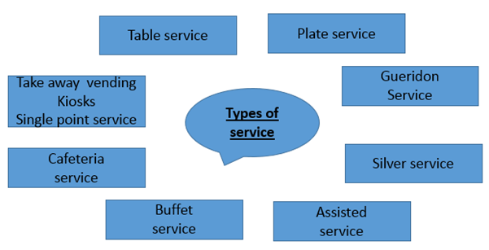
Year 9 knowledge organiser
Skills in preparation and cooking
Cutting techniques
Lamination
Rubbing in
Pastry making
Baking
Binding
Blind baking
Temperature control
Aeration
Whisking
Adapting recipes
Product assembling
Plating techniques
Kneading
Processing
Food preparation
Avoiding cross contamination
Correct food storage
1. Choose the Perfect Plate
Aeration: incorporating air into a mixture by whisking, folding or creaming
2. Placing Your Ingredients
Lamination: folding butter through pastry dough to create layers
3. Pay Attention to the Details
4. Design and Create with Sauces
Stabiliser: added an ingredient such as cream of tarter to make a product stable, meringues for example.
5. Use Garnishes Purposefully
Dietary needs of customers

Slide 2
Understand the environment in which hospitality and catering providers operate
CONTRACT CATERERS
These provide food and drink for a function where catering facilities are not already provided
They prepare the food for functions such as, weddings, banquets, garden parties, and parties in private houses. They may prepare and cook food in advance, and deliver it the venue, or they may cook it on site. They may also provide staff to serve the food if required.
Great for - parties
Weddings
Proms
Establishments that do not have facilities to provide food and drink
Types of provider
Types of service
Commercial/non commercial establishment
Services provided
Suppliers
Where hospitality is provided at non-catering venues
Standards and ratings
The hospitality and catering industry includes hotels, guest houses, bed and breakfasts (B&Bs), inns and pubs, restaurants, cafes and takeaways, contract catering (such as catering in hospitals), catering in leisure attractions (such as museums) and motorway service areas. It includes in flight meals and snacks on rail services. It also includes private clubs (such as the Royal Automobile Club) and mobile catering services.
Hospitality is kindness in welcoming guests
Customer – a person who buys goods or services
Hotels are judged on quality using a star system
5* is best
Food in restaurants is judged in quality and can be awarded Michelin stars if very good
Boutique hotel – a small hotel where all rooms are themed differently
Hostel a budget type of accommodation with shared facilities
Types of residential service – B&B, half board, full board, room only, all inclusive
Hospitality has important links with tourism because people travel for work or pleasure and require accommodation , food and drink.
Some facts and information
commercial | Non commercial
hotels | hospitals
B&B’s | schools
pubs | army
Guest houses | Care homes
Holiday parks | prisons
The main sectors of the Hospitality industry are:
Accommodation e.g. hotels and guest houses
Food and drink e.g. cafes and restaurants
Meetings and events e.g. hotels and conference centres
Entertainment and leisure e.g. spa , leisure centres like the Metrodome and golf clubs
Travel and tourism e.g. aeroplanes , cruise ships and hotels
The catering industry is very diverse. A catering establishment is defined as one that provides food and/or drink. This is known as a product-and-service provider.
Many different kinds of commercial (for profit) businesses operate in the catering industry, but there are also non-commercial businesses in the industry
Commercial – make profit e.g. hotel
Non commercial – do not make profit e.g. prisons
Residential- can book in to stay over night
Non residential – cannot stay overnight

