Slide 1

Choosing your
Key Stage 4 options
For
September 2025

Slide 2


What is Key Stage 4?
Years 10 and 11
Final years of compulsory school education
Leads to national qualifications
Some choice of subjects
Core subjects and option subjects

Slide 3
Post-16 education
Pathways
Sixth form
College
Apprenticeship
During Year 11, you will apply to follow your chosen pathway.
GCSE grades determine which pathway(s) can be followed.
GCSE English and maths grades will be vitally important.
All pathways will have entry requirements.

Slide 4

The Curriculum
Core subjects
Option subjects
60% of your timetable
GCSE English Language
GCSE English Literature
GCSE Maths
GCSE Science
PHSE
PE
40% of your timetable
A range of GCSE/BTEC choices
How many choices can I make?
What subjects are there to choose from?

Slide 5
What are the option subjects?
Art and Design
Business Enterprise
Computer Science
Creative iMedia
Digital Information Technology
Design Technology
Drama
Geography
Health & Social Care
History
Hospitality & Catering
Music
Religious Studies
Spanish
Sport Studies
Triple Science
You will study 4 of these subjects.

Slide 6
Option Subjects: List A
Computer Science
You must choose
at least one of these subjects.
Geography
History
Spanish
Triple Science

Slide 7
Option Subjects: List B
Art and Design
Business Enterprise
Creative iMedia
Design Technology
Digital Information Technology
Drama
Health & Social Care
Hospitality & Catering
Music
Religious Studies
Sport Studies
Your other subject choices must come from this list.

Slide 8
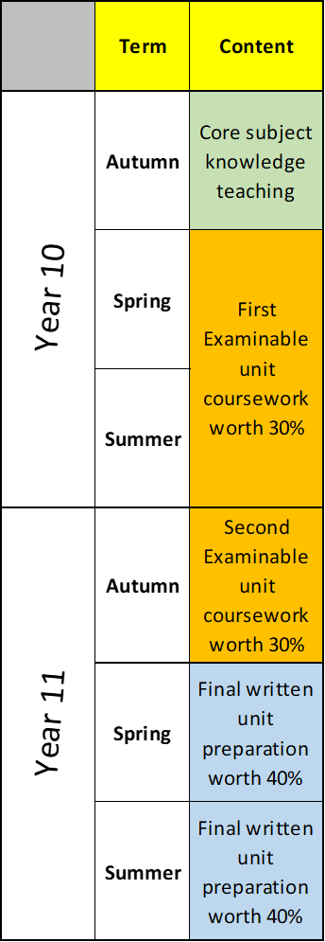
Vocational course structure
Vocational courses
Business Enterprise (BTEC)
Creative iMedia (Cambridge National)
Digital Information technology (BTEC)
Health & Social Care (BTEC)
Hospitality and Catering (Eduqas certificate)
Music (BTEC)
Sport Studies (Cambridge National)

Slide 9
Practical elements
Vocational subjects
Music - 5 hour practical exams
Sport studies - Demonstrate sport skills and coaching
Hospitality - 4 hours cooking exam
Design and Technology- Producing a product
GCSE Subjects
Art - 10 hour practical exam
Drama - Performance exam
Spanish - speaking exam

Slide 10
Selecting subjects
You must select 6 subject choices .
You must decide on an order of preference from choice 1 to choice 6.
You will be allocated 4 of your subject choices.
  1.
  2.
  3.
  4.
  5.
  6.

Slide 11

Choosing subjects
Ask yourself:
What do I enjoy?
What am I good at?
What are my future career plans?

Slide 12
How do I get the information I need?
Subject teachers/ form tutors
Options booklet :
    sent home to parents today
    copy given out in form time tomorrow
School website – options page
1-1 Options Interview
Internet: U-EXPLORE

Slide 13
Timeline for the options process
Date | Action
13th January | Year 9 options assembly Options booklet sent to parents Subject videos on the school website
Week of 13th January | Form time activities
20th January - 14th February | Individual Options interviews
26th February | Deadline for any amendments to the subjects selected
July 2025 | Option subject allocation confirmed

Slide 14
What happens next?
In preparation for your Options interview:
Read the options booklet carefully
Look at the options page on the school website
Discuss the options booklet with your parents
Ask for help if you need it!

Slide 15












FUTURE ENGINEERS ACADEMY

Slide 16
INTRODUCTION TO THE FUTURE ENGINEERS ACADEMY
• Opportunity for students to explore STEM careers
• Focus on employability skills development
• Insight into Science, Technology, Engineering, and Maths (STEM

Slide 17
Program Details
• Open to 20 Year 9 students
• Weekly sessions: Mondays, 2–4 p.m.:
• Skills and technical knowledge development
• Real-world challenge completion
• Exploration of engineering career opportunities
• Two fully funded trips

Slide 18
Benefits for Participants
• Hands-on STEM learning experience
• Work towards an Industrial Cadets Award
• Guidance from industry experts and school leaders

Slide 19
Application Process
1. Application Form: Submit during form time by 17th January to Mrs. Bailey
2. Stage Two:
• Week of 20th January
• Interview with an industry expert, school governor, or leadership team member

