Slide 1


BTEC Applied Psychology
Edexcel 2025

Slide 2

Entry requirements
The entry requirements for Psychology are a minimum of 5 GCSE’s Grade 9-4 including a Grade 5 in Maths and Grade 5 in Science.
This is because Psychology is a Science, and we will be building on the skills acquired at GCSE level.

Slide 3
Course Content Year 1
Unit 1: Psychological Approaches
The approaches covered in BTEC Psychology include…
  The Biological Approach
  Learning Approaches
  The Cognitive Approach
  Social Psychology
This unit is assessed through a 1.5 hour external exam.
Unit 2: Research Methods
In this unit, you will find out about how we conduct research in Psychology. You will also get the chance to conduct your own psychology experiment and write a report on your findings!
This unit is assessed through internal coursework.

Slide 4
Course Content Year 2
Unit 3: Health Psychology
Health psychology explores the motivation behind healthy and unhealthy behaviours, and the factors that might persuade individuals to finally change a behaviour or to follow the advice given by medical professionals.
Why do people become addicted? How is stress linked to illness?
This unit is assessed through a 2 hour external exam.
Unit 6: Criminology
This unit looks at the psychological and social explanations for crime, dealing with offenders and criminal profiling.
This unit is assessed through internal coursework

Slide 5

Previous Results
2024 Leavers Results for BTEC Psychology:
100% Pass rate
26% Merit level
54% Distinction or Distinction*
2023 Leavers Results for BTEC Psychology:
100% Pass rate
36% Merit Level
46% Distinction or Distinction*

Slide 6

Where can BTEC Psychology take me?
Transferable skills
Critical thinking
Researching
Problem-solving
Data Analysis
Time Management
Ethical Awareness
Academic Writing
Careers from Psychology
Any work with people, e.g. Social Work, Youth Work, HR
Marketing and Advertising
Professional Careers that would require specialist qualifications include:
Occupational Psychologist
Clinical Psychologist
Forensic Psychologist
Educational Psychologist
Counsellor
Therapist
Researcher

Slide 7
Psychology lessons at Thomas Alleyne
Skills needed to be successful:
High level of independent study (this will really prepare you for university study!)
Motivation to learn, ask questions and engage in group discussion
Ability to meet deadlines
The structure of the course means that students are assessed throughout, taking the pressure off the FINAL exam!

Slide 8


Enrichment within Psychology
Extensive list of documentaries, podcasts, films and Ted Talks available to deepen your understanding
Psychology Review magazine will be in the 6th form center

Slide 9
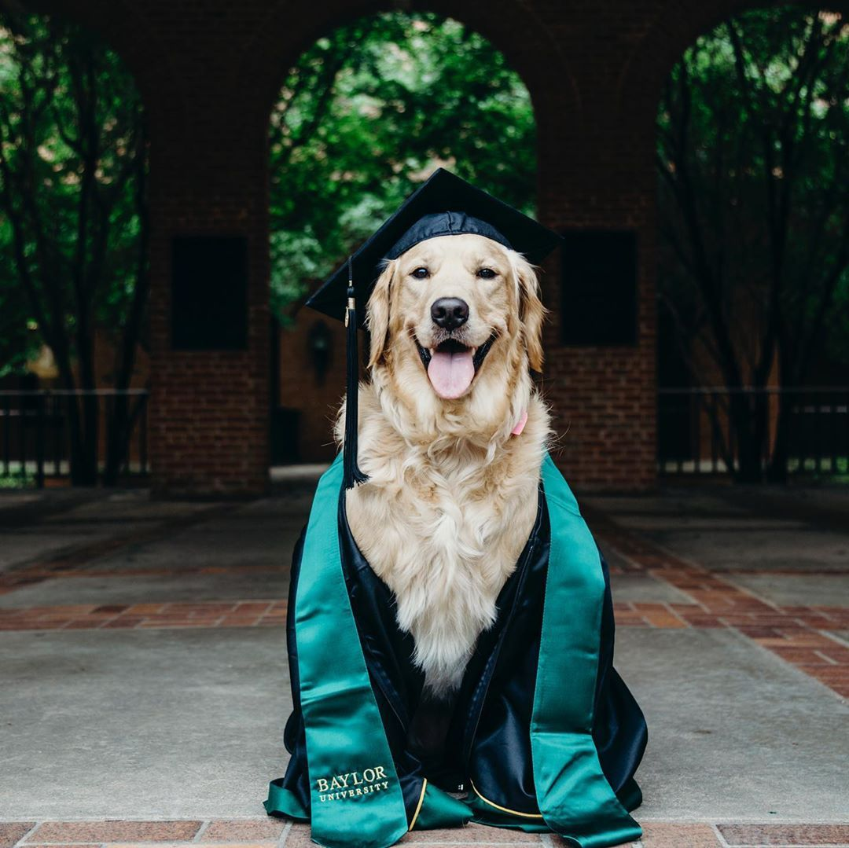
TAA Psychology Student destinations
There are many possible destinations beyond A Level Psychology. Some of our previous students have moved onto the following Higher Education:
Forensic Science - Anglia Ruskin University
Psychology and Neuroscience - University of Reading
Criminology - University of Bristol
Psychology and Child Education - University of Hertfordshire
Business Management - Nottingham Trent University
English & Creative Writing - University of Norwich

