Slide 1
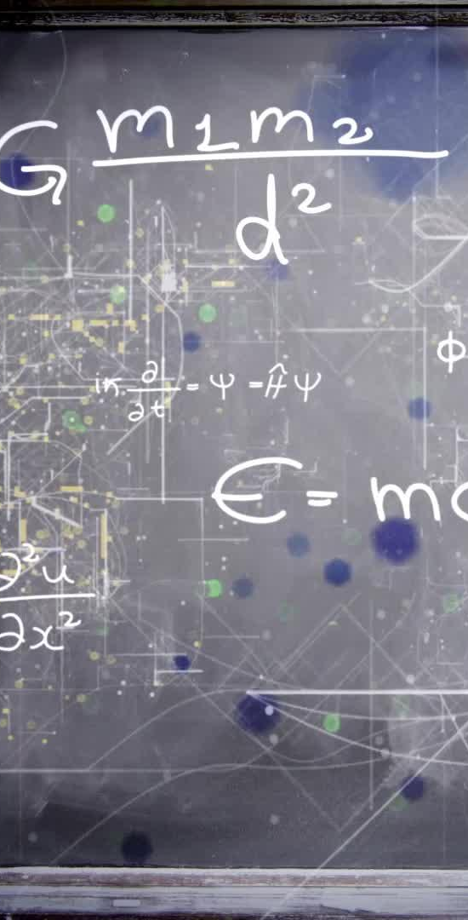
Welcome to
A Level Physics

Slide 2


Entry requirements
Grade 6 for Triple Physics
Grade 7-7 for Combined Science

Slide 3
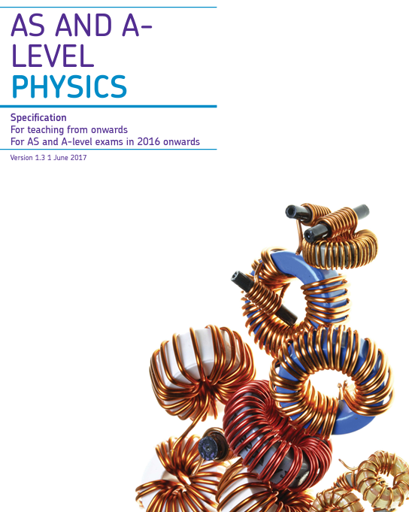
Course overview
AQA A Level Physics
Year 1: Measurements & Errors, Particle Physics, Quantum Phenomena, Waves, Mechanics, Materials, Electricity, Further Mechanics
Year 2: Thermal Physics,
Nuclear Physics, Fields &
Their Consequences
Optional Units: Astrophysics,
Engineering, Medical Physics,
Turning Points in Physics
Notes:
AQA Spec - to follow on from GCSE as well as Physics, Bio and Env Sci are also AQA - continuity of vocabulary and content
Organic – this chemistry to do with carbon (think about alcohols, carboxylic acids, esters etc from GCSE).
Inorganic which is all chemistry not to do with carbon (acids and bases, transition metals, group 2 and group 7)
We both teach parts of the physical which is trends, bonding and maths bits (moles, rates, equilibrium, bond energies etc).

Slide 4
Where can Physics take me?
Transferable skills:
Critical Thinking
Problem Solving
Data analysis and handling
Writing accurate and concise reports
Precision and accuracy
Logic and abstract thinking
Numeracy
Teamwork
Careers Links:
Researcher
Astrophysicist
Clinical Scientists
Radiography
Particle Physicist
Materials Scientist
Civil Engineering
Aerospace Engineering
Automotive Engineering
…and many more!

Slide 5
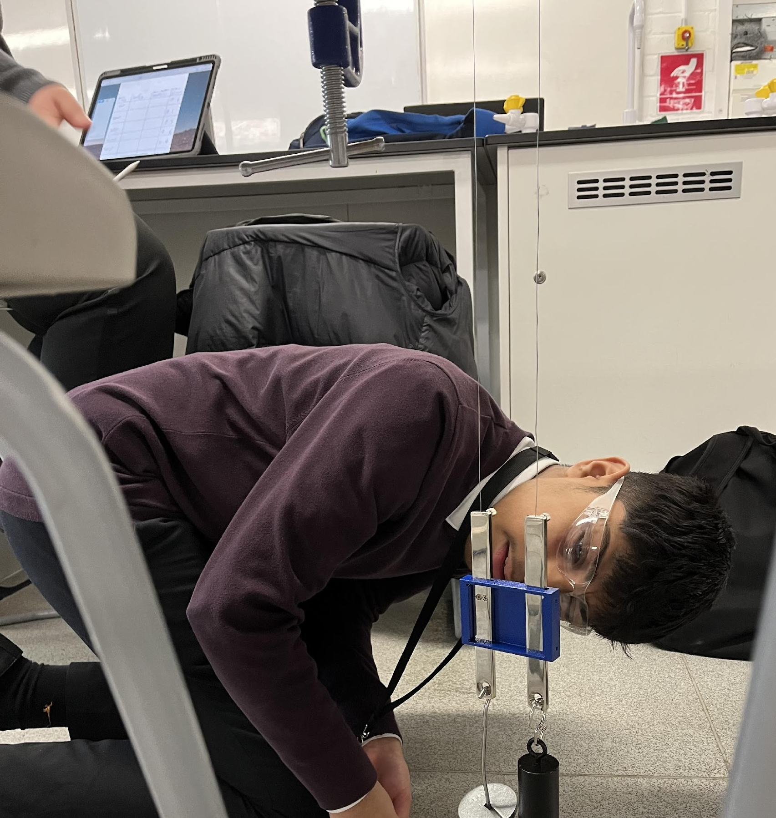
Physics at Thomas Alleyne
Skills needed for A Level:
Good maths skills.
Problem solving and abstract reasoning
Practical skills – plenty of opportunity to develop!
Opportunities at TAA:
One-to-one support as needed
Rigorous assessment and intervention programme

Slide 6


Physics Opportunities at TAA
Online opportunities
with the British Physics Olympiad
External opportunities with COMPOS shared with students

Slide 7
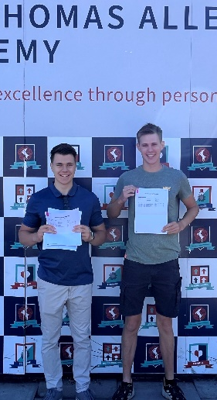
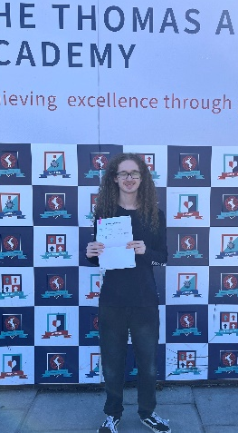
Results 2024
Grades ranging from A – E across cohort
90% Pass Rate for 2024
All students securing destination of choice from university placements to apprenticeships

Slide 8


Recent Destinations
Our students have progressed onto a range of courses and opportunities including:
Aeronautical Engineering – Southampton
Aviation Technology with Pilot Studies – Leeds
Electrical Engineering – Plymouth
Maths – Durham
Maths & Physics – Bath; Queen Mary (London)
Physics – Leicester
Apprenticeships with Hill Group Surveyors
Apprenticeships with GSK

