Slide 1
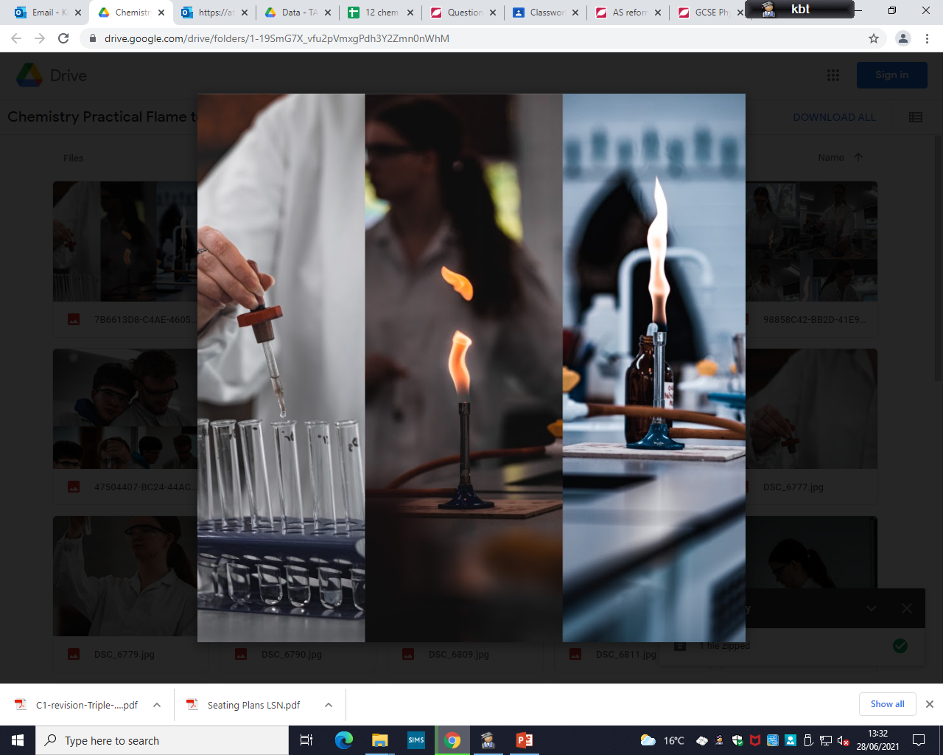
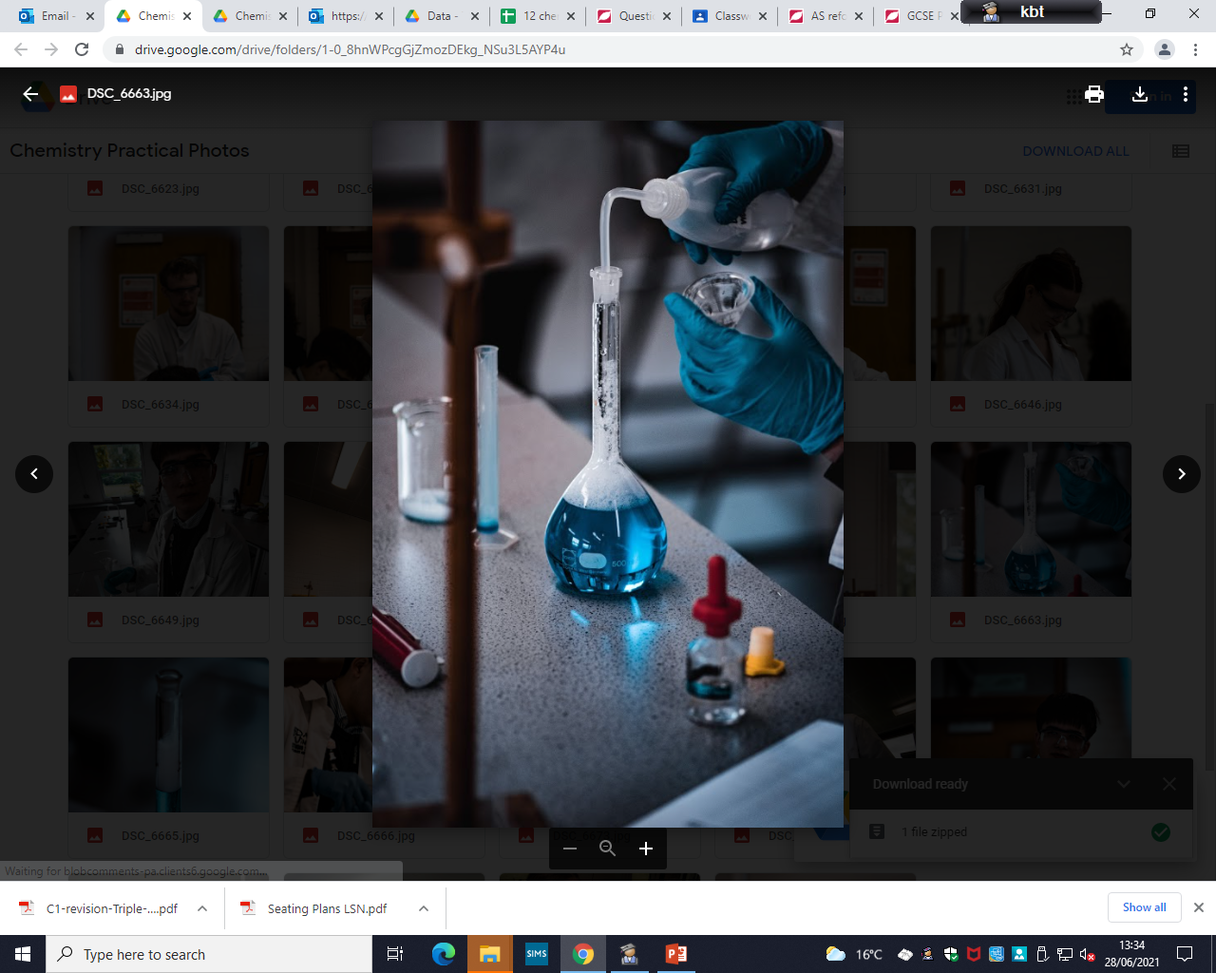
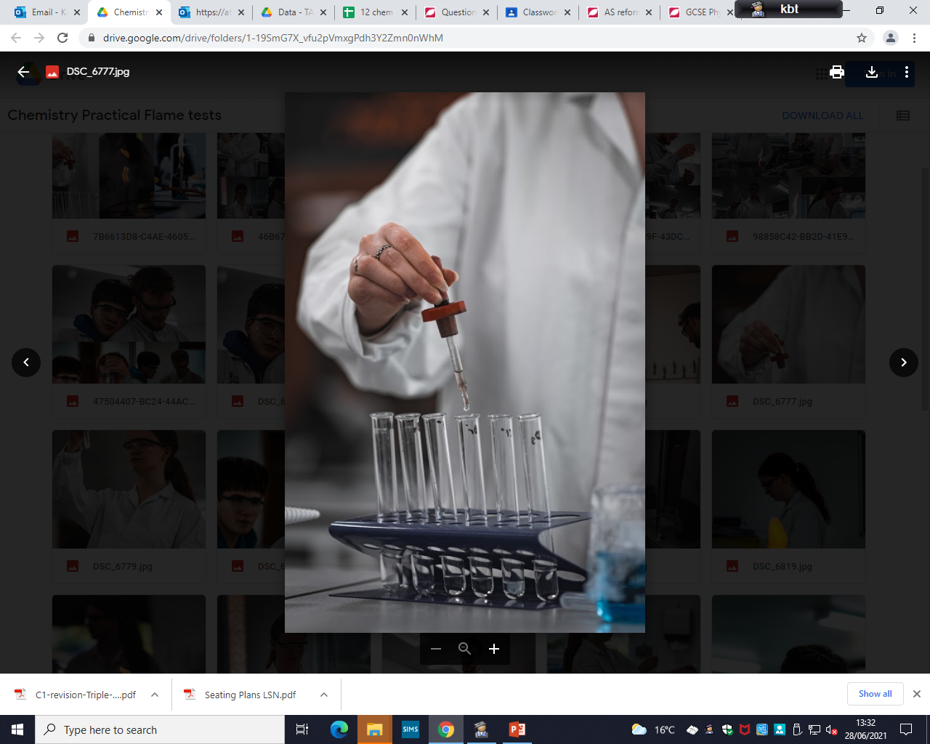
Welcome to
Chemistry A level

Slide 2
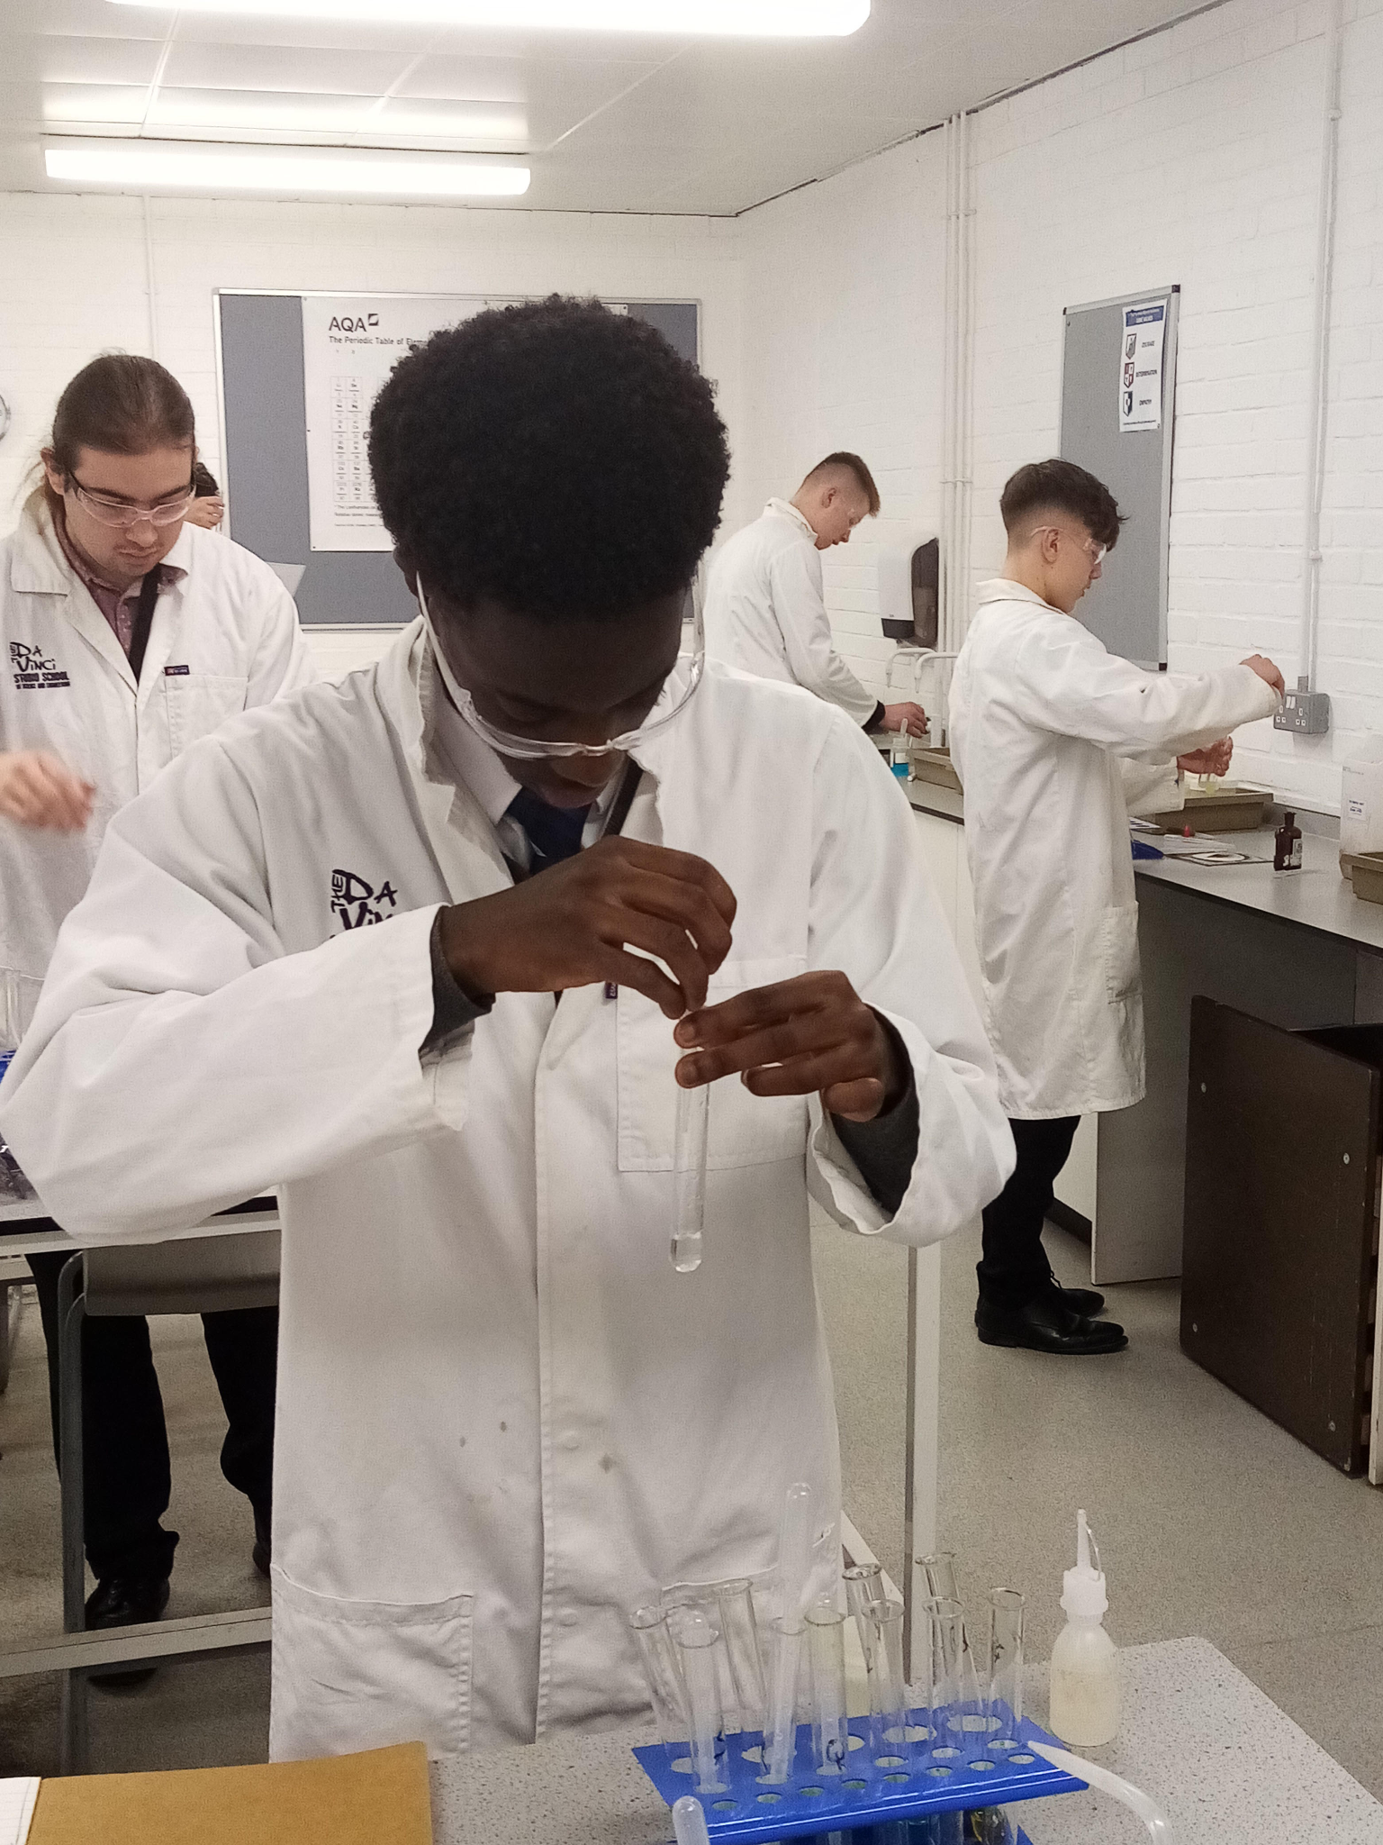
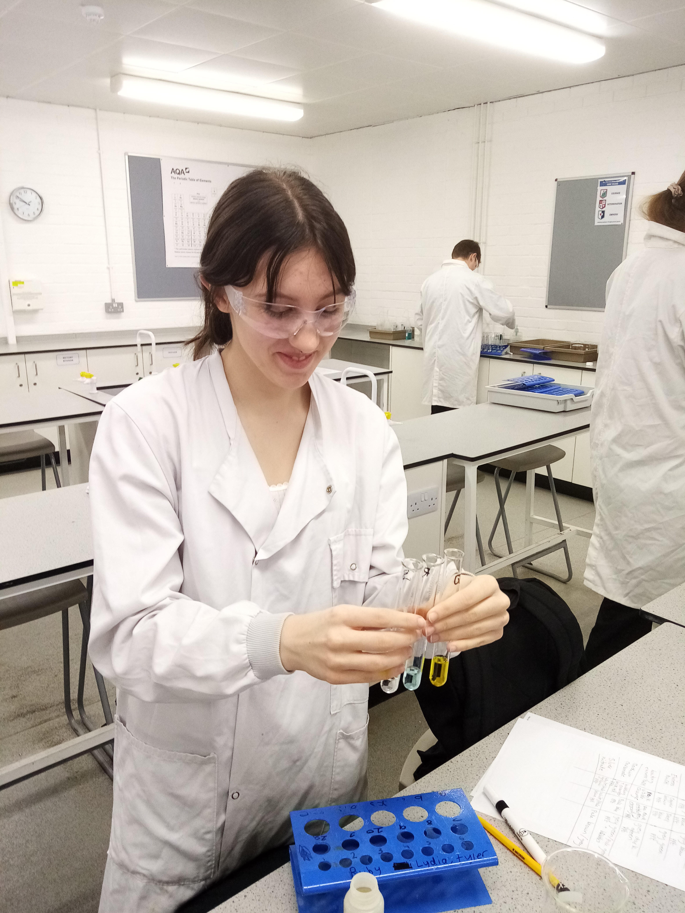
Why Chemistry?
Transferable skills
Critical Thinking
Problem Solving
Data analysis
The ability to write accurate and concise reports
Numeracy
Team working
Careers
Pharmaceuticals
Medicine
Dentistry
Chemical Engineering
Biochemistry
Analytical Chemist
Forensic Science
Toxicologist
Environmental Chemist

Slide 3

Entry requirements
Grade 6 in Chemistry if you are taking Triple Science.
Grade 7,7 overall if you are taking Combined Science.

Slide 4

Course overview
AQA Specification
Curriculum is divided into three main sections:
Physical - atomic structure, bonding, kinetics, equilibrium
Inorganic - periodic table, properties of groups
Organic Chemistry - carbon chemistry, alkanes, alkenes, alcohols, biochemistry
Notes:
AQA Spec - to follow on from GCSE as well as Physics, Bio and Env Sci are also AQA - continuity of vocabulary and content
Organic – this chemistry to do with carbon (think about alcohols, carboxylic acids, esters etc from GCSE).
Inorganic which is all chemistry not to do with carbon (acids and bases, transition metals, group 2 and group 7)
We both teach parts of the physical which is trends, bonding and maths bits (moles, rates, equilibrium, bond energies etc).

Slide 5
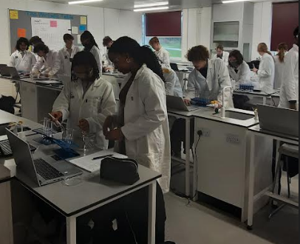
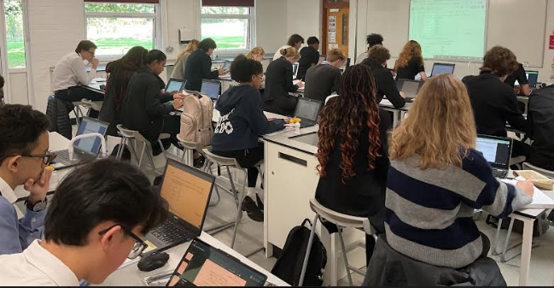
Chemistry at Thomas Alleyne
Skills needed for Chemistry A Level.
Good maths skills
Problem solving skills
Practical skills
Opportunities at TAA
Frequent relevant practical lessons
One to one and small group support
Rigorous assessment and intervention programme

Slide 6

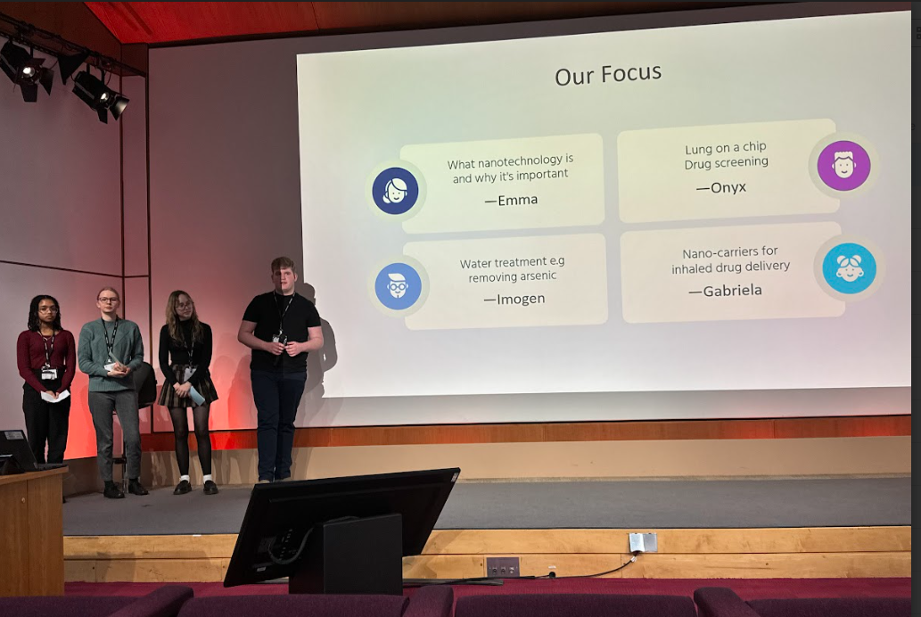

Leader in STEM
enrichment
Bronze Industrial Cadets award in Y12
Notes:
A bespoke programme in conjunction with GSK apprentices and year-in-industry degree students which provides an opportunity to experience industry and understand how to apply for early careers opportunities including apprenticeships, internships, and graduate programmes. This has led to successful applications from our students for GSK apprenticeships
The programme features live sessions with GSK professionals including interactive Q&As, engaging activities and problem-solving on real life industry projects.
Students also build their interpersonal skills such as team working, presenting, communication and decision making.

Slide 7


Enrichment
Life sciences conference at the University of Bedfordshire.
Online conferences e.g. Oxford University looking at Fluorine Chemistry and how Chemistry can tell us about the past.
Bespoke programmes for students depending on their destinations
NHS Volunteering
Medics Workshop

Slide 8
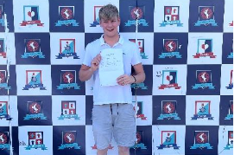
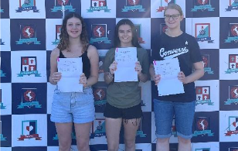
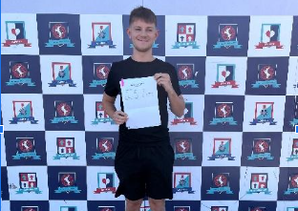
Results
2024 results:
100% pass rate
20% A grades
50% A to B grades
75% A to C grades
Notes:
Ben Palmer - GSK apprenticeship
Gray - zoology
Rose - ARU Domainex lab apprenticeship
Millie - a year out before going into medicine
Arthur -

Slide 9
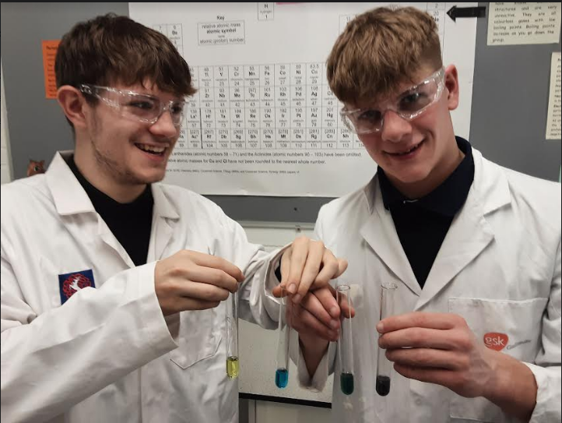
Destinations
Our students have progressed onto a range of courses and opportunities including:
Chemistry
Medicine
BioChemistry
Chemical Engineering
Accountancy
Biomedicine
Degree Apprenticeships

