Slide 1
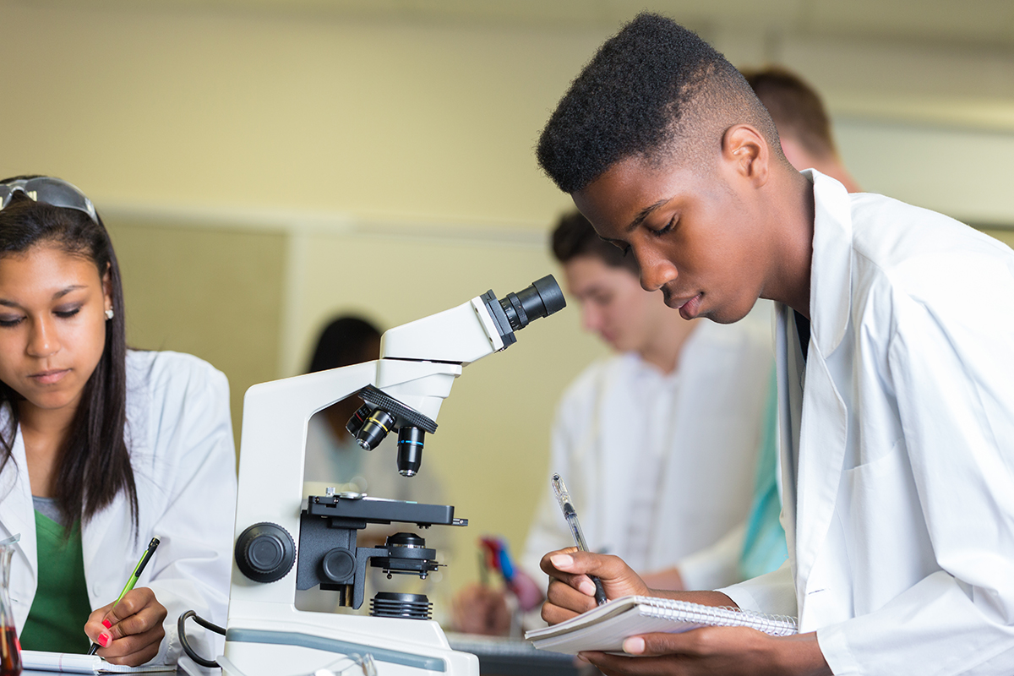
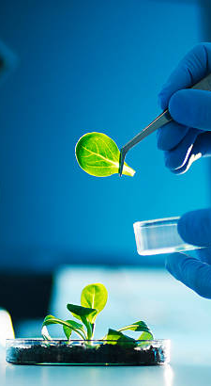
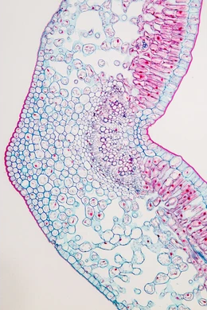
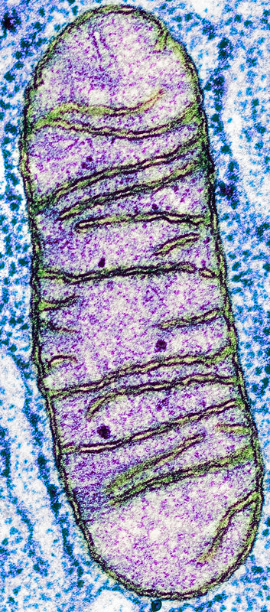
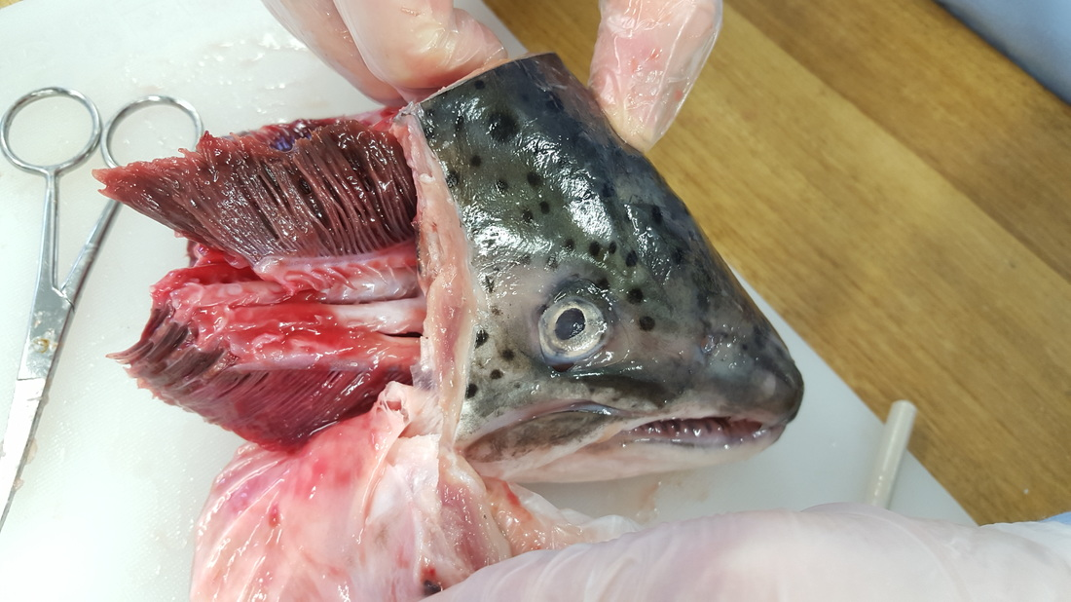
Welcome to
Biology A level

Slide 2

Entry requirements
Level 6 in Biology if you are taking Triple Science.
Level 7,7 if you are taking Combined Science.

Slide 3
Course overview
AQA Specification
Biological molecules
Cells
Organisms exchange substances with their environment
Genetic information, variation and relationships between organisms
Energy transfers in and between organisms
Organisms respond to changes in their internal and external environments
Genetics, populations, evolution and ecosystems
The control of gene expression

Slide 4
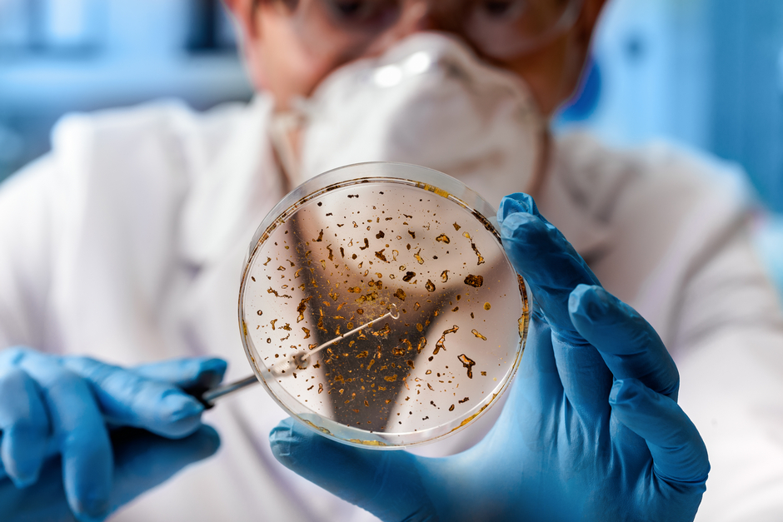
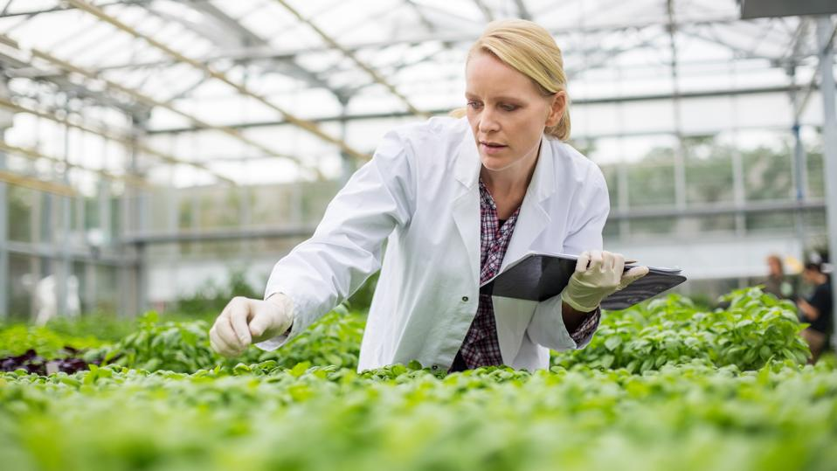

Where can Biology take me?
Biology Careers:
Pharmaceuticals
Medicine
Dentistry
Forensic science
Biochemistry
Botanist
Microbiology
Toxicologist
Ecologist
Teacher
Nutrition

Slide 5

Where can Biology take me?
Transferable skills
Communication, through report writing and presentations.
Team Working and collaboration, through group projects
The ability to work independently.
Organisation and time management, through meeting deadlines.
Numeracy and maths.
IT and computer literacy.
Research and data analysis.

Slide 6
Biology at Thomas Alleyne
Skills needed for Biology A Level.
Good maths skills.
Problem solving skills.
Practical skills
Opportunities at TAA
Frequent relevant practical lesson
One to one support
Rigorous assessment and intervention programme.

Slide 7


Leader in STEM enrichment
We work with GSK apprentices and year in industry students to run a bronze industrial cadets award.
This offers opportunities to see how science is used in industry and to explore new areas of science.
Students also build their interpersonal skills such as team working, presenting, communication and decision making.

Slide 8

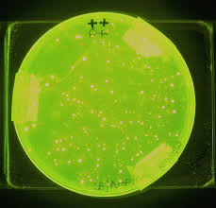
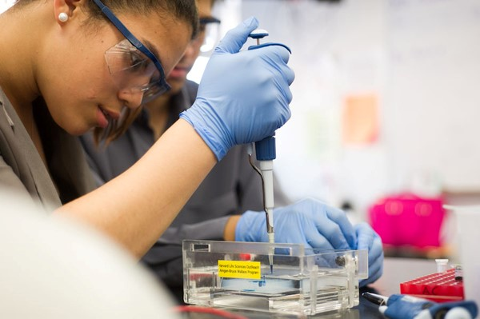
Other enrichment
Students get to genetically engineer bacteria in school using the procedures and techniques that are the foundation of biotechnology.
A gene from a fluorescing sea anemone is inserted into E. coli so it will glow under UV light!

Slide 9

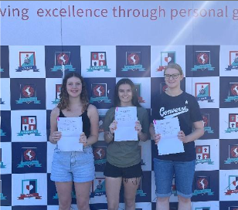
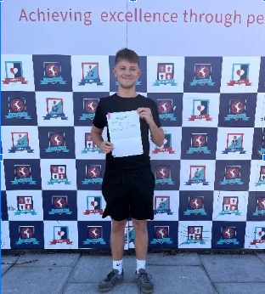
Results
2024 results:
100% pass rate
22% A* - A grades
50% A and B grades
75% A to C grades

Slide 10
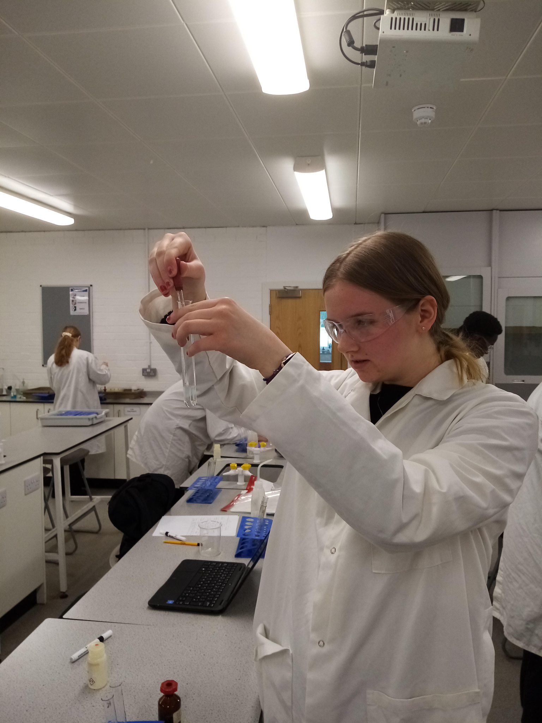
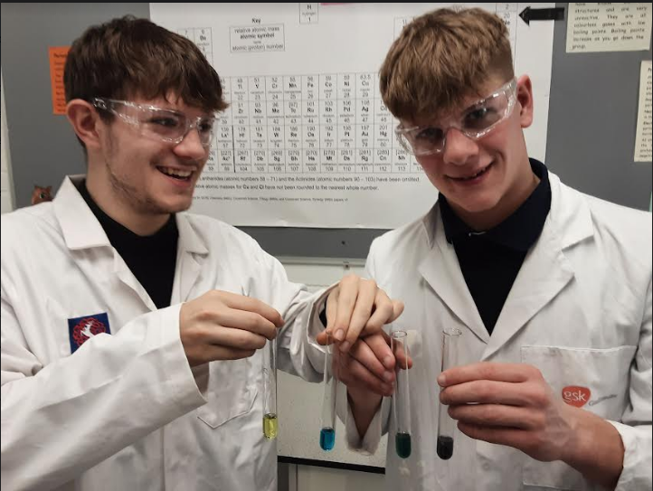
Destinations
Our students have progressed onto a range of courses and opportunities including:
Chemistry
Medicine
Biochemistry
Chemical Engineering
Accountancy
Biomedicine
And degree apprenticeships

