Slide 1
Mathematics
A level

Slide 2
Entry requirements:
Grade 7 or above in Mathematics GCSE
Minimum APS: 5.6

Slide 3
Course description:
Component | Assessment | Teaching time
Pure | 200 marks 2 papers 120 minutes each | 5 hours a fortnight
Statistics | 50 marks Stats 50 marks Mech 1 paper each 120 minutes combined | 4 hours a fortnight
Mechanics

Slide 4
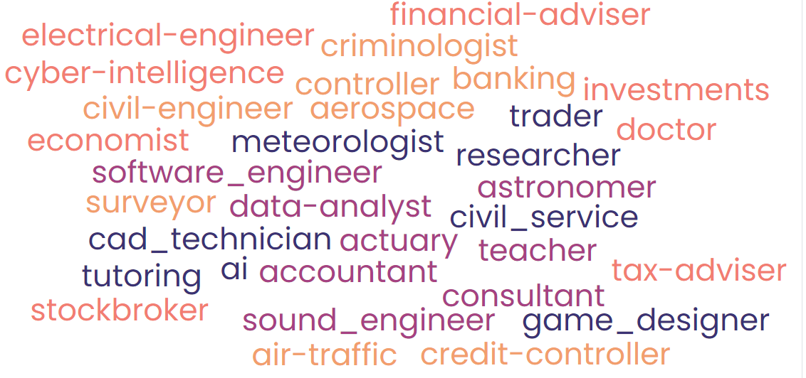
Where can Mathematics take me?
A level Mathematics is considered by many employers, universities and colleges as a vital subject.
Degree subjects
Engineering, Physics, Statistics, and Economics, require A level mathematics. A level Mathematics is a common topic taken by students on degrees as diverse as Architecture, Law, and Psychology, despite the fact that it is not a requirement.
Apprenticeships
Apprenticeships in accounting, engineering, teaching, and technology can benefit having a mathematics degree.

Slide 5


Mathematics lessons at Thomas Alleyne
Skills needed to be successful
Pre-requisite Knowledge:
Strong concept of Algebra and Vectors
Characteristics:
Independent, Resilient, Determined and Organised
Opportunities here
After school tuition, Free online access to textbook resources and Integral
Students will require an advanced scientific calculator (for example Casio FX-991CW)!
Students are required to purchase textbooks (available in digital and hard copy format) for each of the courses and these are an integral part of the teaching process. Staff use a range of teaching styles, both traditional and involving the use of technology when appropriate. There is no coursework involved in either course.

Slide 6
Results 2024:
A* / A: 43%
C and above: 93%
Pass: 100%

Slide 7
TAA Student destinations
Physics degree at Leicester university
Civil engineering Degree
Mathematics
at Durham university
Swansea university for a four
year course in zoology
Contract surveyor apprenticeship
laboratory
degree apprenticeship
Biology degree
at Imperial College London
Business Management
at the University of London

