Slide 1
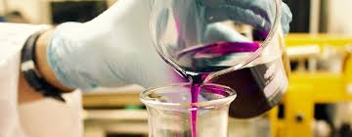
Welcome to
Applied Science BTEC
New for 2025!

Slide 2

Entry requirements
Grade 4 in Science

Slide 3
Course overview
Pearson BTEC Applied science
Curriculum is divided into four main sections:
Principles and Applications of Biology – Structure and function of cells and tissues, biological molecules, enzymes and their role in organisms
Principles and Applications of Chemistry – Structure of the Periodic Table and its implications on physical and chemical properties of substances, through analysis of different bonding methods
Principles and Applications of Physics – Waves and their applications; force principles and their application in transportation and construction of electrical circuits
Practical Scientific Procedures and Techniques – Practical applications across the sciences, including chromatography, colorimetry and electrical circuits

Slide 4
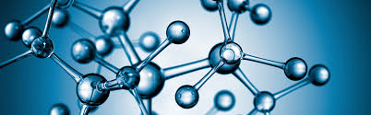
Where can Applied Science take me?
Transferable skills
Communication
Problem solving skills
Team work
Time management
Data Analysis
Research
Project management
Careers from Applied Science
Biological Sciences
Biotechnology
Ecology and Environmental Biology Microbiology
Biochemistry
Environmental Science
Food Science
Forensic Science
Nutrition and Dietetics
Hydrology / Water Science
Health
Nursing
Sport and exercise studies.

Slide 5

Applied Science at Thomas Alleyne
Skills needed for Applied Science.
Good maths skills.
Problem solving skills.
Practical skills
Opportunities at TAA
Frequent relevant practical lessons
One to one support
Rigorous assessment and intervention programme.

Slide 6


Leader in STEM enrichment
We work with GSK apprentices and year in industry students to run a bronze industrial cadets award.
This offers opportunities to see how science is used in industry and to explore new areas of science.
Students also build their interpersonal skills such as team working, presenting, communication and decision making.

