Slide 1

Key Stage 4 Options
Information Evening
Thursday 9th January 2025

Slide 2

What is Key Stage 4?
Years 10 and 11
Final years of compulsory school education
Leads to national qualifications
Some choice of subjects
Core subjects and option subjects

Slide 3

Post-16 education
All pathways will have entry requirements.
During Year 11, students will apply to follow their chosen pathway.
GCSE grades determine which pathway(s) can be followed.
GCSE English and maths grades will be vitally important.
Pathways
Sixth form
College
Apprenticeship

Slide 4
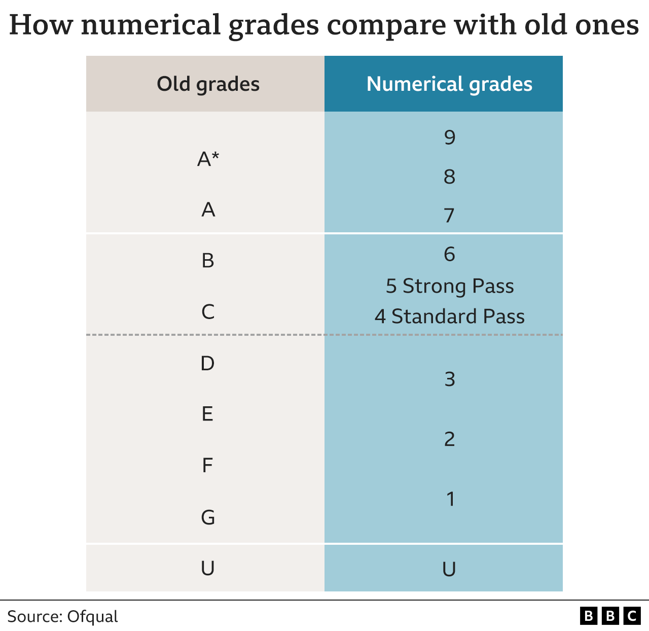
GCSE grades

Slide 5
The Curriculum
Core subjects
Option subjects
60% of the timetable
GCSE English Language
GCSE English Literature
GCSE Maths
GCSE Science
PHSE
PE
40% of the timetable
A range of GCSE
(and equivalent) choices

Slide 6
What are the option subjects?
Art and Design
Business Enterprise
Computer Science
Creative iMedia
Digital Information Technology
Design Technology
Drama
Geography
Health & Social Care
History
Hospitality & Catering
Music
Religious Studies
Spanish
Sport Studies
Triple Science
Students will study 4 of these subjects.

Slide 7
Option Subjects: List A
Computer Science
Students must choose
at least one of these subjects.
Geography
History
Spanish
Triple Science

Slide 8
Option Subjects: List B
Art and Design
Business Enterprise
Creative iMedia
Design Technology
Digital Information Technology
Drama
Health & Social Care
Hospitality & Catering
Music
Religious Studies
Sport Studies

Slide 9
Selecting subjects
Students must select 6 subject choices.
Students must decide on an order of preference from choice 1 to choice 6.
Students will be allocated 4 of their subject choices.
  1.
  2.
  3.
  4.
  5.
  6.

Slide 10
Restrictions
Computer Science | Must be working at a grade 16 or above in Computer Studies and Maths
Spanish | Must be working at a grade 16 or above
Triple Science | Must be working at a grade 16 or above
Music | Must play (or be willing to learn) an instrument
Sport Studies | Must actively participate in PE lessons/ sports clubs
Students will not be allowed to study all 3 IT courses:
Computer Science, Creative iMedia, Digital IT
Students will be advised against completing 3 vocational courses

Slide 11
The Options Process
Date | Action
13th January | Year 9 options assembly Options booklet sent to parents Subject videos on the school website
Week of 13th January | Form time activities
20th January - 14th February | Individual Options interviews
26th February | Deadline for any amendments to the subjects selected
July 2025 | Option subject allocation confirmed

Slide 12

Choosing subjects
Questions for students to ask
What do I enjoy?
What am I good at?
What are my future career plans?

Slide 13

Choosing option subjects:
How can students get the information they need?
Options booklet (issued next week)
School website - Year 9 Options page
Subject teachers in lessons
Form tutors and other staff
Research online, e.g. U-Explore

Slide 14

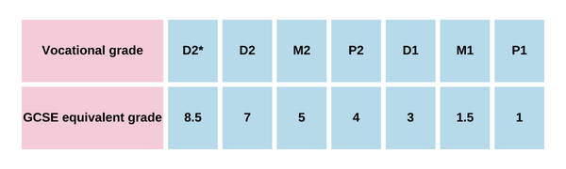
Vocational course equivalent
Vocational courses
Business Enterprise (BTEC)
Creative iMedia (Cambridge National)
Digital Information technology (BTEC)
Health & Social Care (BTEC)
Hospitality and Catering (Eduqas certificate)
Music (BTEC)
Sport Studies (Cambridge National)

Slide 15
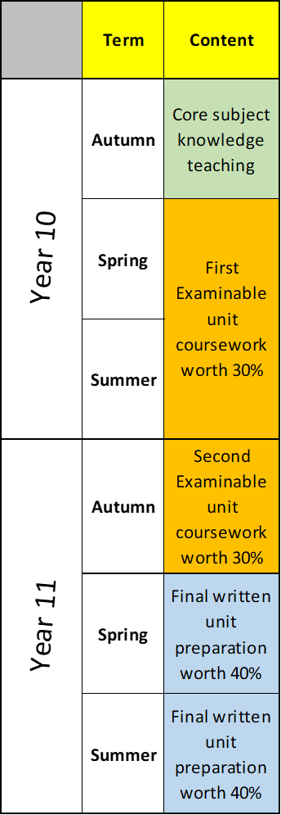
Vocational course structure

Slide 16
Practical elements
Vocational subjects
Music - 5 hour practical exams
Sport studies - Demonstrate sport skills and coaching
Hospitality - 4 hours cooking exam
Design and Technology- Producing a product
GCSE Subjects
Art - 10 hour practical exam
Drama - Performance exam
Spanish - speaking exam

Slide 17
Year 9 Timeline
September
  Personal Development Portfolio starts
  TAA Open Evening
  Launch of careers/character opportunities
  Duke of Edinburgh begins
November
  Progress report
  Parents Evening
December
  Interform debating
January
  Options evening
  Student options assembly
  Option interviews begin
  Future Engineers Academy
May
  Progress report
  Y9 Work Shadowing
  Annual Fun Run
July
  Personal Development Celebration event
  Sports Day
Notes:
MCN

Slide 18

Attendance
Students need to be in school and in lessons on time as much as possible.
In a study from 2019, secondary school pupils who did not achieve a grade 4 or above in English and maths had missed, on average, 10 more days than those who achieved grade 5 or above in both English and maths.
Notes:
MCN
5 lessons a day means a week off is 25 lessons missed – can students catch up?

Slide 19
Behaviour
•Focus on rewards
Merits
Postcards
Badges
Phone calls home
•Follow behaviour policy
•Escalations for students consistently getting it wrong
Notes:
MCN
We want to be continue rewarding students (merits, postcards, badges, phone calls home, etc)
Clear policy - reminders, on-call
Students being sanctioned means missing lessons, means missing learning

Slide 20
Careers and
Character Curriculum
Prepare students for the future
•Key skills
•Organisation
•Revision
•Overcoming setbacks
•Social issues
Personal Development Portfolios
Notes:
MCN

Slide 21
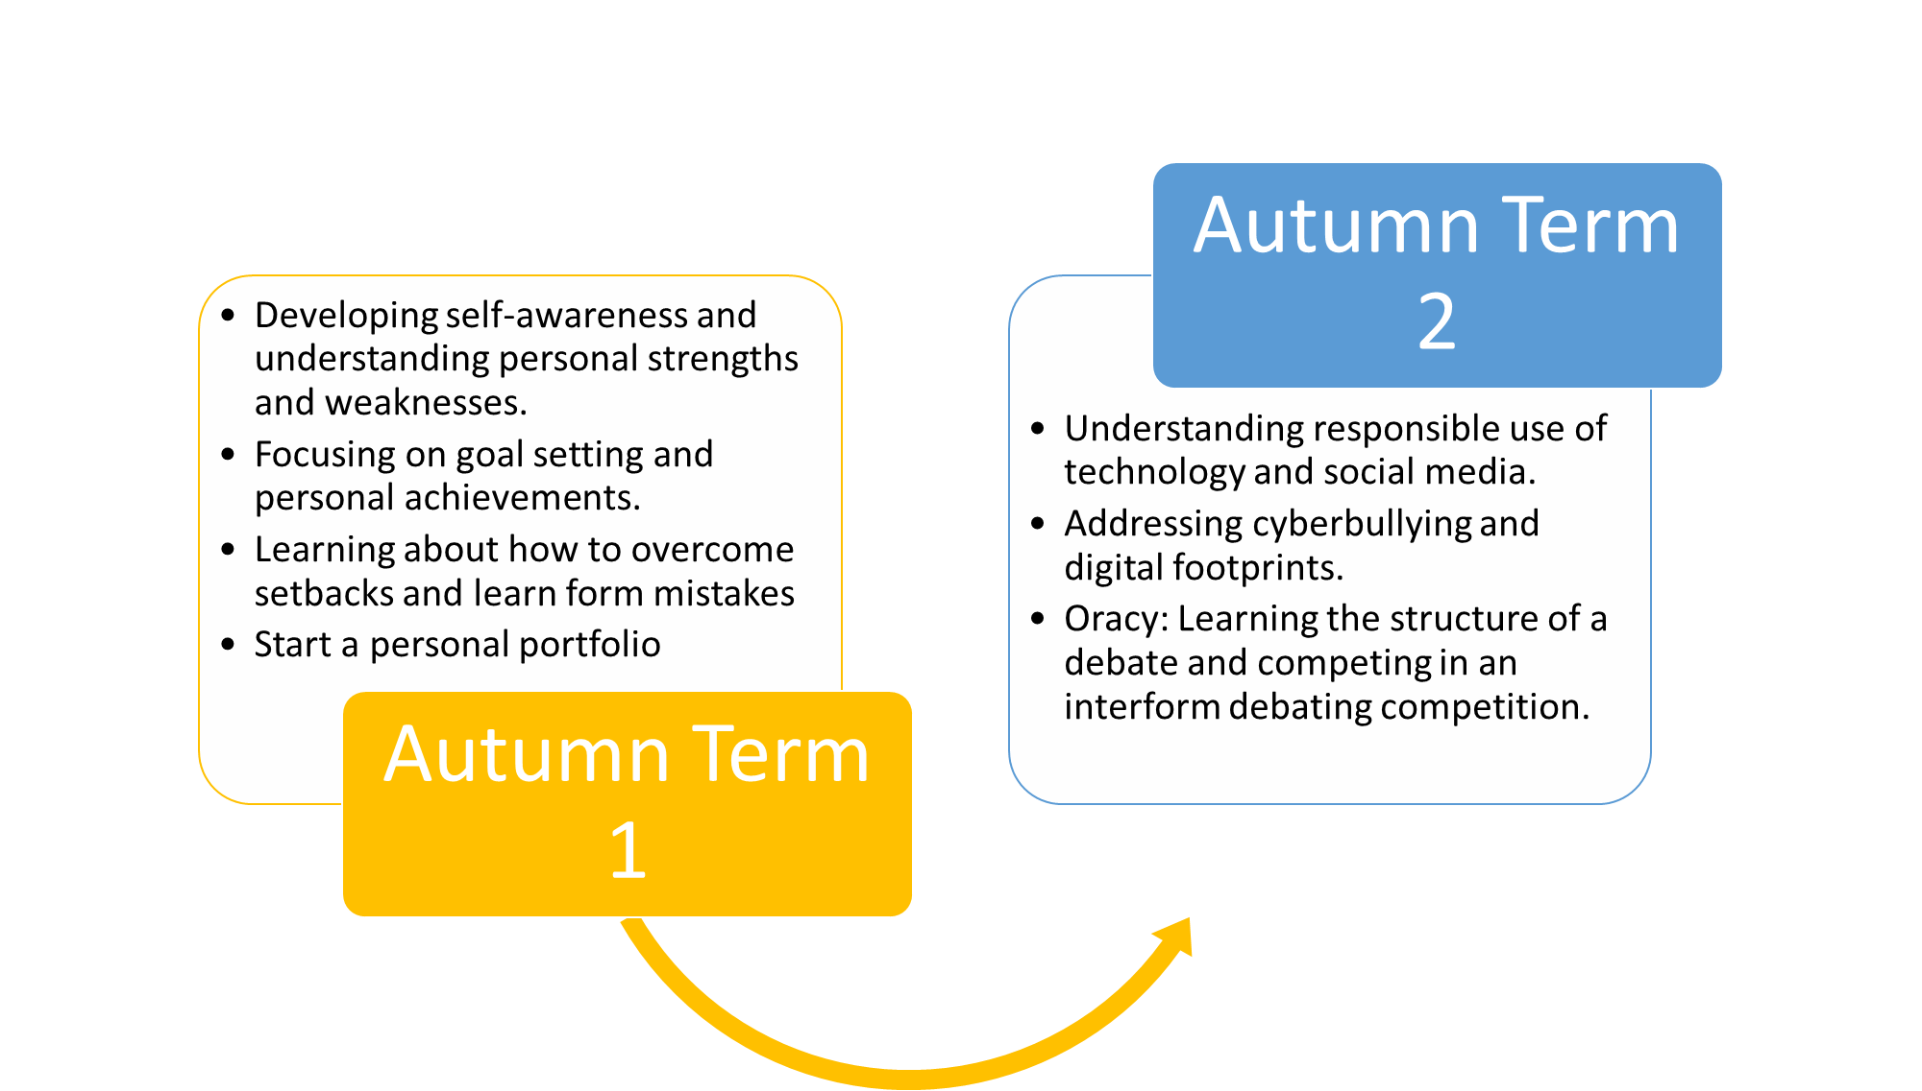
Careers and Character Curriculum
Notes:
MCN

Slide 22
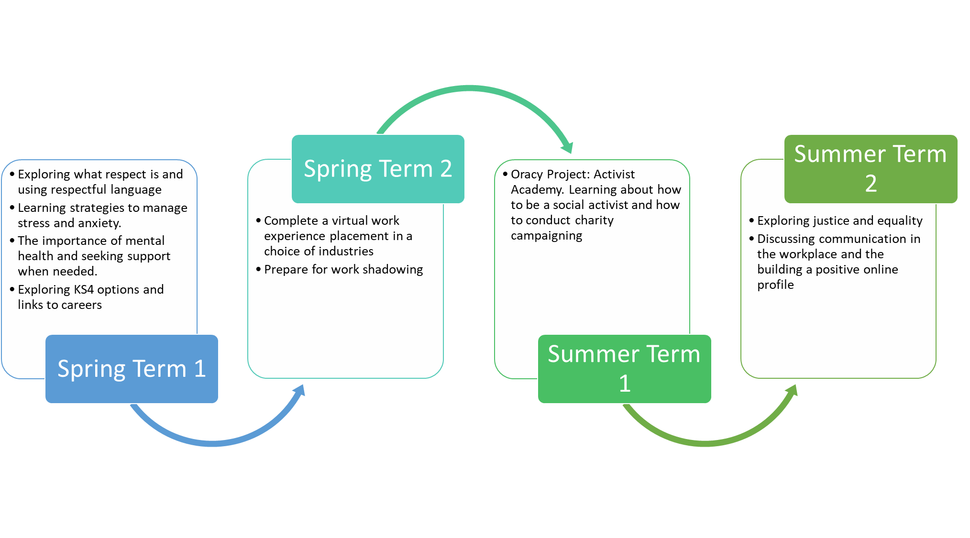
Careers and Character Curriculum
Notes:
MCN

Slide 23

How can we help?
Options interviews
Form tutors
Pastoral Team: Mr Catlin or Miss Kolthammer
For a mental wellbeing concern, Mrs Hayman
Notes:
MCN

Slide 24

How can you help?
Ask your child about school
Help your child develop good habits
Encourage routines
Make time for treats
Notes:
MCN

