Slide 1

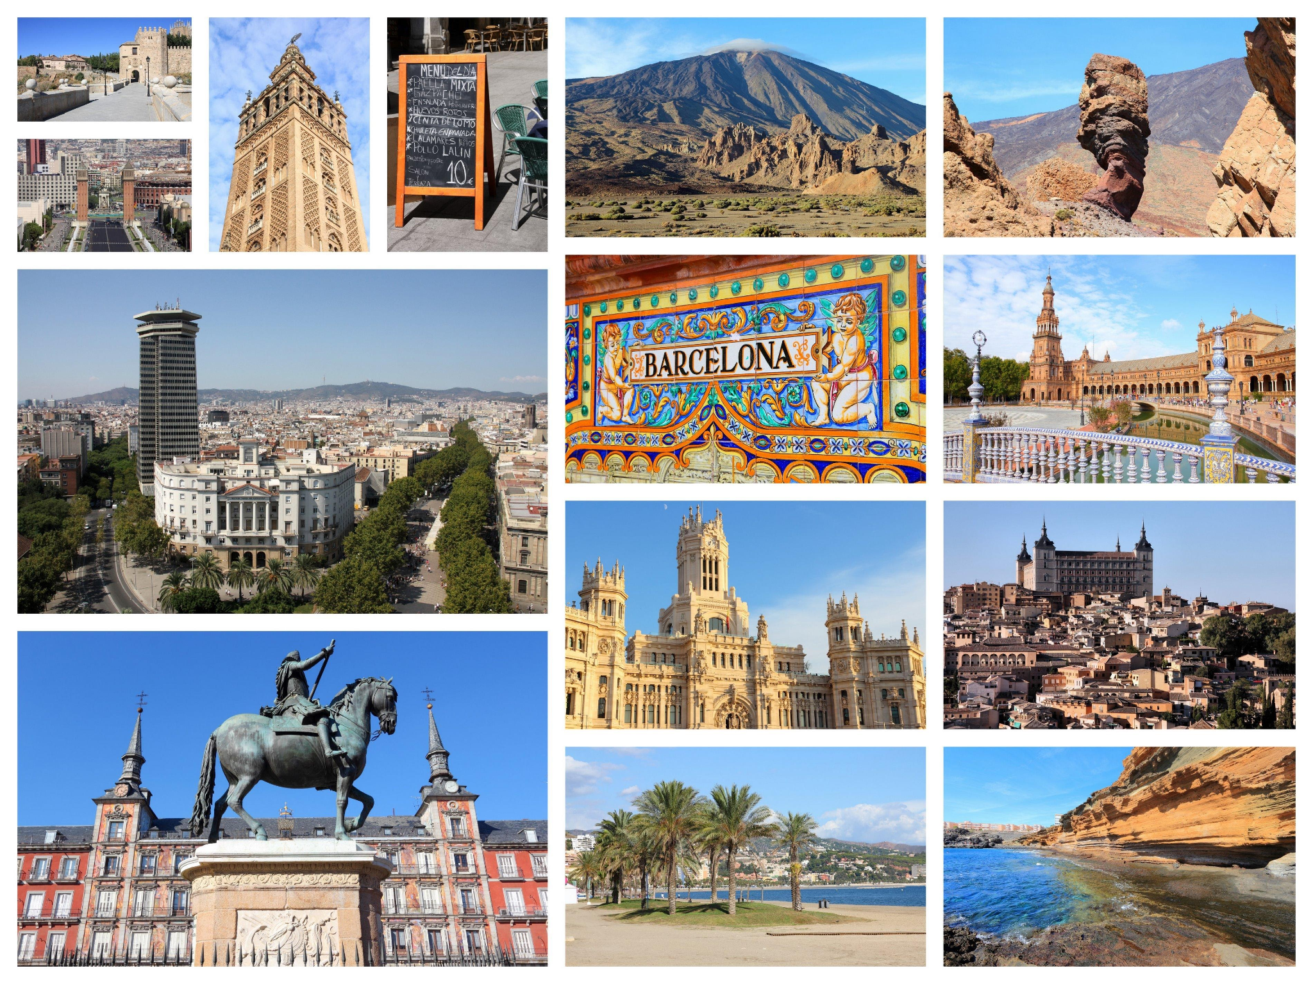
Key Stage 4 Options Process
Spanish

Slide 2
Spanish GCSE
at Thomas Alleyne Academy
Students follow the AQA GCSE.
Languages open up a world of opportunities, such as work and travel. Learning a language is a skill for life and will enable new experiences and friendships. We want our students’ eyes to be opened to other cultures and for them to learn how to communicate about subjects that interest them. We are passionate about growing a love of languages. Our aim is to foster communication, broaden perspectives, introduce new cultures and develop students into global citizens.

Slide 3
The course is divided into 3 big topics (called themes)
Assessment is set in the context of these three themes.
Theme 1: People and lifestyle
Theme 2: Popular culture
Theme 3: Communication and the world around us

Slide 4
Teaching is divided into 8 smaller topics which cover the themes
 | Term 1 | Term 2 | Term 3
Year 10 | Módulo 1: ¡Diviértete! -Have fun! (Themes 2 and 3) Módulo 2: Viajes - Trips (Themes 2 and 3) | Módulo 3: Mi gente, mi mundo - My people, my world (Themes 1,2, and 3) Módulo 4: Mi estilo de vida - My lifestyle (Theme 1) | Módulo 5: ¡A clase! - To class! (Theme 1)
Year 11 | Módulo 6: Mi barrio y yo -My neighborhood and me. (Theme 3) Módulo 7: Un mundo mejor para todos - A better world for everyone (Theme 3) | Módulo 8: El futuro te espera The future awaits you. (Theme 1)

Slide 5
How is the course assessed?
There are 4 exams, each worth 25% of the GCSE grade.
Listening - Understanding and responding to spoken Spanish. Dictation of short, spoken extracts.
Speaking - Undertake a Role-play. Carry out a Reading aloud task. Talk about a photograph.
Reading - Understanding and responding to written texts. Translating from Spanish into English.
Writing - Writing texts in Spanish. Translating from English into Spanish.

Slide 6
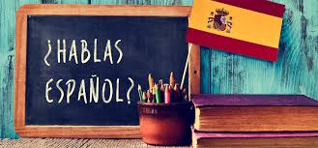

Why is this a good subject to study?
What can it lead to?
Learning a language builds and demonstrates a lot of transferable skills: communication, improved memory, focus, critical thinking and creativity
Spanish is not just a GCSE, it is a life skill that will open up new travel and adventure opportunities. Around 600 million people speak Spanish around the world. Over 20 countries speak Spanish as their first language.
Having a GCSE in a language will make your application to employers, universities and colleges stand out.

