Slide 1
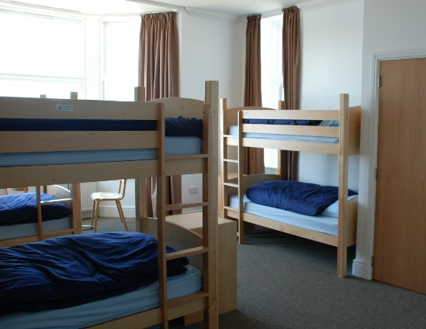
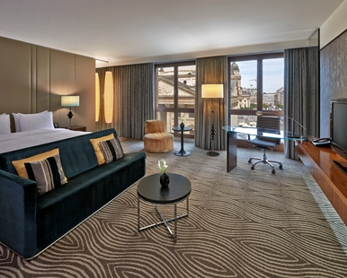
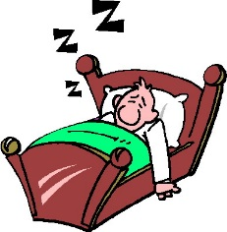
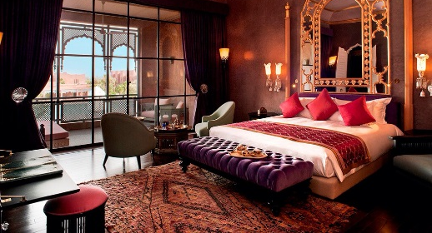
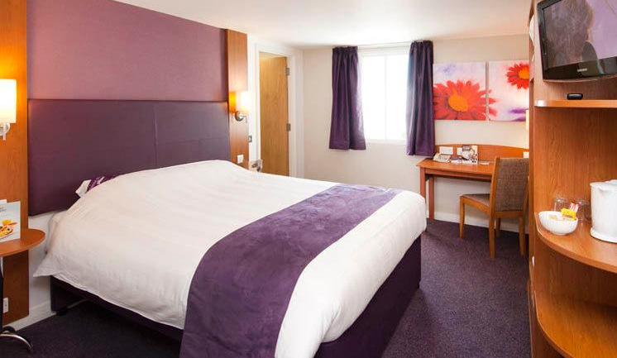
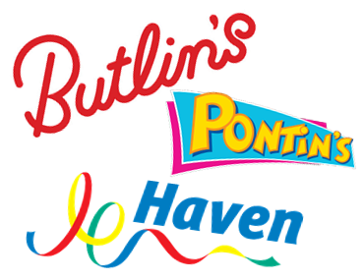
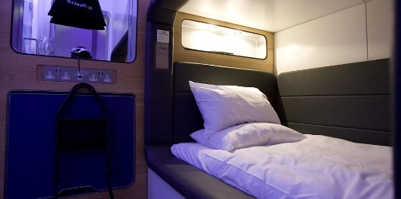
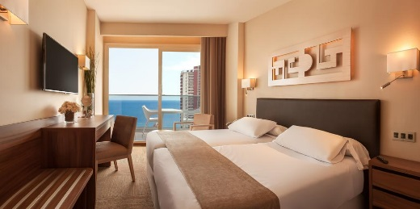
1
The Hospitality Industry
Other commercial hospitality businesses include:
Types of Bedroom (Commercial Accommodation)
Commercial = for profit/make money
Non Commercial = not for profit
Residential = you can sleep there
Non Residential = there is no accommodation there
Restaurants, Bars, Cafés, Fast Food Restaurants, Deli/Sandwich Shops, Airports, Trains, Coaches and Ships/Ferry.
All of the above need to make money to continue operating, therefore the care of their customers is paramount (very important) so that they come back!
Youth Hostel
Deluxe Suite (Hotel)
The commercial residential sector includes guest houses, hotels, B&Bs, hostels, and holiday parks.
There are different types of accommodation in the hospitality industry to suit different budgets. For example, a businesswoman travelling to London for a meeting would not need to book a luxury penthouse apartment for one night's stay. A couple on their honeymoon might book a deluxe suite as they will have saved up for the occasion and want to make their holiday special. Look at the examples (right) and memorise them.
Boutique Hotel
Budget Room
The non-commercial sector includes catering in business and industry, education, healthcare and the armed forces. These can be both residential and non-residential.
Yotel – Cabin rooms in airports
Standard Bed and Breakfast (Twin) Room
Key Words
Hospitality - Relatively modern word, meaning the friendly and generous treatment of guests and strangers.
Guest/Client/Customer – the person/people who book/receive the service, e.g. hotel guests.
Service – to do/provide something for someone else, this can be paid for or done for free depending on the business, e.g. hospitals provide free healthcare services. Restaurants provide food service that customers pay for.
Business – the buying and selling of goods/services to make money, e.g. airports make money from flight ticket sales/meals.
Accommodation - a room, group of rooms, or building in which someone may live or stay.
Catering - offering facilities to people, especially the provision of food and beverages.
Hostel - establishment which provides inexpensive food and lodging for a specific group of people, such as students, workers, or travelers.
Hotel - an establishment providing accommodation, meals, and other services for travelers and tourists.
Guest House - a private house offering accommodation to paying guests, smaller business than hostels and hotels.

Slide 2
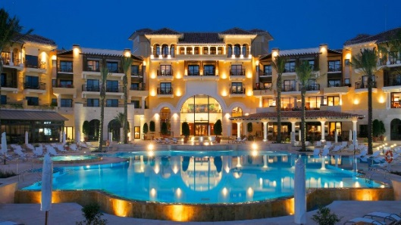
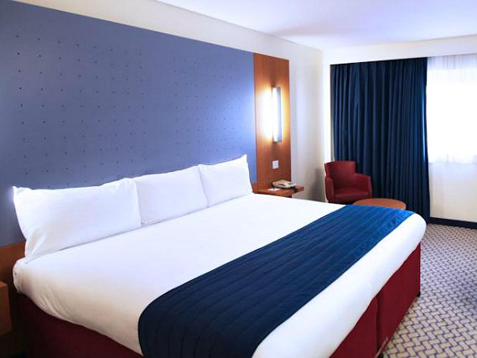
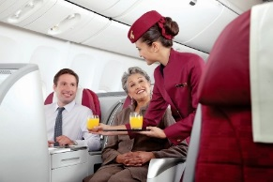
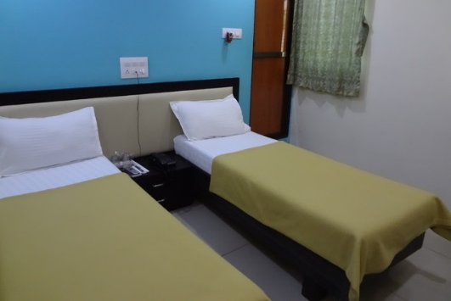
Other types of hospitality!
There’s more?!
Bowling alleys. Golf clubs, leisure centres, racetracks and the cinema.
Hospitality establishments are rated by Stars and Diamonds as well as by review sites like Trip Advisor. The rating lets guests know what level of service to expect.
4*/5* Hotel Well decorated, spa facilities such as pool, spa, steam/sauna rooms, massage treatments, concierge service, 24hr room service, complimentary mini bar, well maintained public areas, gardens, multiple choices of onsite restaurants/bars, porter service (carrying luggage), well staffed reception desk, modern facilities and technology in rooms e.g. docking stations, TVs, Jacuzzi bath. Staff uniform quite formal, shirt and trousers/skirt or a suit.
Planes, Trains and Automobiles
People need to eat, drink and sometimes sleep when travelling. Planes, trains, coaches and ships all offer food, drink and some form of accommodation if it is a long journey.
3* Hotel Clean and basic, décor very minimal. Basic bed linen and pillows but still comfortable. Possibly a small fridge and TV, not likely to have modern technology or facilities. Often near airports or city centres for commuters. Popular brands: Travelodge, Premier Inn, Ibis
One restaurant, dining area on site for breakfast and possibly evening meals/snacks. Menu will be limited compared to 4* and 5* hotels. Limited staff on reception, uniform may be more basic such as polo shirt and skirt/trousers with company logo. Self check out facility/key drop off (less personal but more efficient/money saving).
1*/2* Hotel Very basic, often in city centres where accommodation is in high demand or on the outer skirts of popular holiday resorts. Rooms feature a bed, often single beds, wash facilities and cupboard/rail to hang clothes. No concierge service/porter service and possibly limited staff on reception. Won’t have a fridge/minibar and likely to have one designated eating area for breakfast. Limited menu, some may serve evening meals but not all. Not very expensive.
Economy – the amount of money a region/country has
When people have jobs they have money. When they have money they spend money. When they spend money, businesses make money and can pay their workers. It is a cycle, which can work forwards or backwards!
Hospitality helps the economy by creating jobs, so workers have money, they can spend it and other business can then grow too!
AA Star Ratings: Hotels | * * * * *
1 star: Courteous staff provide an informal yet competent service. All rooms are en suite or have private facilities. A designated eating area serves breakfast daily and dinner most evenings. | *
2 stars: A restaurant or dining room serves breakfast daily and dinner most evenings. | * *
3 stars: Staff are smartly and professionally presented. The restaurant or dining room is open to residents and non-residents. | * * *
4 stars: Professional, uniformed staff respond to your needs or requests. Well-appointed public areas. The restaurant or dining room is open to residents and non-residents. Lunch is available in a designated eating area. | * * * *
5 stars: Luxurious accommodation and public areas. A range of extra facilities and a multilingual service available. Guests are greeted at the hotel entrance. High quality menu and wine list. | * * * * *
AA Star Ratings: Guest Houses | * * * * *
1 star: Minimum quality requirements for cleanliness, maintenance, hospitality, facilities and services. A cooked or substantial continental breakfast is served in a dining room or eating area, or bedroom only. | *
2 stars: Courteous service, well-maintained beds. Breakfast prepared with a good level of care. | * *
3 stars: Friendly welcome, and good-quality, well-presented beds and furniture. A choice of good-quality, freshly cooked food is available at breakfast. | * * *
4 stars: Attentive, more personalised service. At least half of the bedrooms are en suite or have private bathrooms. Very good beds and high quality furniture. Breakfast offers a greater choice, and fresh ingredients are cooked and presented with a high level of care. | * * * *
5 stars: Awareness of each guest's needs with nothing being too much trouble. All bedrooms are en suite or have a private bathroom. Excellent quality beds and furnishings. Breakfast includes specials/home-made items, high quality ingredients, and fresh local produce. | * * * * *

Slide 3
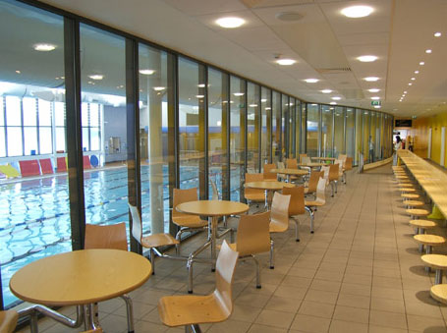
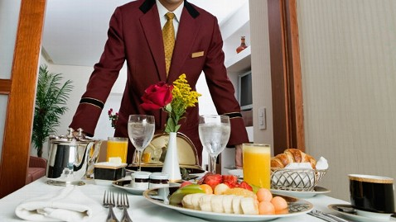
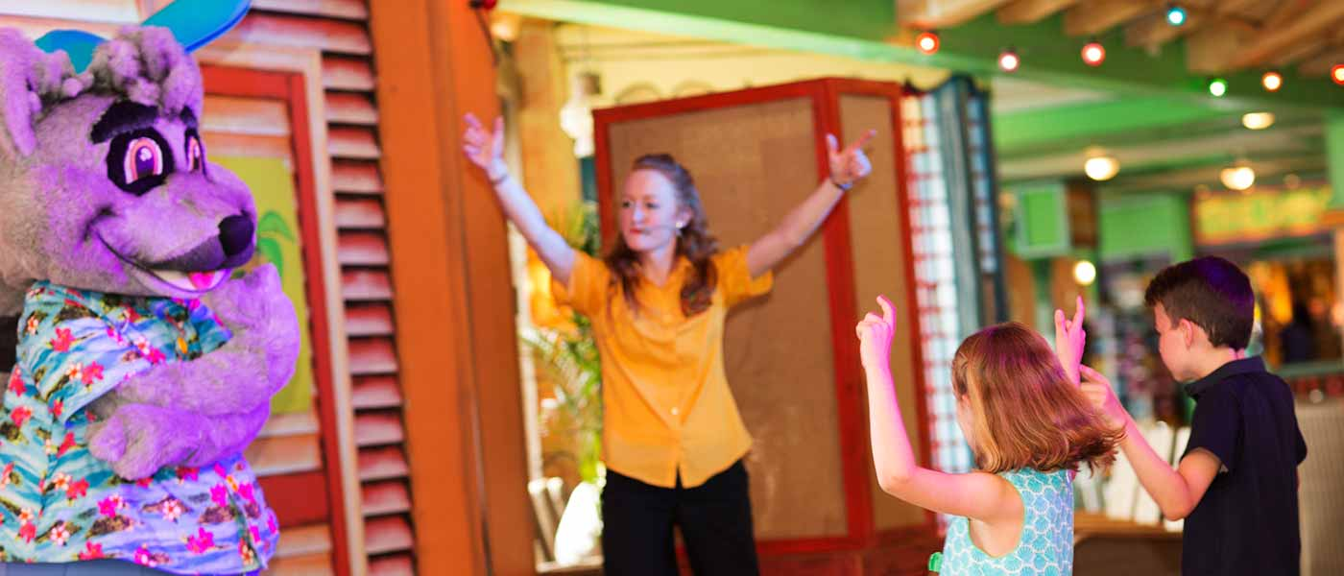
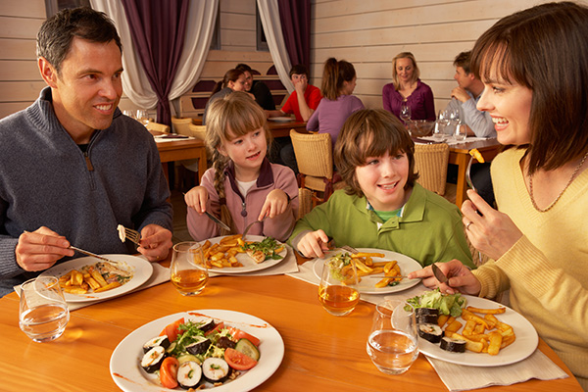
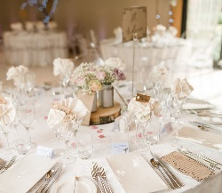
2
Types of Service Provided
2
Client Groups
You should be able to identify the range of services offered by the hospitality industry. REMEMBER, hospitality is not just about hotels and restaurants. There are many other services an establishment can provide other than bedrooms and meals.
Other services a hotel may offer include:
Meals – breakfast, lunch, dinner, snacks
Specialist menus for weddings or special occasions
Meeting rooms for business people to hold corporate events
Leisure facilities such as pools, spas, beauty treatments, play areas, gyms, tennis/football courts
Childcare facilities such as kids clubs, crèche/nanny services
Entertainment especially in hotel resorts for tourists
Laundry service often used by business guests for suits
Room Service meals/beverages brought to the room cooked to order, tea and coffee in the room
Business
Business guests/clients/ customers will use the hospitality industry for a number of reasons: Meetings some companies will hire corporate rooms in hotels or book restaurants to hold important meetings away from the office.
Advertising Events that promote the company.
Charity Events to raise awareness/money.
Impress Clients the business might ‘wine and dine’ potential clients to get their business.
Networking these are events where similar business meet up to share ideas or meet new staff.
Staff Training some businesses may send staff on courses that are far away that can last a few hours to a few days. The staff would need accommodation and meals provided if so.
Staff Parties at times such as Christmas or to celebrate a new achievement.
Awards Ceremonies some companies award their staff and host a night with food, drinks and dancing to celebrate. Some examples are Saks (hairdressers) and EDF (energy company).
Private
Private functions need to meet the needs of an individual, the most common private event is a wedding:
Event Management the hotel or establishment will meet with the clients to discuss their needs. The clients will agree with the services offered and agree on the ‘quote’ (sum of money to be paid to hold the event). The establishment is then responsible for organising numerous parts of the event, including:
•Room Décor
•Menu
•Seating Plans •Table Plan
•Table Décor
•Room Set Up, e.g. dance floor, table positioning, aisle
Other services the establishment might offer are:
•Wedding Organiser for the day (Master of Ceremonies) •Complimentary Champagne •Accommodation for the bride and groom before and after the wedding
•Transportation
•Wedding Cake •Wedding Stationery
Leisure
Some guests may only visit an establishment to use its facilities, these are often referred to as ‘users’.
Hotels that have leisure facilities such as a gym, pool, sauna, steam room and spa may offer discounted memberships to local residents. This ensures the establishment is busy all year round and not just when hotel guests are booked in, which means more money going into the business.
Key Words
Corporate – a large company or group
Networking - to meet and share ideas with people
Event Management – organising of large events such as festivals, conferences, ceremonies, weddings, formal parties, concerts, or conventions.
Advertising – to promote or make people aware
Families
Families may visit establishments for meals together or hire venues for special occasions such as birthdays. They may use the crèche facilities at leisure centres or visit certain pubs/restaurants just because they have a play area. Popular chain restaurants that often have children’s menus and play areas are The Toby Carvery and Farmhouse Inns.

Slide 4
3
Job Roles
There are two areas in the hospitality industry, front of house and back of house. Front of house refers to any staff the customer may see, e.g. a receptionist. Back of house refers to staff the customer may not see, e.g. a chef.
Front of House Staff
Housekeeping Supervisor
Can also be called: Housekeeping Deputy, Facilities Duty Manager, Housekeeping Supervisor,
Housekeeping Deputy manager.
Salary: £13-17k per year
Head Receptionist
Can also be called: Reception Supervisor, Administrative Supervisor, Office Manager, Member, Services Manager, Front Desk Manager, Reception Manager.
Salary: £20-24k per year
Restaurant Manager
Can also be called: Food Service Supervisor, Food Service Director, Food Service Manager,
Supervisor of Food and Nutrition Services, Cafeteria Manager, Fast Food Manager, General Manager, Assistant Restaurant Manager, Assistant Unit Manager, Assistant Manager, Catering Manager, Catering Supervisor, Front of House Manager, Pub and Restaurant Manager. Salary: £16-30k per year
Cleaner
Can also be called: Caretaker, Janitor. Salary: £11-14k per year
Front Office Manager
Can also be called: Front of House Manager, Front Desk Manager, Director of Front Office, Hotel
Manager, Bed and Breakfast Innkeeper. Salary: £22-28k per year
Head Waiter
Can also be called: Chef De Rang, Restaurant Supervisor, Maitre d'Hotel, Assistant Restaurant
Manager. Salary: £14-25k per year
Bar Manager
Can also be called: Bar Supervisor, Bar Duty Manager, Beverage Manager, Trainee Assistant Manager, Team Leader, Pub Manager, Pub Landlord. Salary: £20-35k per year
Owner
Can also be called: Business Owner, Operator, Proprietor, Patron, Landlord. Salary: £30-200k per year
Room Attendant
Can also be called: Housekeeper, Environmental Services Worker, Housekeeping Laundry Worker, Environmental Services Aide, Housekeeping Aide, Cottage Attendant, Room Cleaner. Salary: £11+k per year
Conference & Banqueting Manager
Can also be called: Conference Services Manager, Catering Manager, Convention Services Manager (CSM), Conference Planner, Director of Conference Services, Conference Manager, Conference Planning Manager, Event Manager, Catering and Convention Services Coordinator, Catering and Convention Services Manager. Salary: £22-35k per year
Front of House Manager
Can also be called: Front Office Manager, Front Desk Manager, Director of Front Office, Hotel
Manager, Bed and Breakfast Innkeeper, Customer Services Manager, Front of House Supervisor. Salary: £26-33k per year
Porter
Can also be called: Concierge, Bellman, Bell Captain, Bellhop, Bellperson, Bell Staff, Bellman
Driver, Bellstaff, Valet, Doorman.
Salary: £11-15k per year
Waiter
Can also be called: Table Server, Table tender, Food Service Assistant, Floor Tender, Waitress. Salary: £12-16k per year
General Manager
Can also be called: Operations Manager, Director of Operations, Area Manager, Store Manager,
Chief Operating Officer (COO), Chief Operations Officer, Resort Director, Unit Manager,
Restaurant Manager, Attractions Manager. Salary: £21-55k per year
General Manager
Can also be called: Operations Manager, Director of Operations, Area Manager, Store Manager, Chief Operating Officer (COO), Chief Operations Officer, Resort Director, Unit Manager, Restaurant Manager, Attractions Manager. Salary: £21-55k per year
Receptionist
Can also be called: Receptionist, Administrative, Assistant, Secretary, Community Liaison,
Member Service Representative, Office Assistant, File Clerk, Front Desk Receptionist, Greeter.
Salary: £12-18k per year
Bar Person
Can also be called: Bar Tender, Bar Keeper, Bar Server, Drinks Server, Bar Maid, Bar Man, Bar Back. Salary: £11-20k per year

Slide 5
3
Job Roles
For those in less senior roles, there are many opportunities to take on new responsibilities and develop supervisory skills or team management skills.
Transferable skills such as these provide excellent experience which can be used in almost any other industry.
Customer service skills are very important in public facing roles such as waiting staff or bar staff.
Building experience in dealing with customers, especially conflict management, is a skill sought after in many other industries where staff deal with the public on a daily basis.
There is always the opportunity for trainee/newly qualified chefs, waiters and receptionists to move up the employment ladder and become assistant managers. Assistant managers can then move up to a full management position.
To succeed in the industry staff need lots of experience so there are always opportunities to learn and develop in each role.
Back of House Staff
EXECUTIVE CHEF
Kitchen Brigade
CHEF DE CUISINE
SOUS CHEF
SAUCIER
RÔTISSEUR
POISSONIER
ENTREMÉTIER
GARDE MANGER
PÂTISSEUR
COMMIS
STAGIARE
PLONGEUR or ESCUELERIE
Employment and Opportunities
Chef
Can also be called: Food Service Supervisor, Kitchen Manager, Executive Chef, Dietary
Manager, Dietary Supervisor, Food Service Director, Food Service Manager, Restaurant Manager, Supervisor of Food and Nutrition Services, Cafeteria Manager. Salary: £15-20k per year
Full time No specific number of hours that makes someone either full or part time, but a full time worker usually works more than 35 hours. The law says that workers don’t usually have to work more than 48 hours a week on average, unless they choose to. This law is sometimes called the ‘working time directive’ or ‘working time regulations’.
Occupations in the UK Hospitality Industry | Number of people employed
Hotel & accommodation managers | 57,700
Conference & exhibition managers | 23,700
Restaurant & catering managers | 148,200
Publicans & managers of licensed premises | 46,900
Chefs, cooks | 255,100
Kitchen & catering assistants | 394,600
Waiters, waitresses | 222,200
Bar staff | 197,800
Many people choose work in the industry as it offers opportunity to work on a part time basis.
This often appeals to women returning to work after bringing up children or people who have other commitments which prevent them from taking on a full time position.
The industry also has a large number of migrant workers. Employers are often willing to take on hard working migrant workers even if they don’t always have particularly good English language skills. Many migrant workers therefore take this opportunity to earn money and, as their language skills improve, progress up through the organisation they’re working for. Some people take on work in the industry on a temporary basis. Employers, however, prefer to take on staff they know will stay for a prolonged period. There is therefore considerable opportunity to progress very quickly in the industry for the ambitious and committed worker.
Senior/Sous Chef
Can also be called: Sous Chef, Kitchen Supervisor, Head Cook, Senior Cook, Second Chef. Salary: £17-28k per year
Part time Part-time work is when a worker is contracted for anything less than the basic full-time hours. There are no set number of hours that makes someone full or part-time, however average part-time contracts are often 16-20 hours.
Section Chef Can also be called: Chef de Partie, Saucier, Patisseur, Poissonier, Rotisseur, Entremetier, Garde Manger. Salary: £14-18k per year
Junior/ Commis Chef
Can also be called: Commis Chef, Trainee Cook, Trainee Chef, Apprentice Chef, Food
Preparation Assistant. Salary: £10-16k per year
Casual Casual workers are hired on an irregular basis for a short period of time (no more than 12 weeks). There is no continuing commitment from the employer to offer work, and no obligation on the part of the casual worker to do the work offered.
The five most common skills employers would like applicants to have are:
1. Technical, practical or job specific skills
2. Customer handling skills
3. Team working skills
4. Oral communication skills
5. Problem solving skills
Key Words
Employment – having paid work
Skills – to train to do a particular task
Qualities – characteristics people have
Contract – a written agreement (legal document)
Salary – payment, wages, money for working

Slide 6
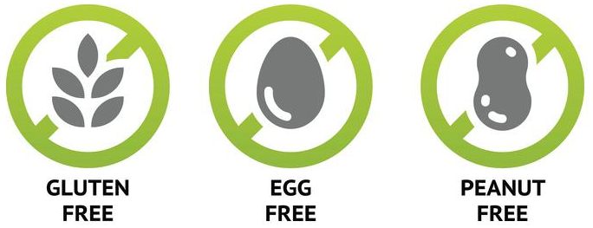
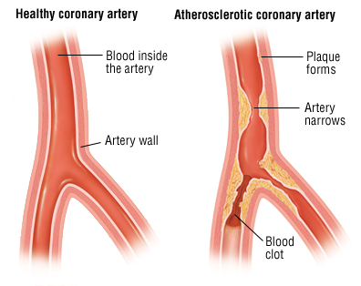
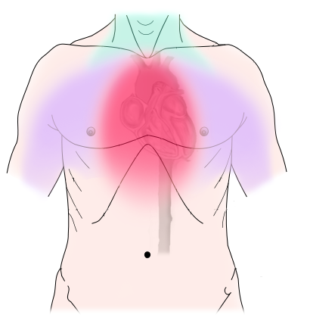
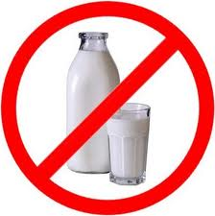
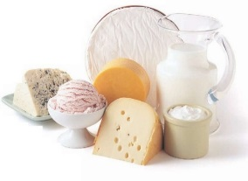
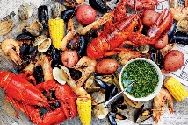
4
Menu Planning: Medical, Ethical and Religious Diets
Menu Planning is an essential part of the hospitality industry. Chefs, restaurant managers, establishment owners must plan menus to meet the needs of a wide range of people, as we are not all the same. Below are some of the factors a menu planner MUST consider:
Allergies
Some people may develop an allergy to peanuts or to the gluten in wheat. If they eat foods containing these, they may become very ill, and possibly die.
The 8 most common food allergies include:
Cow’s milk, Eggs, Tree Nuts, Peanuts, Shellfish, Wheat, Soy and Fish.
You can alert customers of allergies by printing information on your menus. In UK we use recognisable logos for nut, lactose and gluten containing products to make it easier for the customer to make an informed choice. Servers should also be knowledgeable to answer any guest queries on allergens.
Some people may choose or be advised to eat a low saturated fat (often comes from animal fats such as meat and butter) diet for health reasons:
Coronary Heart Disease (CHD) is a build up of fatty deposits in the coronary arteries.
Coeliac Disease
This is intolerance to gluten which is found in wheat, rye and barley. Coeliacs cannot absorb nutrients if they eat gluten. Corn rice and potatoes do not contain gluten. You can also buy special gluten free products in most shops.
High Blood Cholesterol is high level of cholesterol in the blood.
Symptoms can occur anywhere from a few minutes after exposure to a few hours later, and they may include some of the following:
Swelling of the tongue, mouth or face, Difficulty breathing, Low blood pressure, Vomiting, Diarrhea, Hives, Itchy rash.
High Blood Pressure (BP) is higher force than normal pushing against the artery walls (caused by having fatty deposits in the arteries which narrows the artery, increasing the force against the walls).
Lactose Intolerance
Can’t digest lactose (because they don’t produce the lactase enzyme). Milk, milkshakes and other milk-based beverages, whipping cream and coffee creamer, ice cream, cheese, butter, puddings, custards, cream soups, cream sauces, foods made with milk.
Cow’s Milk Allergy
Foods found in:
Milk, Milk powder, Cheese, Butter, Margarine, Yogurt, Cream, Ice Cream
Religious Diets
Muslim Diet: Do not eat pork . Only eat Halal meat (which is killed in the same way as Kosher). Sea food without fins or scales (such as crabs, prawns and squids) considered undesirable by some Muslims. Muslims also avoid alcohol.
Jewish Diet (Judaism): Do not eat shell fish or pork. They do not eat dairy and meat in the same meal (this is because they do not eat mother and child together – so you can not have chicken and egg together or milk and beef). They only eat Kosher meats (where the blood is drained from the body through a slit in the throat before the meat is soaked or salted). Kosher houses should have different sinks for dairy and meat along with different plates, cutlery and utensils: this is taken very seriously within the Jewish religion.
Hindu Diet (Hinduism): Do not eat beef or any beef product – this is because the cow is a sacred animal and is treated as such, this includes the use of leather for clothes and furniture. Milk is permitted as no animal is killed during the collection. Often vegetarian, which comes from the principle of Ahimsa (not harming). Most Hindus don’t drink alcohol.
Ethical Diets
Some people avoid meat due to environmental issues or health risks. Some people avoid beef due to concerns over BSE. Some avoid chicken and turkey due to the bird flu issues. Some people avoid fish due to the overfishing. Or prawns because this fishing is very energy expensive and wasteful. Producing unnecessary greenhouse gases. Some people just don’t like the thought of harming animals.
Types of Vegetarian:
Vegetarians: Do not eat meat or fish.
Lacto-vegetarians: Do not eat the flesh of any animal but they will eat eggs, milk, cheese, honey etc.
Vegans: Do not eat any animal products (including honey).
Pescetarians: Do not eat chicken or red meat but do eat fish.
Demi or Semi Vegetarians: Often choose to eat a mainly vegetarian diet because they don’t eat red meat. They sometimes eat poultry and fish and eggs, milk and cheese.
Nut Allergy
Foods found in:
Brazil nuts, Almonds, Cashews
Macadamia nuts, Pistachios
Pine nuts, Walnuts
Seafood Allergy
Foods found in:
Shrimp, Prawns, Crayfish, Lobster, Squid, Scallops

Slide 7
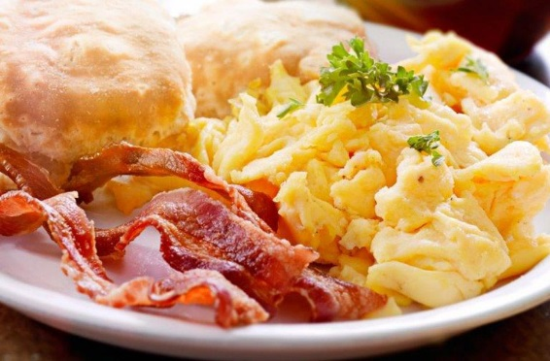
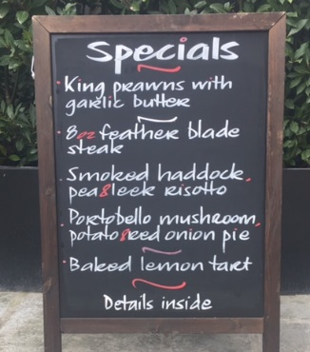
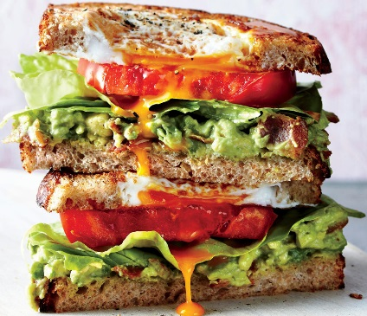
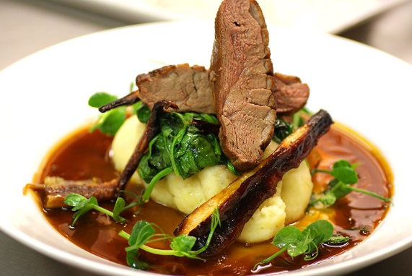
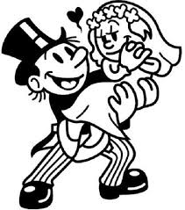
4
Menu Planning: Occasions and Types of Menu
Different occasions suit different types of menu. For example, if you go to a wedding you would expect a sit down meal, often silver service. If you go to a party you would probably expect a buffet. Most importantly, the style of service, menu and event needs to suit what the customer wants.
Besides the nutritional, medical, ethical or religious dietary needs, we looked at (overleaf) you should also consider:
Time of year, weather, types of customer, time available, price, portion control, ability of the cook, ability of the waiting staff, equipment available (for preparation, serving, cooking), balance (colour, flavour, texture, shape, variety of ingredients), presentation.
Children's Menus
Should be fun and include healthy alternatives to children's favourites, e.g. potato wedges instead of chips. Children could have more choice by offering smaller portions of main meal dishes from the adult menu. Children’s menus should not be excessively high in fat, salt and sugar and demonstrate smaller portion sizes.
Breakfast
Breakfasts usually offer a choice of hot (bacon, egg, sausage, tomato etc.) and cold continental (rolls, croissants, cheese, cold meats, fruits and yoghurts). Hot and cold drinks and a tasty selection of preserves are also often offered.
Specials
Many restaurants have ‘specials boards’, which is a good way of adding seasonal dishes to the menu.
Lunch Often needs to be served quickly for customers who have limited time. Sandwiches, wraps and baguettes are ideal. An ideal menu will offer a variety of breads with a selection of hot and cold fillings, together with snack items such as jacket potatoes, salads, pastries, cakes and muffins.
Evening meal Vegetarian and healthy choices should be offered as well as dishes using a variety of cooking methods. In the UK, the most popular menus offer hot and cold starters, a variety of main courses and a selection of desserts that include chocolate and fruit.
Menu Types: Key Terminology
Special Events
Table d’hôte or set-price menu A fixed or set-price menu with a limited selection of dishes for every course.
Ethnic or Speciality menu Can be fixed price or á la carte. Some offer dishes from particular countries, e.g. China, Italy. Others offer specialised food, e.g. fish or vegetarian dishes.
One of the most common functions/events in the hospitality industry are weddings. Weddings are a great example of where customer needs need to be closely followed. This is the biggest day of the bride and grooms’ life and is often very expensive. Therefore accuracy and attention to detail is very important. It is often the event manager’s job to liaise (discuss with) with the client, take notes of what the bride and groom would like then contact suppliers/event staff to make the big day happen. The event manager must price up the service and get a deposit from the couple before work begins, to make sure the establishment does not lose money if the day gets cancelled – it happens more often than you think!
A la Carte menu All dishes are individually priced.
Fast-Food menu This is similar to a speciality menu. Food tends to have ‘themes’ such as burgers, chicken or baked potatoes. Items are priced individually.
Rotating menu cycle Often used in primary schools. A fixed pattern of menus is used to cover a fixed number of days. The minimum number of days is eight, so that menus are never repeated on the same day each week.
Party or Function menu Usually a fixed-price menu offered for parties or functions such as wedding receptions. Some party's menus offer a limited choice.

Slide 8
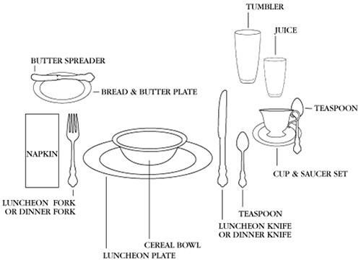
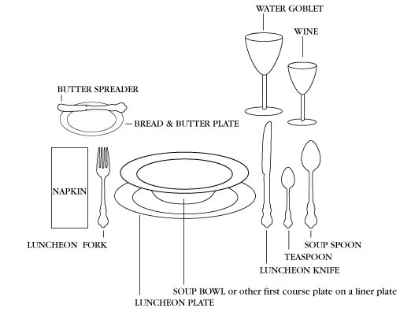
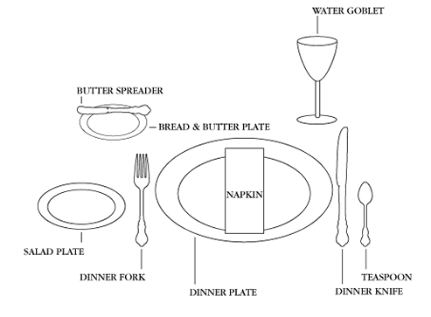
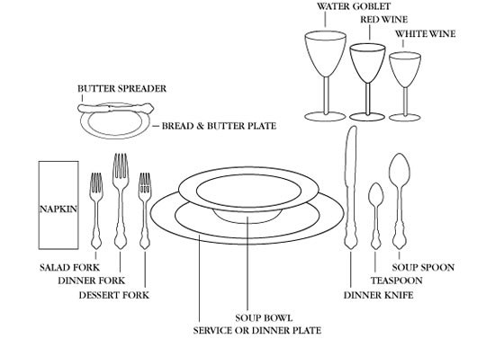
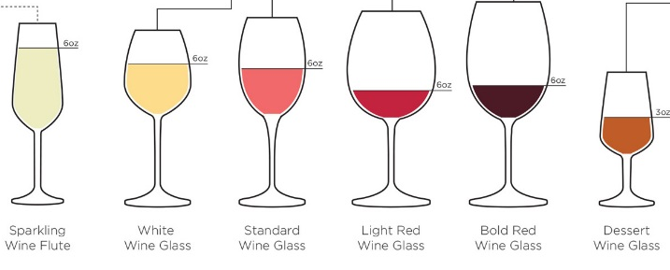
4
Menu Planning: Presentation
Different types of meal and service require setting up differently, however, some things stay the same. The fork is always placed to the guest’s left, the knife to the right with the blade facing the plate. Bread plates go to the left with cups and glasses on the guest’s right. Meals such as lunch and dinner may involve more than one course and therefore more plates, cutlery and glasses may be required. There is often more than one type of glass as guests should have a choice between water and wine.
Breakfast: Hotel breakfasts can be hot or cold, therefore plates and bowls are necessary. A cup and saucer to serve tea and coffee as well as multiple cutlery for the different types of food served, e.g. spoons for cereal and fruit. Tumblers/glasses for water and juice are also available as everyone may not drink tea or coffee.
Lunch A lunch service may offer a starter, therefore a bowl for this course may be set as well as a spoon. Wine glasses are featured as some guest may drink wine with their lunch, these were not featured on the breakfast set up as it is unlikely guests will drink alcohol with breakfast.
Family Dinner A family dinner set up is less formal and therefore there are likely to be less courses, therefore less crockery/cutlery. A bread and butter is placed as soup may be served (accompanied by bread) as a starter or main course. Again, wine glasses are set as meals are often paired with white, red and rosé wines depending on the meat usually.
Formal Dinner a formal dinner involves a lot more cutlery and crockery as there are likely to be multiple courses, especially at an event such as a wedding. There will be different cutlery for starter, main and dessert. A dessert fork would be used for pastries and cakes. There will be multiple glass styles for different drinks, white and red wine are served in different shaped glasses (see explanation at the bottom of this page). There will be enough cutlery for at least 3 courses, more would be brought out with the meal if there were more than 3 courses to save space on the table.
Buffet Buffets can be served multiple ways, the important thing is that guests can move around the buffet area easily and quickly to limit queuing. Food should be served at different heights and on different plates to show the difference in choices. Hot food must be kept hot (usually in a bain marie) and cold food should not be left out longer than 90 mins. Cutlery and plates should be accessible by guests.
Typically red wine glasses will be a bit taller and have a larger bowl than white wine glasses. In general reds are bigger and bolder wines so they require a larger glass to allow all those aromas and flavours to emerge.

Slide 9
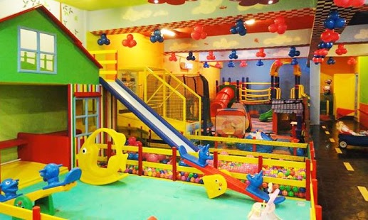
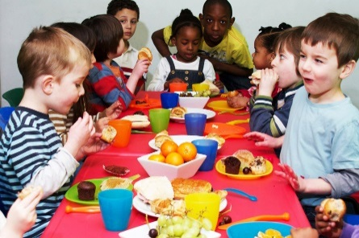
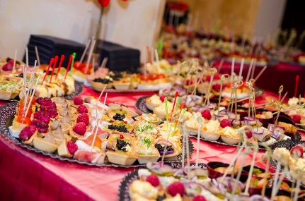
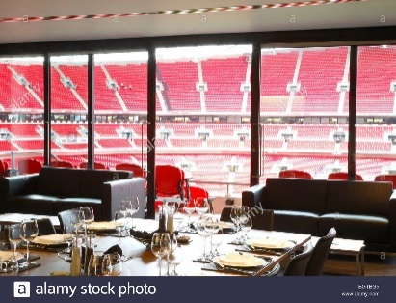
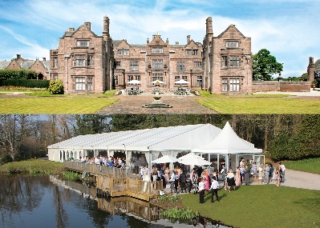
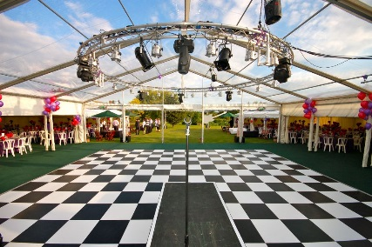
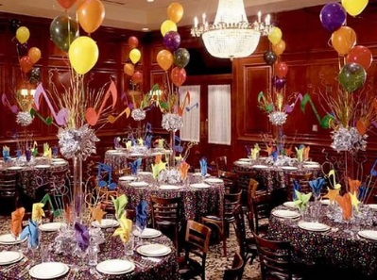
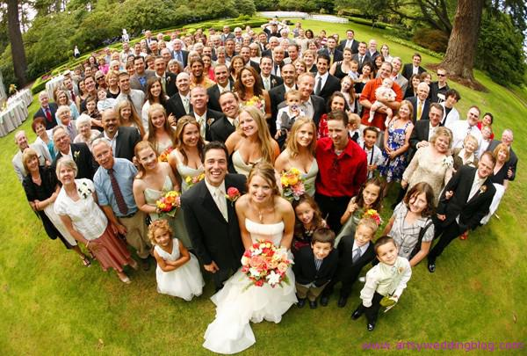
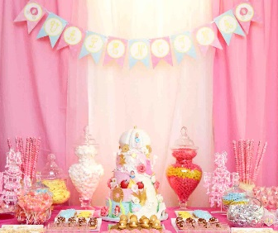
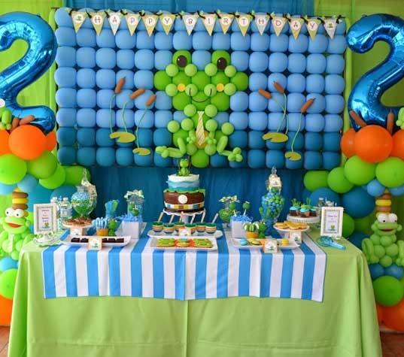
5
Planning for Functions and Events
When an event manager plans an event you must consider the following factors:
Type of function/event
Date and time
Choice of venue
Number of guests
Menu and type of service
Promotion/advertising
Décor and presentation
Room layout/table layout
Menu cards/place cards
Risk Assessment
Type of function: The most important factor to consider is what type of event are you planning? Common functions/events in the hospitality industry are: weddings, charity fundraisers, school proms, awards nights (the Oscars), business networking, opening of a new business, staff Christmas party, christenings, birthdays, confirmations, bar mitzvah, sporting events e.g. football hospitality (private boxes), horse racing (The Grand National). The event may have to suit the theme, sports club, company or brand, for example Newcastle Utd wouldn’t have red and white room décor! If the event is a special occasion/luxury a silver service may be expected, however work parties and discos may only require a buffet service. The type and purpose of the event will determine every other factor and decision.
Date: Time of year, e.g. Christmas, Easter, Summer, Spring. The time of year might have an impact on the theme you choose or ingredients that are in season. The date may be specific to the client, e.g. a wedding day, date of the school prom, that cannot be changed. Time: Morning = Breakfast Dishes such as cooked breakfast (Full English), light snacks, fruit, pastries, Danishes, yoghurt. Daytime = Lunch/Snacks such as sandwiches, baked potatoes, wraps, salads, pasta dishes.
Evening = 2 or 3 course dinner, starters, mains, desserts, vegetarian options. The time may dictate the type of food you serve or style of service, e.g. in the evening guests would not expect a breakfast course, in the morning guests probably don’t expect a 3 course meal. If you are asked to plan a menu in the exam remember to think about the time of day or year!
Soft Play Areas
Corporate Meeting Rooms
Sports Arenas
Stately Homes
Outdoor Marquee
Restaurants
Venues Once the event planner knows what type of event is planned, they can then decide a venue, or be told where the event will take place by the client. Children's’ parties may take place at a soft play area, whereas an adult’s party may take place at a restaurant. These are called ‘private functions’ and often don’t require an event planner, family members of friends are more likely to organise these. Larger events such as weddings and charity events require an event planner. 5* hotels usually offer their own wedding/event planning and management service. The advantage to the customer is that the event planner is probably very experienced at their job and has many contacts for different things such as decorations, food and entertainment. It also makes it less stressful for the customer, knowing an expert is taking care of their needs. Above are some different venue types used for functions and events. Think about whether an event planner would be needed at each?
Number of Guests The number of guests is VERY important! The event planner/manager needs to make sure that if 60 guests are expected, 60 guests are catered for, plus some extra in case people turn up unexpectedly. A wedding is a great example of where the number of guests must be correct, as the cost per person is often expensive (around £70 per guest)! If an event expected lots of guests (over 200) the event manager may suggest serving a buffet as a 3 course meal for over 200 people may be time consuming (unless there is a large number of chefs and wait staff employed for the event). All these things must be considered so the event runs smoothly and everyone is catered for.
Advertising Public events need to be advertised in order to sell tickets. The cost of the ticket and number of tickets available will have been carefully calculated by a sales or budget manager. The ticket price will need to cover the cost of any food, entertainment or prizes at the event so the event organisers do not lose money. Charity functions usually take a percentage of the ticket sales money as donations. There are many mays to advertise, the most common today is via social media, Facebook, Instagram, Twitter as well as company websites. Printed advertising is usually leaflets, flyers and posters.
DécorThe room décor must match the theme/style of the event also. A child’s birthday party should be bright and colourful, perhaps with a theme from a popular kids’ TV show. A wedding may have a certain colour scheme that is carried through the table and chair decorations. A well decorated room gives an impression of quality, remember, first impressions count! If you are asked in the exam to consider the factors when planning a child’s party don’t forget to mention how the room should look.

Slide 10
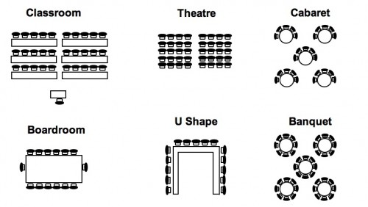
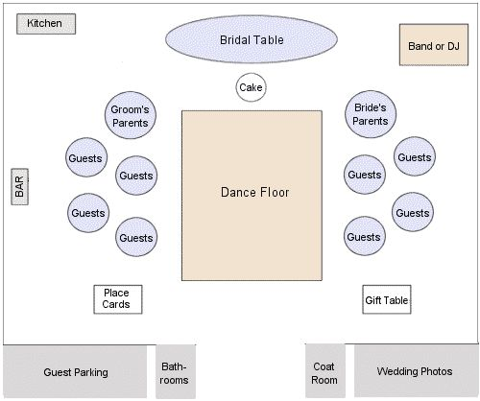
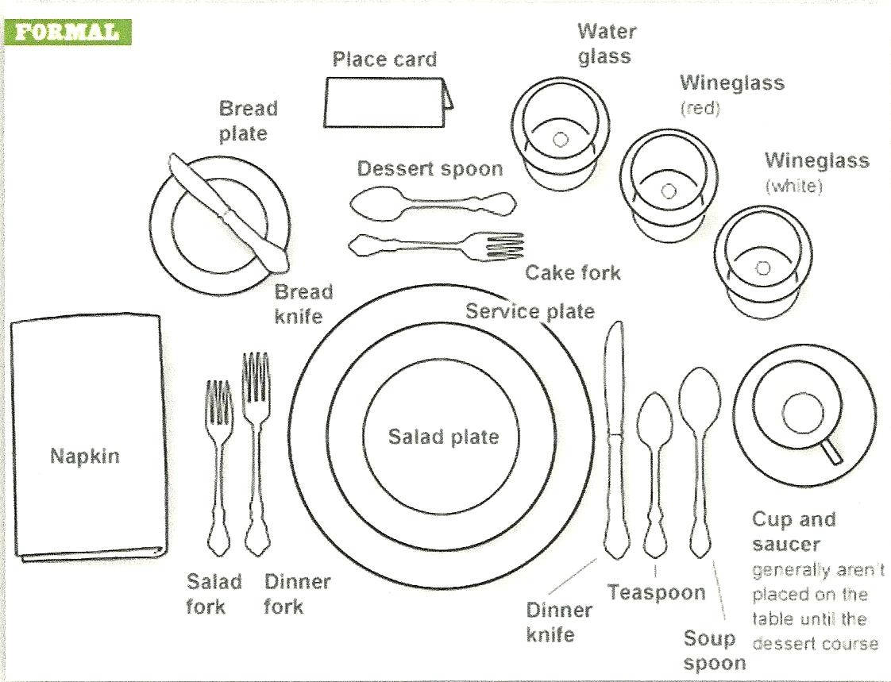
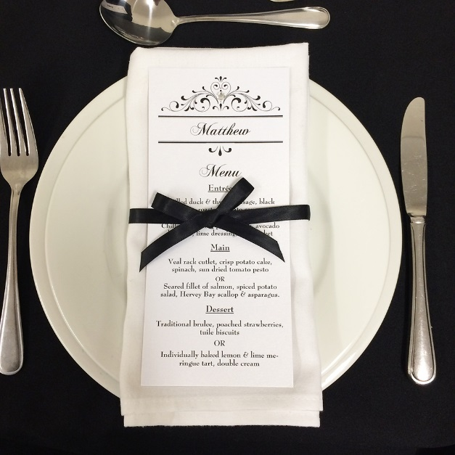
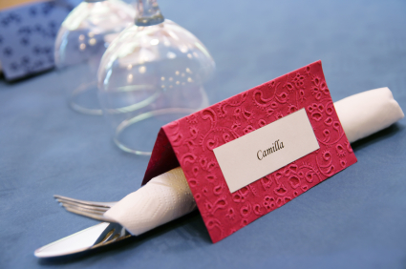
5
Planning for Functions and Events
Example wedding room layout
When an event manager plans an event you must consider the following factors:
Type of function/event
Date and time
Choice of venue
Number of guests
Menu and type of service
Promotion/advertising
Décor and presentation
Room layout/table layout
Menu cards/place cards
Risk Assessment
Room Layout The room layout depends on the type of event and the number of guests attending. A wedding may use a banquet style room layout with guests sat together in a seating plan. For an event where there may be entertainment a cabaret style may be more appropriate so all the guests can see the stage. A corporate meeting may require a boardroom or U shape layout.
Table Layout The diagram (left) is a formal table set up, Use your revision mat 4 Menu Planning Presentation, to look at other ways of setting tables. If you are asked a function planning question in the exam, don’t forget about the table. What should be on it? Why? Does the table need to look formal or informal (think about the type of meal being served)? Is it a formal wedding with silver service or an informal buffet at a birthday party?
Pirates Cove Party Room Risk Assessment
Example Menu and Place Cards These let guests know where to sit and what is on the menu.
What are the hazards? | Who might be harmed and how? | What are you already doing? | What further action is necessary? | Action by whom? | Action by when?
Parties, Party Room | Customers Potential incidents such as cuts, bruises, burns fractures, child security could occur if parties are not managed correctly. | Only staff trained to carry out parties can do so. During training staff are made aware of all the safety issues that require adhering too to ensure a safe party. Parents made aware of rules and regulations surrounding parties in party paper leaflets prior to parties. Depending on numbers at the party correct staff levels must be in place. Manager to ensure any photography is part of a party. Whoever is taking the photographs/videoing is to be instructed to be careful they do not linger on the activity of children or adults outside of that party. Pirates Cove staff to use and control secret passageway. Staff and parents to supervise the stairs leading to party room. Children do get excited when returning to the play area, so do stay on your toes BE ALERT. We advice the parent of the birthday child to obtain telephone numbers of any unaccompanied children in the unlikely event in an emergency. | No more action required. | Duty Manager to monitor. Supervisor All staff | Already in place and ongoing/.

Slide 11
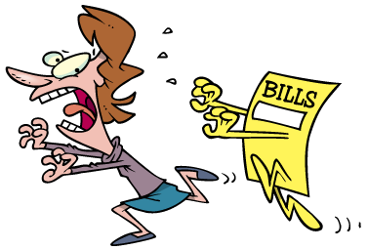
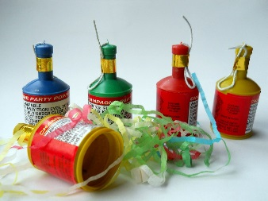
6
Costs Menus and Events
To have a successful business, you need to make a profit! There are many different costs you need to consider to run a business.
These different costs can be split into 3 categories: Material Costs, Labour Costs and Overheads.
Fixed costs are those that stay the same, e.g. rent, insurance, energy, rates
Variable costs are those that can change, e.g. wages, food costs, drink, tax.
Fixed Expenses Insurance, Taxes, Rent/Rates Staff wages (also called labour costs) Advertising
Material Costs Food, drinks, recipe ingredients, printer paper, from decorations e.g. balloons and table covers, party poppers, napkins.
Room Expenses Newspapers Guest stationary Tea/Coffee Toiletries Flowers Hangers Complimentary sweets
Linen Expenses Towels Facecloths Dry cleaning Bed linen
Food Expenses Ingredients Storage equipment Cooking equipment Crockery Cutlery Glasses
Cleaning Expenses Cleaning cloths/mops Cleaning chemicals Dusters
Dustpans
Buckets Bin bags Vacuum cleaners Other equipment
Energy Gas Electricity Water
Printing Expenses Manuals Guides Maps Signage Desk pads Stationery Envelopes Room cards Admin forms
Transport Expenses Limousines Town Cars Transport services (mini bus) Petrol/Diesel
Labour Costs Staff salaries (wages) – staff who are regular workers at an establishment or on a permanent or fixed term contract will have a set wage they are paid each month. Examples of this type of staff are: chefs, waiters, managers, receptionists, chamber maids, cleaners, janitors, porters, concierge, sales staff, event planners/managers.
Key Words
Capital - wealth in the form of money or other assets owned by a person or business that can be used to buy things necessary for the business to run (be maintained) or grow.
V.A.T - or Value Add Tax, is a tax that is charged to all businesses.
Profit - amount of money earned after costs have been deducted.
Overheads – a cost or an expense, e.g. electricity, gas, water, staff wages, food costs such as ingredients, phone/internet bills, drinks e.g. wine, beer, lager, spirits, tea and coffee.
Labour Costs Establishments may have to hire in staff for one off or specialist jobs such as: builders, plumbers, electricians, painters and decorators, contract caterers, pest control, line cleaners (for the bar).

Slide 12
6
Costs Menus and Events: Calculations
Food costs are large percentage of costs for most hospitality businesses. When planning menus chefs must calculate how much dishes will cost per portion to be able to justify keeping it on the menu. Expensive dishes that are not ordered often may lead to wasted ingredients that are unused, which result in less profit. Chef’s must design dishes that generate a profit to stay operational.
VAT (or Value Add Tax) VAT is currently 20%
To work out a price including the standard rate of VAT (20%), multiply the price excluding VAT by 1.2 e.g. £300 x 1.2 = £360.
Try the following calculations:
Add VAT to £50
Add VAT to £75
Add VAT to £6.40
If a dish costs £4 to make, how much does it need to be sold for to make profit?
If a dish costs £12 to make, how much does it need to be sold for to make profit?
If a dish costs £23 to make, how much does it need to be sold for to make profit?
If a dish costs £20 on the menu, how much did it cost to make?
If a dish costs £30 on the menu, how much did it cost to make?
To work out the minimum cost per portion for the business to make a profit, businesses use the following formula.
Cost per portion x 100 ____________________ 40
The cost is sometimes rounded up or down so the number ends in a 5 or 0 making it easier to calculate a customer’s bill and calculate change, e.g. £20.50 instead of £20.47
Example: A dish costs £17.56 to make, to calculate the cost per portion you would:
£17.56 x 100 = 1,756
1,756 / 40 = £43.90
The dish would be advertised on the menu for £43.90

Slide 13
7
Customer Care
Good Customer Service Can:
• Boost repeat business
• Create demand from new customers
• Cut costs, such as marketing costs (attracting new customers is calculated to be five times more expensive than retaining existing ones)
• Motivate staff, encouraging them to work harder and stay with the company longer
• Provide an edge over competitors
• Encourage customers to pay more to be certain of receiving good service
• Lead to higher profits
• Win awards!
Poor Customer Service Can:
• Discourage customers from returning
• Encourage them to turn to competitors.
• Research shows that 68% of lost customers are dissatisfied about service
and attitude; only 14% are dissatisfied about the product.
Dealing with Complaints
• Listen with empathy
• Allow the customer to make their point (do not take things personally)
• Be supportive, apologise if necessary (this can diffuse the situation)
• Do not blame someone else (this looks unprofessional)
• Have a positive attitude
• Offer a solution
• Follow through on the situation
Quality Service is integral to securing repeat business and being successful.
Basic services that should always be of a high standard are:
who anticiCleanliness
Employees ability to respond to customer requests quickly
Employees pate customers’ needs
The above can be achieved with quality training and a good attitude/work ethic from the employee.
Service should be consistently high and not sporadic. Your business is only as good as your last visit. If guests feel standards have slipped they will move on.
Customer Care and Accessibility
In the UK, 1 in 5 people have a disability - this could be visual, hearing, motor or cognitive (affecting memory and thinking).
Accessibility is about making sure your service can be used by as many people as possible. Thinking about this from the beginning will help you:
make sure that nobody is excluded
find out earlier if any parts of your service aren’t accessible – problems
usually cost less to fix if you find them early
If you provide any sort of accommodation, serviced or self-catering, the Equality Act 2010 applies to you.
The Act gives people rights of access to goods, facilities and services (including tourist accommodation) and ensures that they are treated no less favourably than other customers.

Slide 14
7
Customer Care
Basic Customer Services Include:
1. Cleanliness: This is an absolute must. Hotels, regardless of stars, need to uphold the highest cleanliness standards, offering clean public spaces, bathrooms, bedrooms, and amenities. While it's an important initiative, recycling must not give way to a lack of hygiene.
2. Adequate safety/security: For many, a hotel functions as a home away from home. With that comes a hefty expectation for the most diligent safety and security measures. Many hotels now focus on providing personalized safety and security measures for different guest profiles such as women, children, and the elderly.
3. Internet: Guests at all types of hotels demand some level of Internet service, but business hotels especially must offer the highest level of connectivity and flexibility. At many hotels, if not all, guests expect Internet access to be complimentary—for some, free WiFi is as necessary as the air we breathe.
4. Comfortable beds: At the end of the day, a hotel serves a very basic need: It provides a place to rest your head, but only if the bed is of good quality, clean, well maintained, and well designed. It also needs to be well positioned in the room to allow proper circulation.
5. Bathroom plumbing: All guests should expect clear, potable water; proper and continuous hot running water in the shower; flowing water in the sink and toilet; and no leaks.
6. Lighting: Most don’t offer adequate lighting in the hotel rooms, from bathrooms to bedside lamps, and it's a hassle for guests across the board. Improved lighting serves to enhance the guestroom experience and provide a sense of security.
7. Aroma: Upon entering a hotel and the hotel room, the smell of the property has a major impact on a traveler's first impressions. Guests are often sensitive to newly created hotel "signature" scents or stale smells from carpets and bathrooms, which can influence the guest’s perception of the quality and cleanliness of a hotel.
8. Simple, tasty food: The availability of food and beverage outlets varies based on the hotel service level. However, certain things—such as a hot breakfast—are a basic offering that really adds to a guest experience. Even budget hotels could be conveniently located next to an all-day diner, which caters to hotel guests. Access to a convenient and affordable breakfast is turning from a plus to a must.
9. Check in/Check out: Nowadays, a front desk check-in and -out experience is constantly evolving—from pod check-ins to a personalized iPad check-in. While these advances are exciting, hotels need to stay focused on certain elements of a check-in/check-out process that really effect a guest stay.
No matter what the hotel, from a luxury Four Seasons to a budget Premier Inn, all guests should expect a warm welcome, a friendly face, attentive service, heartfelt thanks and know that the hotel is their ‘home away from home.’
Customers can leave feedback about the service they have received by review sites, such as Trip Advisor, directly by completing customer satisfaction questionnaires/forms or social media, such as Facebook.

Slide 15
8
Standards of Service
Michelin Guides are a series of guide books published by the French tire company Michelin for more than a century. The term normally refers to the annually published Michelin Red Guide, the oldest European hotel and restaurant reference guide, which awards Michelin stars for excellence to a select few establishments. The acquisition or loss of a star can have dramatic effects on the success of a restaurant.
Food Hygiene are the conditions and measures necessary to ensure the safety of food from production to consumption. Food can become contaminated at any point during slaughtering or harvesting, processing, storage, distribution, transportation and preparation. Lack of adequate food hygiene can lead to foodborne diseases and death of the consumer. This is NOT a measure of service but still an important factor that customers will consider before staying at or eating in an establishment.
Reviews can make or break a business! A good review can increase business for establishments, as people will often try an establishment based on a recommendation. Reviews and ratings generate publicity, awards get you in the press! Customers might come from further away to dine or stay or both based on reviews. Customers can identify less favourable establishments that they will then avoid.
A very good restaurant in its category
Excellent cooking, worth a detour
Exceptional cuisine, worth a special journey
Rosettes | Criteria
 | These restaurants will be achieving standards that standout in their local area, featuring: food prepared with care, understanding and skill good quality ingredients. Around 45% of restaurants/hotels with an AA Rosette have one Rosette.
 | The best local restaurants, which aim for and achieve: higher standards better consistency greater precision is apparent in the cooking obvious attention to the selection of quality ingredients. Around 45% of restaurants/hotels with an AA Rosette have two Rosettes.
 | Outstanding restaurants that achieve standards that demand national recognition well beyond their local area. The highest quality ingredients, seasoning and the judgment of flavour combinations will be excellent. Around 10% of the restaurants/hotels with an AA Rosette have three Rosettes and above.
 | Among the top restaurants in the UK where the cooking demands national recognition. These restaurants will exhibit: intense ambition, a passion for excellence, superb technical skills, remarkable consistency, an appreciation of culinary traditions combined with a passionate desire for further exploration and improvement. 42 restaurants in the Best Restaurants of Britain and Ireland guide have four Rosettes.
 | The pinnacle, where the cooking compares with the best in the world. These restaurants will have: highly individual voices exhibit breathtaking culinary skills and set the standards to which others aspire to, yet few achieve 15 restaurants in this guide have five Rosettes.
Rosette Award
First introduced in 1956, the AA’s Rosette Award scheme was the first UK-wide scheme for assessing the quality of food served by restaurants and hotels.

Slide 16
9
Communication and Teamwork
Effective teamwork will lead to a much better event. When people work together jobs are generally completed quicker and more efficiently. Saving time can usually save money and effort which is always important in running a successful business. As the hospitality industry is made up of so many different sectors, there can be many different teams having to communicate to create a successful event. E.g. the wait staff team and the chef brigade, both have to communicate and work with each other to make sure the right dishes go to different tables and on time .
How are teams organized (created)?
The team leader will: decide who works in the team
Decide what the team has to do
Take responsibility for the standard or work produced
Make sure current legislation (the law) is followed
Communication
Communication can be verbal (spoken) and non verbal (written). Communication can also be through the use of body language, e.g. someone who smiles and has an upright, open posture will appear competent and friendly. People communicate without realising by their body language, this is important for customer facing staff such as receptionists and waiters. People who slouch may appear disinterested, unprofessional and not confident. Someone with good posture appears more confident, friendly and approachable.
Stage 1
A task is set, everyone in the team will discuss the task and make sure everyone understands, e.g. the team has been asked to plan a menu for a school prom.
Stage 2
The team will discuss ideas, there may be some disagreement over the best option, e.g. the team may not be able to decide between a buffet or three course meal.
Types of Communication with Customers
Administrative procedures, e.g. filing and processing enquiries
Billing of customers – methods of payment
Booking systems – software, online, websites
Customer care – welcome, body language
ICT – databases, word processing, emails
Storage of data – Data Protection Act 1998
Stage 4
The team works together well and are able to plan for other problems, e.g. the team plan are able to plan a menu that will suit all dietary needs. Work is completed calmly and efficiently.
Stage 3
The team comes to an agreed decision and start to work together as a unit, e.g. the team decide to accept the majority decision and everyone works together to plan the best menu.
Good Teamwork
Team members communicate with each other.
Team members feel valued and can suggest ideas.
Team members share responsibility.
Tasks are carried out quickly.
Tasks are carried out effectively.
Team members are happy with their jobs.
Team members have high self-esteem.

Slide 17
9
Communication Tasks in the Hospitality Industry
Administrative Procedures
• Reservations
• Cancellations, changes to bookings
• Enquiries
• Communication with other departments, e.g. housekeeping
• Security e.g. lost property, room keys
• Check in/out
• Registration
• Gust Accounts
• Guest Services
• Admin – filing, updating records
• Customer care
• Answering phones/emails
Billing Customers
• Payment of the room
• Payment of services
• Food and beverages
• Mini bar usage
• Running a tab at the bar (when drinks/food are charged to the room, not paid for immediately)
• Usually recorded by a POS (point of sale) system, the total charges are given to the customer when they check out.
• Can also be recorded on paper or with till receipts in smaller hotels/guest houses who may not have this type of technology.
Booking Systems
Bookings can be taken by:
• Email • Phone • Online Booking Forms • In Person • Post
This is the first point of contact with the customer so needs to function well.
The details needed when booking are:
• Guest name and telephone number
• Date and time booking is needed
• Number of guests
• Special requests
• Dietary needs
Guests should be given a written confirmation of their booking, called a booking confirmation, to ensure the details are correct top prevent problems later.
Storage of Personal Data
The Data Protection Act 1998 requires all organisations that hold data about individuals on computerised systems to register with the Data Protection Registrar. Examples in hospitality include guest reservation systems, guest registration forms, guest history files and mailing lists.
The Act gives customers the right to:
• Be informed of where the data is being processed
• Have a description of all the details being held
• Know why the data is being used
• Know who has access to it
Front of house staff such as receptionists must be aware of their responsibilities under this Act as they are primarily responsible for guests’ security and protection of their data, such as bank details.
Customer Care
Staff appearance and the welcome guests receive is the first impression a customer has of an establishment.
• Good customer care is vital because:
• Guests feel welcome and cared for
• Guests leave good reviews
• More guests
• Guests come back (repeat custom)
• Staff will have higher self esteem
ICT Skills
ICT skills are becoming more and more important with the advancement of technology and social media. Lots of businesses go ‘paperless’ to benefit the environment, therefore more work is done online. Skills staff should have are:
• Good literacy skills (accurate spelling)
• Good communication skills for letter writing
• Good word-processing skills
• Accuracy when entering data on a database
Good understanding of software packages

Slide 18
10
Environmental Considerations
Establishments can Conserving Energy by:
• Having keycards in room s that only turn lights/electricity on when inserted
• Timers on heating
• Timers on air conditioning units
• Thermostats on heating and air conditioning units
• Advising guests on the establishment’s environmental policies
• Energy saving lightbulbs
• Installing modern toilets that flush less water
• Installing energy efficient equipment's, e.g. ovens and hobs in the kitchen
• Smaller kettles in guest rooms to prevent over filling and wasting energy
Establishments can Reduce, Reuse and Recycle by:
• Only issue newspapers if guests ask
• Refillable soap dispensers in bathrooms
• Reusing paper for notes and messages
• Only print out information that is necessary
• Send emails rather than printing
• Buy ingredients that are fresh
• Buy ingredients in less packaging (in bulk)
• Reuse large containers to store things
• Encourage guests to recycle
• Have recycling bins around the property
• Recycling glass, tins, cardboard and paper
• Reduce number of free items given out to guests, e.g. sewing kits
• Send food waste to local farms for feed
• Use vegetable peelings to make compost
Establishments can Conserving Water by:
• Use towels more than once
• Fit showers rather than baths
• Taps that disperse only short bursts of water
• Motion sensor taps
• Using washing up water to water gardens
• Water butt to catch rain water for gardening
• Only serve water on tables if guests request it
Why consider the Environment?
The hospitality industry contributes to much of the world’s total water and energy consumption as there are millions of establishments worldwide. It is important for establishments to act now and encourage guests to save water and energy as it tells guests the establishment (and industry as a whole) cares about the environment and in turn will give the establishment a good reputation.
Reduce – lowering the amount of waste produced
Reuse - using materials repeatedly
Recycle – using materials to make new products

