Slide 1
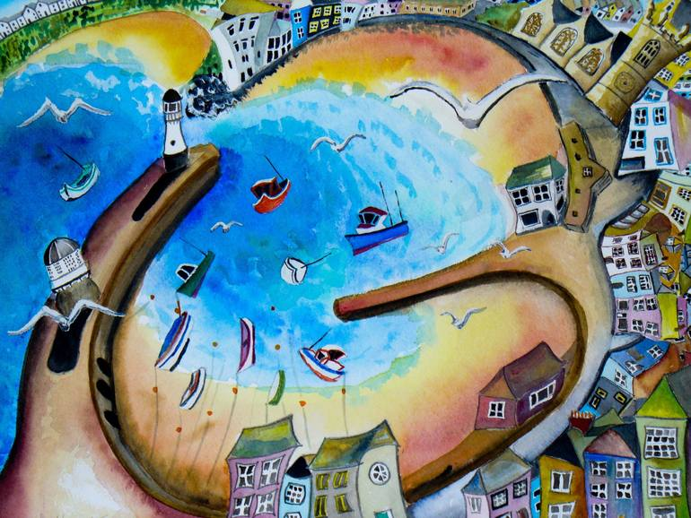
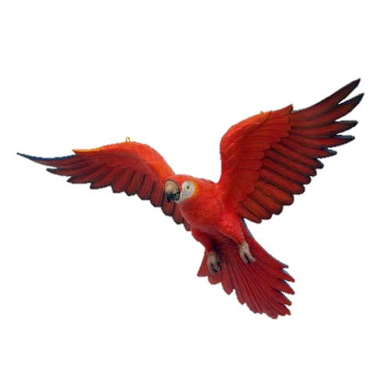
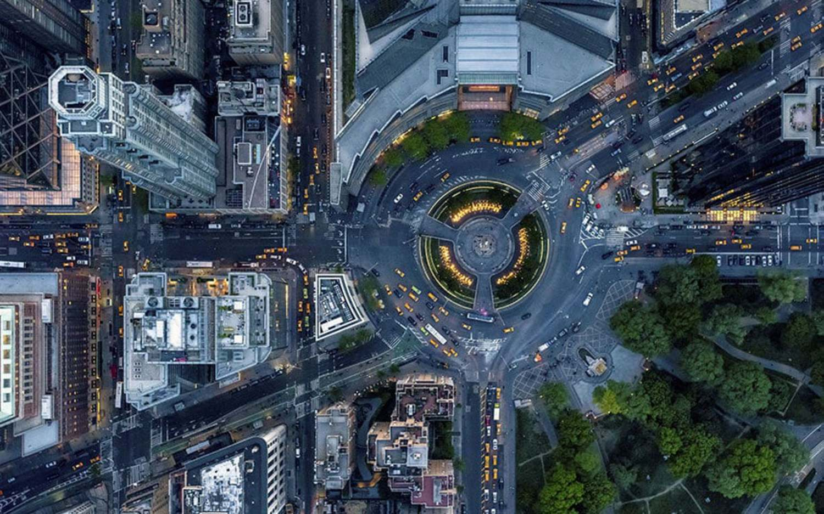
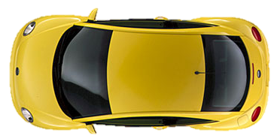
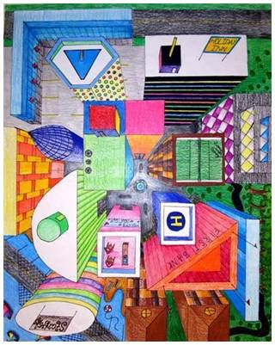
Knowledge Organiser – Year 8 – Birds Eye View
What is a Birds eye view?
Drawing from a birds eye view is looking at an object or scene from directly above. This provides us with the opportunity to work from a different perspective.
Key Vocabulary:
Plan view
Perspective
Tone
Depth
Scale
Students will develop skills in perspective drawing, building on their work from year 7. They will begin layering different materials to create effects developing their use of water colours and powder paints. They will be able to recognize different styles of artwork and be able to discuss them with confidence.

Slide 2
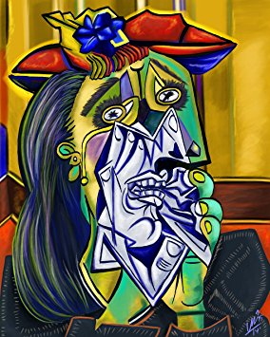
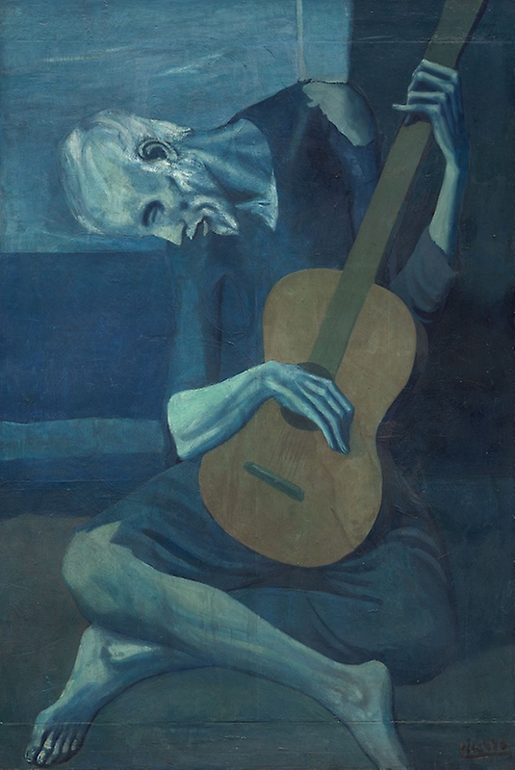
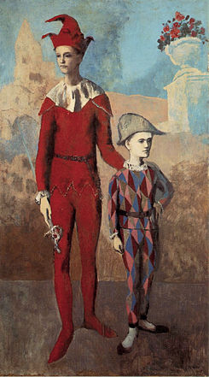
Knowledge Organiser- Year 8 - Picasso
Pablo Picasso was the most dominant and influential artist of the first half of the 20th century. Associated most of all with pioneering Cubism, alongside Georges Braque, he also invented collage and made major contributions to Symbolism and Surrealism. He saw himself above all as a painter, yet his sculpture was greatly influential, and he also explored areas as diverse as printmaking and ceramics
Key skills:
Cultural studies – semi abstract and abstract art
Blending water soluble pastels
Analysing colour theory and emotion
Critical Analysis & research
Key vocabulary:
Blue Period
Rose Period
Tone
Mood
Cubist/ Cubism
Abstract
Blue Period
Rose Period

Slide 3
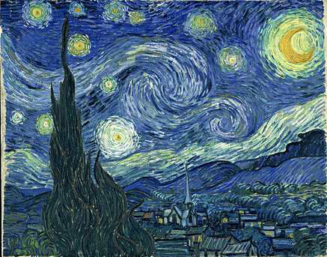
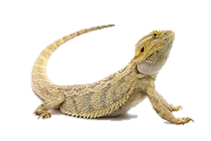
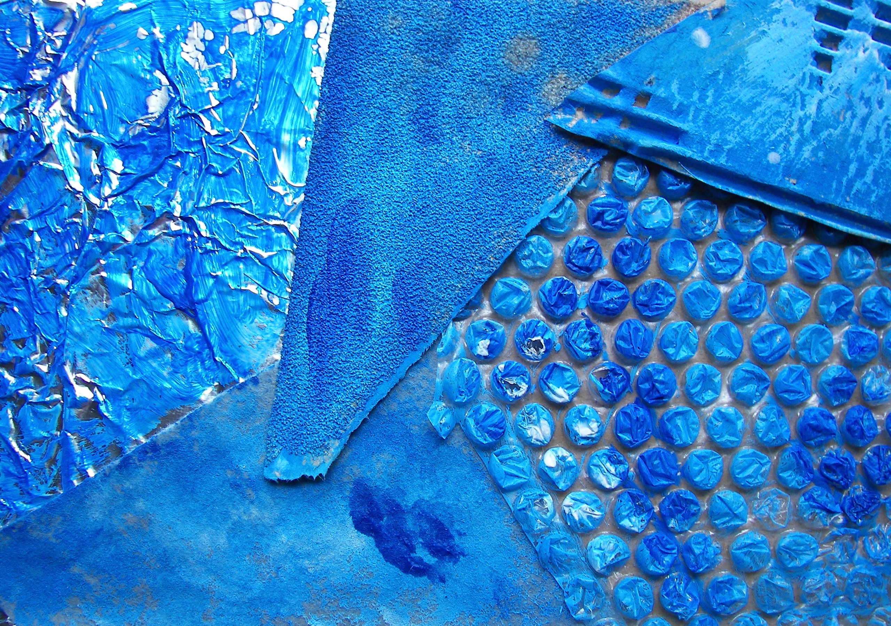
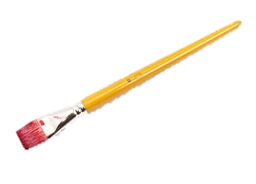
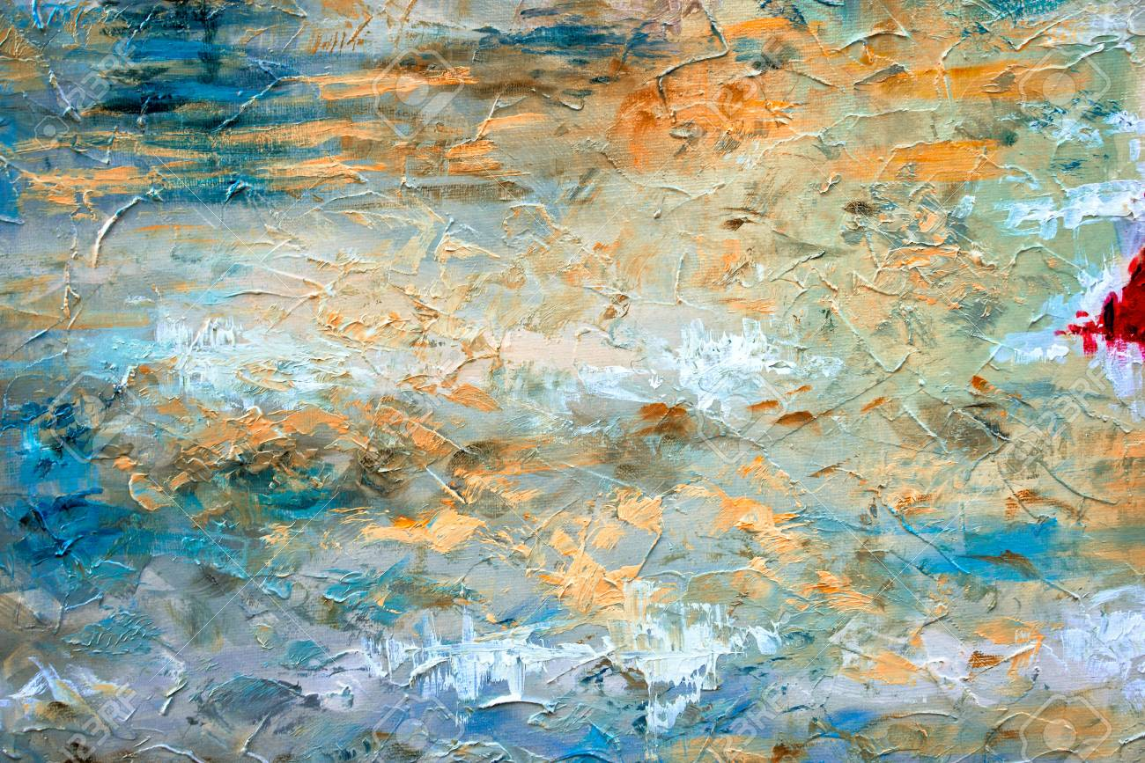
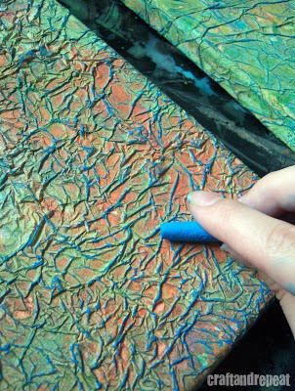
Knowledge Organiser – Year 8 – Textured Hand
Colour and Emotions
In Arles Vincent painted at the height of his powers. As a true ‘colourist’, he harnessed the expressive power of colour and produced bold colour combinations. He used colour for the effective rendering of specific emotions.
Key Vocabulary:
Mark Making
Texture
Mood
Detail
Reptile
Pastels
Media
You will begin to explore a variety of textures working in mixed media. You will go onto create your own unique piece of artwork based on some of the textured experiments that you will create. You will analyse the work of other artists and be able to explain how an artist can create mood within an image and the impact the artists emotional state has on your own work

